Slide 1
N26 – THE MOLE RATIO AND STOICHIOMETRY

Slide 2
Stoichiometry Calculating the amounts of reactants and/or products that are involved in a reaction How much do I have, need, or make?

Slide 3
Stoichiometry We need a balanced equation before we can do stoichiometry. The coefficients in the balanced equation gives insight into how much of each thing we need or make

Slide 4
Balanced Equation Coefficients
2H₂ + O₂ → 2H₂O
Can be thought of as how many molecules are needed
- 2 hydrogen molecules
- 1 oxygen molecule
- 2 water molecules

Slide 5
Balanced Equation Coefficients
2H₂ + O₂ → 2H₂O
Can ALSO be thought of as how many MOLES of molecules
- 2 moles hydrogen molecules
- 1 moles oxygen molecule
- 2 moles water molecules

Slide 6
Why use Molar Coefficients and not Grams for our calculations?
Allows us to compare “apples to apples”
Grams of molecule A
Grams of molecule B
MOLES of molecule A
MOLES of molecule B

Slide 7
Mole Ratios
The “KEY” to stoichiometry!
If I have 3 moles of this, how many moles of that do I have?
If I have 2 moles of this, how many moles of that can I make?
Stoichiometry
Mole Ratios

Slide 8
Mole Ratios
2H₂ + O₂ → 2H₂O
$$\frac{2 moles H2}{1 mole O2}$$
$$\frac{2 moles H2}{2 moles H2O}$$
Stoichiometry
$$\frac{1 mole O2}{2 moles H2O}$$
Mole Ratios

Slide 9
Mole Ratios
You can flip all mole ratios
$$\frac{2 moles H2}{1 mole O2}$$
$$\frac{2 moles H2}{2 moles H2O}$$
$$\frac{1 mole O2}{2 moles H2O}$$
$$\frac{1 mole O2}{2 moles H2}$$
$$\frac{2 moles H2O}{2 moles H2}$$
$$\frac{2 moles H2O}{1 mole O2}$$

Slide 10
Mole Ratios
Write all the mole ratios
2C₂H₂ + 5O₂ → 2H₂O + 4CO₂
$$\frac{2 mole C2H2}{5 moles O2}$$
$$\frac{2 mole C2H2}{2 moles H2O}$$
$$\frac{2 mole C2H2}{4 moles CO2}$$
$$\frac{5 moles O2}{2 moles H2O}$$
$$\frac{5 moles O2}{4 moles CO2}$$
$$\frac{2 moles H2O}{4 moles CO2}$$

Slide 11
Mole Ratios
2C₂H₂ + 5O₂ → 2H₂O + 4CO₂
Can be used as conversion factors!
How many moles of carbon dioxide can be made from 19.46 moles of oxygen gas?
19.46 moles O₂
4 moles CO₂
= 15.57 moles CO₂
5 moles O₂

Slide 12
Mole Ratios
2C₂H₂ + 5O₂ → 2H₂O + 4CO₂
Can be used as conversion factors!
If you made 13.42 moles of water, how many moles of oxygen gas did you start with?
13.42 moles H₂O
5 moles O₂
= 33.55 moles O₂
2 moles H₂O

Slide 13
What if you don’t want your answer in moles? What if you weren’t given moles?

Slide 14
THE MOLE HIGHWAY All roads lead to the mole!

Slide 15
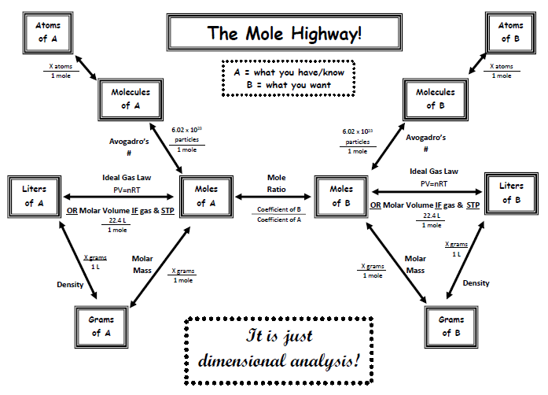

Slide 16
Guided Stoichiometry Practice Problems

Slide 17
Q #1
N₂ + 3H₂ → 2NH₃
54 grams N₂ → ? moles NH₃
Pathway:
grams A →
moles A →
moles B
Molar mass of A
X g A
1 mole A
Mole Ratio moles B moles A

Slide 18
Q #1
N₂ + 3H₂ → 2NH₃
54 grams N₂ → ? moles NH₃
54 g N₂
1 mole N₂
2 mole NH₃
28.01 g N₂
1 mole N₂
= 3.9 moles NH₃

Slide 19
Q #2
N₂ + 3H₂ → 2NH₃
75 grams NH₃ → ? g H₂
Pathway:
moles A →
moles B →
grams B
grams A →
Molar mass of A
X g A
1 mole A
Mole Ratio moles B moles A
Molar mass of B
X g B
1 mole B

Slide 20
Q #2
N₂ + 3H₂ → 2NH₃
75 grams NH₃ → ? g H₂
75 g NH₃
1 mole NH₃
3 mole H₂
2.02 g H₂
17.03 g NH₃
2 mole NH₃
1 mole H₂
= 13.34 g H₂

Slide 21
LOTS of possible routes! - Just follow the mole highway - Use dimensional analysis - Flip conversion factors - Cancel units

Slide 22
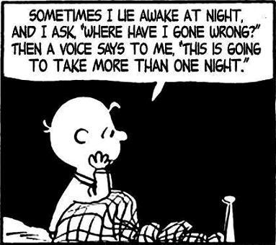
Things don’t always work perfectly…
In the lab sometimes you don’t make 100% of what your stoichiometry calculation says you should make

Slide 23
Theoretical Yield
The quantities that the stoichiometry calculations predict should be made

Slide 24
Actual Yield
The quantity that you actually made in the lab experiment

Slide 25
% Yield
The quantity that you actually made in the lab experiment

