Slide 1
N26 – THE MOLE RATIO AND STOICHIOMETRY

Slide 2
N26 – THE MOLE RATIO AND STOICHIOMETRY
Target: I can use a balanced equation to determine the “mole ratio” between various molecules in a reaction, so that I can perform “stoichiometry” where I convert from an amount of one molecule to an amount of a totally different molecule.

Slide 3
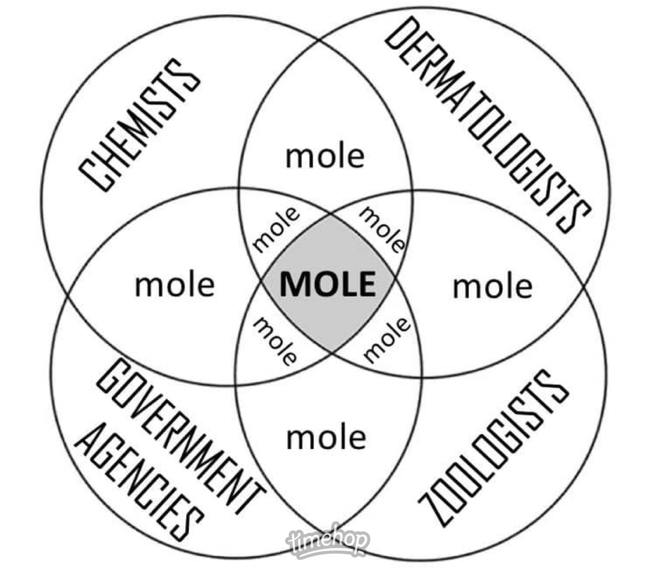

Slide 4
Stoichiometry
Calculating the amounts of reactants and/or products that are involved in a reaction
How much do I have, need, or make?

Slide 5
Stoichiometry
We need a balanced equation before we can do stoichiometry.
The coefficients in the balanced equation gives insight into how much of each thing we need or make

Slide 6
Balanced Equation Coefficients
2H₂ + O₂ → 2H₂O
Can be thought of as how many molecules are needed
- 2 hydrogen molecules
- 1 oxygen molecule
- 2 water molecules

Slide 7
Balanced Equation Coefficients
2H₂ + O₂ → 2H₂O
Can ALSO be thought of as
how many MOLES of molecules
- 2 moles hydrogen molecules
- 1 moles oxygen molecule
- 2 moles water molecules

Slide 8
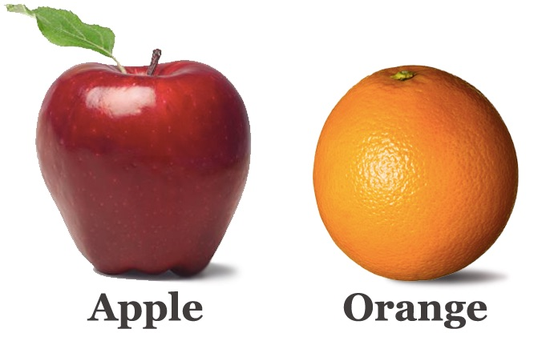
Why use Molar Coefficients and not Grams for our calculations?
Allows us to compare “apples to apples”
Grams of molecule A
Grams of molecule B
MOLES of molecule A
MOLES of molecule B

Slide 9

Mole Ratios
The “KEY” to stoichiometry!
If I have 3 moles of this, how many moles of that do I have?
If I have 2 moles of this, how many moles of that can I make?
Stoichiometry
Mole Ratios

Slide 10



Mole Ratios
2H₂ + O₂ → 2H₂O
$$\frac{2 moles H2}{1 mole O2}$$
$$\frac{2 moles H2}{2 moles H2O}$$
Stoichiometry
$$\frac{1 mole O2}{2 moles H2O}$$
Mole Ratios

Slide 11






Mole Ratios
You can flip all mole ratios
$$\frac{2 moles H2}{1 mole O2}$$
$$\frac{2 moles H2}{2 moles H2O}$$
$$\frac{1 mole O2}{2 moles H2O}$$
$$\frac{1 mole O2}{2 moles H2}$$
$$\frac{2 moles H2O}{2 moles H2}$$
$$\frac{2 moles H2O}{1 mole O2}$$

Slide 12






Mole Ratios
Write all the mole ratios
2C₂H₂ + 5O₂ → 2H₂O + 4CO₂
$$\frac{2 mole C2H2}{5 moles O2}$$
$$\frac{2 mole C2H2}{2 moles H2O}$$
$$\frac{2 mole C2H2}{4 moles CO2}$$
$$\frac{5 moles O2}{2 moles H2O}$$
$$\frac{5 moles O2}{4 moles CO2}$$
$$\frac{2 moles H2O}{4 moles CO2}$$

Slide 13
Mole Ratios
2C₂H₂ + 5O₂ → 2H₂O + 4CO₂
Can be used as conversion factors!
How many moles of carbon dioxide can be made from 19.46 moles of oxygen gas?
19.46 moles O₂
4 moles CO₂
= 15.57
moles CO₂
5 moles O₂

Slide 14
Mole Ratios
2C₂H₂ + 5O₂ → 2H₂O + 4CO₂
Can be used as conversion factors!
If you made 13.42 moles of water, how many moles of oxygen gas did you start with?
13.42 moles H₂O
5 moles O₂
= 33.55
moles O₂
2 moles H₂O

Slide 15
What if you don’t want your answer in moles?
What if you weren’t given moles?

Slide 16


THE MOLE HIGHWAY
All roads lead to the mole!

Slide 17
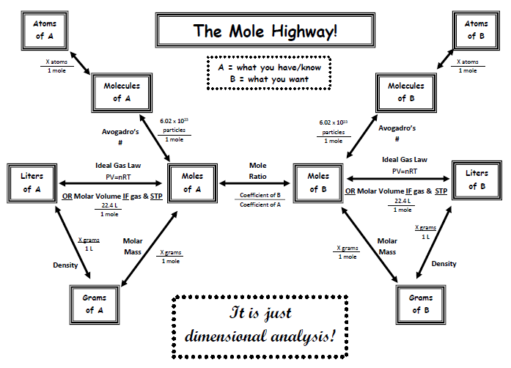

Slide 18
Guided Stoichiometry
Practice Problems

Slide 19
Q #1
N₂ + 3H₂ → 2NH₃
A
B
54 grams N₂ → ? moles NH₃
Pathway:
grams A →
moles A →
moles B
Molar
mass of A
X g A
1 mole A
Mole Ratio
moles B
moles A

Slide 20
Q #1
N₂ + 3H₂ → 2NH₃
A
B
54 grams N₂ → ? moles NH₃
Pathway:
grams A →
moles A →
moles B
Molar
mass of A
X g A
1 mole A
Mole Ratio
moles B
moles A

Slide 21
Q #1
N₂ + 3H₂ → 2NH₃
A
B
54 grams N₂ → ? moles NH₃
54 g N₂
1 mole N₂
2 mole NH₃
28.01 g N₂
1 mole N₂
= 3.9
moles NH₃

Slide 22
Q #2
N₂ + 3H₂ → 2NH₃
B
A
75 grams NH₃ → ? g H₂
Pathway:
moles A →
moles B →
grams B
grams A →
Molar
mass of A
X g A
1 mole A
Mole Ratio
moles B
moles A
Molar
mass of B
X g B
1 mole B

Slide 23
Q #2
N₂ + 3H₂ → 2NH₃
B
A
75 grams NH₃ → ? g H₂
75 g NH₃
1 mole NH₃
3 mole H₂
2.02 g H₂
17.03 g NH₃
2 mole NH₃
1 mole H₂
= 13.34 g H₂

Slide 24

LOTS of possible routes!
- Just follow the mole highway
- Use dimensional analysis
- Flip conversion factors
- Cancel units

Slide 25

Things don’t always work perfectly…
In the lab sometimes you don’t make 100% of what your stoichiometry calculation says you should make

Slide 26
Theoretical Yield
The quantities that the stoichiometry calculations
predict should be made

Slide 27
Actual/Experimental Yield
The quantity that you
actually made in the lab experiment

Slide 28
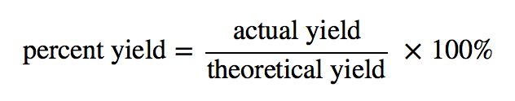
% Yield
How good did you do!?
Not the same as % error!!!

Slide 29
Careful finding extra stuff online!
Do not do anything that says “limiting reagents” – we haven’t learned that yet. Don’t do problems that give you two starting values (you start with 15 grams of N₂ and 7 grams of H₂, how much NH₃ can you make?) – that is a limiting reagent problem. We will do limiting reagents after winter break!

Slide 30
Class Group Practice
15 g sodium nitrate and excess calcium hydroxide react. How many grams of your calcium containing product can be made?
14.5 g Ca(NO₃)₂

Slide 31
Class Individual Practice – timed!
15 g magnesium nitrite and excess ammonium phosphate react. How many grams of your magnesium containing product can be made?
11.3 g Mg₃(PO₄)₂

Slide 32
YouTube link to presentation
https://youtu.be/FjNpLz_Wxt4

