Slide 1
N29 – PERCENT COMPOSITION AND EMPERICAL FORMULAS
Target: I can calculate the percent composition of an element in a molecule, and can determine the empirical and molecular formulas for substances.
Link to YouTube Presentation: https://youtu.be/5OxEDmFjv_w

Slide 2
N29 – PERCENT COMPOSITION AND EMPERICAL FORMULAS
Remember – make a clear, obvious title! It needs to be numbered and titled. Don’t forget KCQ boxes and color annotations as homework!

Slide 3
Percent Composition Determining how much of a molecule’s mass is from each element
Part x 100 = %
Whole
Element’s Mass x 100 = % Composition Molecule’s Mass

Slide 4
% Composition Steps
2) Divide each element’s atomic mass by the molar mass of the molecule 3) Multiply by 100 to put answer in terms of an actual % *note* If you add up the % for each element it should add up to 100%...but rounding answers may make it not quite add up to 100%. That’s ok.
1) Find the molar mass of the molecule
2) Divide each element’s atomic mass by the molar mass of the molecule
3) Multiply by 100 to put answer in terms of an actual %
*note* If you add up the % for each element it should add up to 100%...but rounding answers may make it not quite add up to 100%. That’s ok.

Slide 5
Example
Element’s Mass x 100 = % Composition Molecule’s Mass
Calculate the % composition of Magnesium Carbonate
Molar Mass of Molecule 24.31 + 12.01 + 3(16.00) = 84.32 g/mol
Check that it adds up to 100% !!!
3 x 16 because there are 3 oxygens!

Slide 6
Empirical Formula The simplest, reduced version of a formula. Smallest whole number ratios possible.
Molecular Formula The real version of the formula – may or may not be in the simplest most reduced form, just depends on the specific formula.

Slide 7
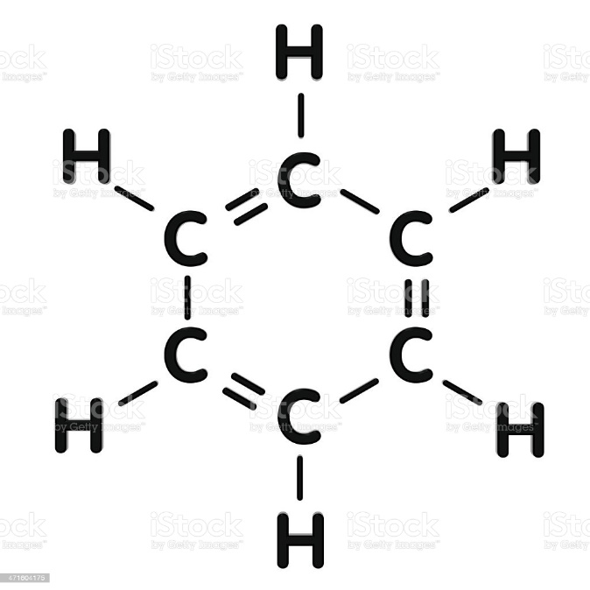
Molecular: C₆H₆
Example
Empirical: CH

Slide 8
Ionic Formulas Are always empirical! NaCl, MgCl₂, Al₂(SO₄)₃
Covalent Formulas Sometimes empirical, sometimes not.
Molecular:
H₂O
C₆H₁₂O₆
C₁₂H₂₂O₁₁
Empirical:
H₂O
CH₂O
C₁₂H₂₂O₁₁

Slide 9
Determining Empirical Formula
1) Given: % composition
2) Assume you have 100g sample to make #s easy
3) Use the poem!
Percent to mass
Mass to moles
Divide by small
Multiply ‘till whole

Slide 10
Adipic acid contains 49.32% C, 43.84% O, and 6.85% H by mass. What is the empirical formula of adipic acid?
Percent to mass – 49.32g C, 43.84g O, 6.85g H
Mass to mole

Slide 11
Divide by small – divide the mole values by the smallest mole value found… gets you the simplest ratios!
Carbon:
Hydrogen:
Oxygen:

Slide 12
Multiply ‘till whole – If necessary, multiply the values found until they are whole numbers. The numbers may not be perfect, might have to round a little bit! YOU HAVE TO MULTIPLY THEM ALL BY THE SAME # !
Hydrogen:
2.47
Carbon: 1.50
2.50
Oxygen: 1.00
x 2
x 2
x 2
3
5
2
Empirical formula:
C₃H₅O₂

Slide 13
Determining Molecular Formula
1) Find molar mass of the empirical formula
2) Divide molecular formula mass by empirical formula mass
3) Multiply empirical formula subscripts by the multiplier # found in step 2
No cute rhyme this time…sorry! ☺

Slide 14
The empirical formula for adipic acid is C₃H₅O₂. The molecular mass of adipic acid is 146 g/mol. What is the molecular formula of adipic acid?
Molar mass of empirical formula 3(12.01 g) + 5(1.01) + 2(16.00) = 73.08 g/mol
Divide molecular by empirical masses 146 = 1.997 → 2 *you will usually have to round a bit* 73.08
Multiply empirical by multiplier found in step 2
(C₃H₅O₂) x 2 =
C₆H₁₀O₄

Slide 15
YouTube Link to Presentation
https://youtu.be/5OxEDmFjv_w

