Slide 1
Adv. Chem. Ratios
WS#6
#1-5

Slide 2
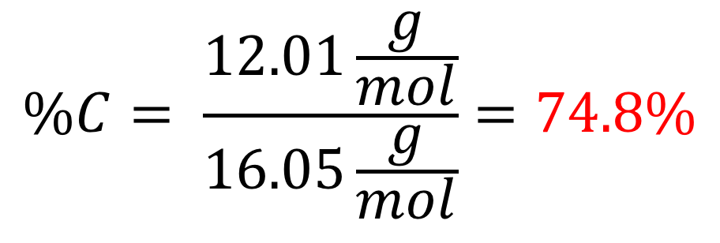
QUESTION #1
What percentage of methane (CH₄) is carbon?
What we know:
Mass of CH₄ = 16.05 g
Mass of C = 12.01
$$\%C= \frac{12.01\frac{g}{mol}}{16.05\frac{g}{mol}}=74.8\%$$

Slide 3
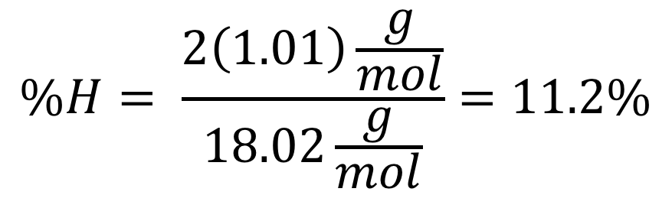
QUESTION #2
What percentage of water is hydrogen?
What we know:
Mass of H₂O = 18.02 g
Mass of H = 1.01
$$\%H= \frac{2\left(1.01\right)\frac{g}{mol}}{18.02\frac{g}{mol}}=11.2\%$$

Slide 4
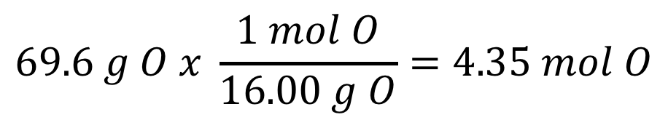
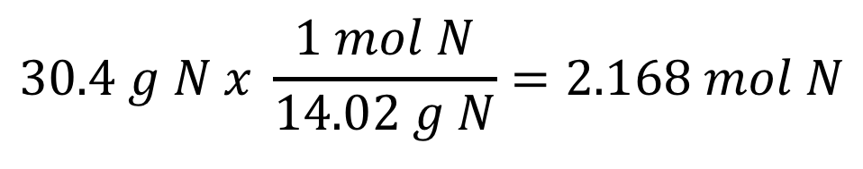
QUESTION #3
What is the empirical formula of a compound which is 30.4% Nitrogen and 69.6% Oxygen?
USE THE RHYME
% to mass
Mass to Mole
Divide by small
Multiply till whole
30.4% → 30.4 g N
69.6% → 69.6 g O
$$30.4 g N x \frac{1 mol N}{14.02 g N}=2.168 mol N$$
= 1
2.168
Empirical Formula:
NO₂
$$69.6 g O x \frac{1 mol O}{16.00 g O}=4.35 mol O$$
= 2
2.168

Slide 5
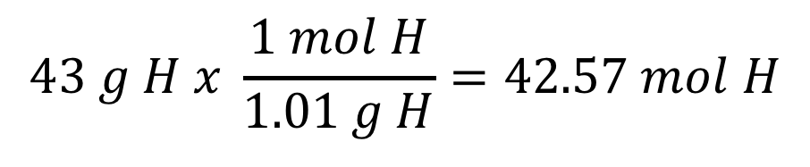
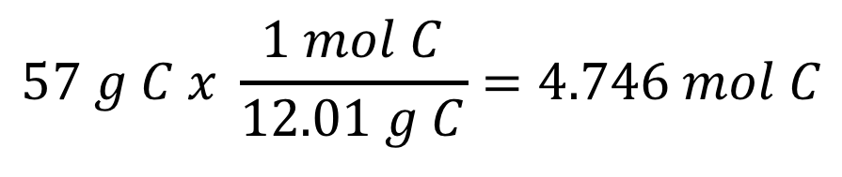
QUESTION #4
What is the empirical formula of a compound which is 57% Carbon and 43% Hydrogen?
USE THE RHYME
% to mass
Mass to Mole
Divide by small
Multiply till whole
57% → 57 g C
43% → 43 g H
$$57 g C x \frac{1 mol C}{12.01 g C}=4.746 mol C$$
= 1
Empirical Formula
CH₉
4.746
$$43 g H x \frac{1 mol H}{1.01 g H}=42.57 mol H$$
= 8.97 = 9
4.746

Slide 6
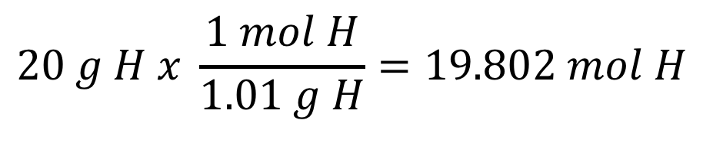
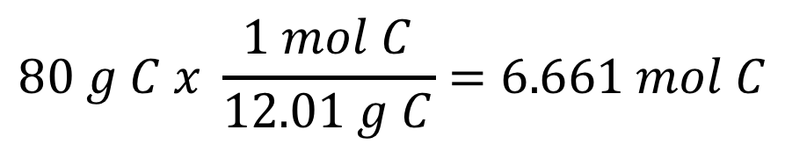
QUESTION #5
What is the molecular formula of a compound which is 80% Carbon and 20% Hydrogen, with a molar mass of 30 g/mol?
USE THE RHYME
% to mass
Mass to Mole
Divide by small
Multiply till whole
80% → 80 g C
20% → 20 g H
$$80 g C x \frac{1 mol C}{12.01 g C}=6.661 mol C$$
= 1
6.661
Empirical: CH₃
Mass = 15.04 g/mol
$$20 g H x \frac{1 mol H}{1.01 g H}=19.802 mol H$$
= 2.97 = 3
6.661

Slide 7
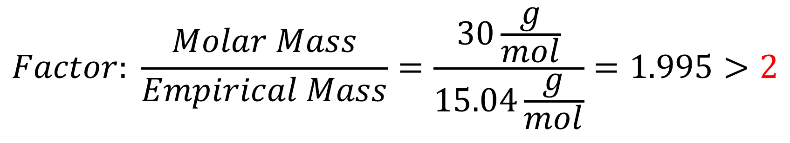
QUESTION #5
What is the molecular formula of a compound which is 80% Carbon and 20% Hydrogen, with a molar mass of 30 g/mol?
USE THE RHYME
% to mass
Mass to Mole
Divide by small
Multiply till whole
Empirical: CH₃
Mass = 15.04 g/mol
$$Factor: \frac{Molar Mass}{Empirical Mass}=\frac{30\frac{g}{mol}}{15.04\frac{g}{mol}}=1.995>2$$
(CH₃) x 2 = C₂H₆

