Slide 1
N-31 Basic Gas Law Equations

Slide 2
N-31 Basic Gas Law Equations
Target: I can identify the relationship between various conditions of a gas to mathematically calculate any missing conditions.
Link to YouTube Presentation: https://youtu.be/A1Uob8yAU5k

Slide 3
But First…
A couple odds and ends

Slide 4
Use Kelvins!
Just another unit of measurement.
K = °C + 273
We will use Kelvin for all gas law problems

Slide 5
Why Use Kelvins?
Zero means a true zero with Kelvin scale. There are no negative temperatures.
We don’t want to end up with negative temperatures and then end up with negative volumes and pressures… wouldn’t make sense!

Slide 6
“Absolute Zero”
At 0 K there is NO MOLECULAR MOVEMENT!
Zero really means zero!

Slide 7
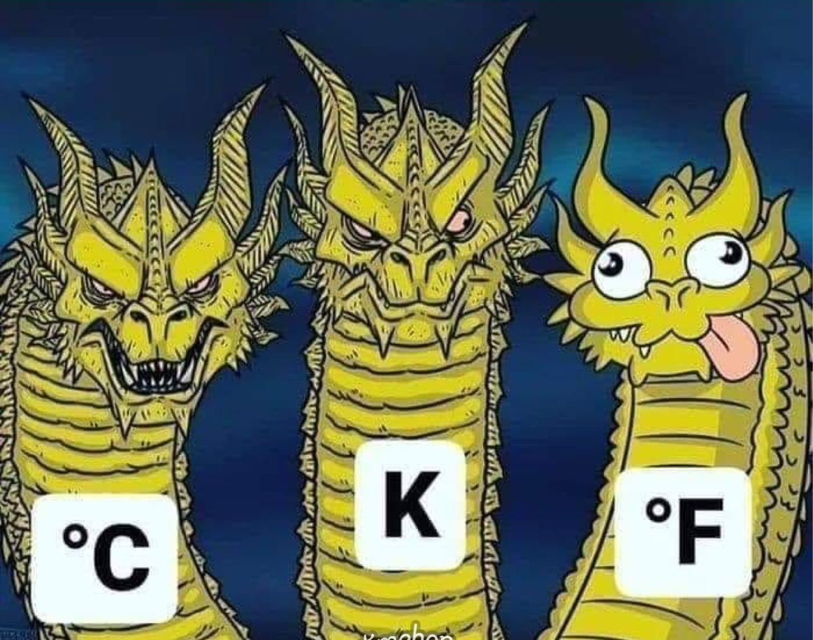
What about Fahrenheit?

Slide 8
Units of Pressure
Lots of choices, just convert
Conversions
1 atm = | 1.01325 x 10⁵ Pa
 | 101.325 kPa
 | 760 mmHg
 | 760 torr
 | 14.7 psi

Slide 9
STP
“Standard” Temperature & Pressure
0° C → 273 K
1 atm → 760 mmHg

Slide 10
Basic Gas Law Equations
Memorize them!

Slide 11
Boyle’s Law
$$P_{1}V_{1}= P_{2}V_{2}$$

Slide 12
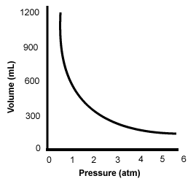
Boyle’s Law
$$P_{1}V_{1}= P_{2}V_{2}$$
Temperature and # moles held constant
Indirect (or inverse) relationship
If pressure goes ↑
Then volume goes ↓

Slide 13
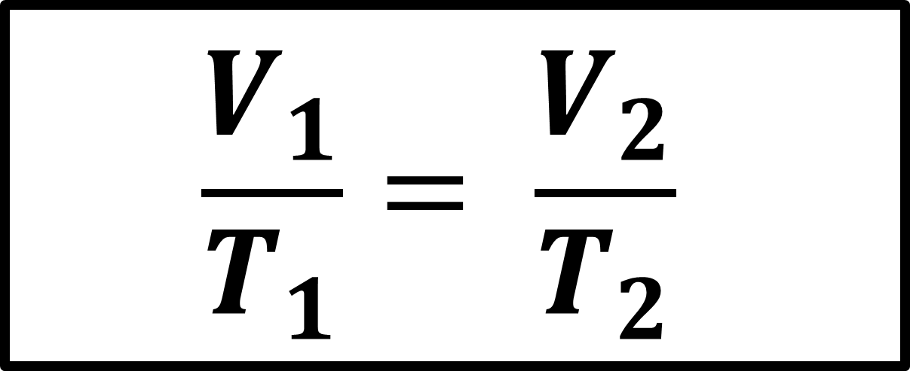
Charles’ Law
$$\frac{V_{1}}{T_{1}}= \frac{V_{2}}{T_{2}}$$

Slide 14
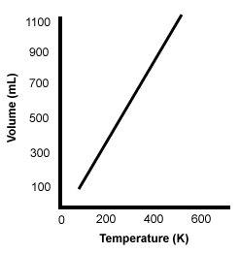

Charles’ Law
$$\frac{V_{1}}{T_{1}}= \frac{V_{2}}{T_{2}}$$
Pressure and # moles held constant
Direct relationship
If temperature goes ↑
Then volume goes ↑
*note* Graph doesn’t go all the way to zero because the molecules will eventually get as close as possible and they will still always take up space

Slide 15
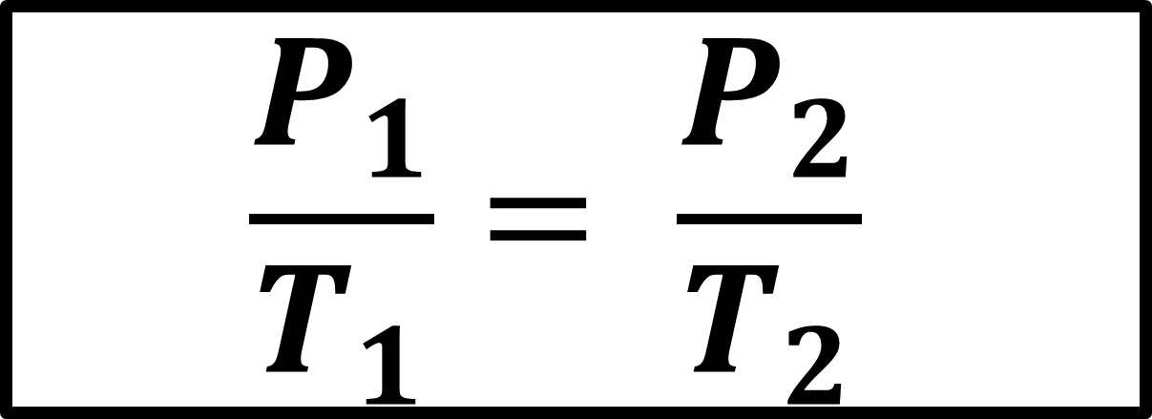
Gay-Lussac’s Law
$$\frac{P_{1}}{T_{1}}= \frac{P_{2}}{T_{2}}$$

Slide 16
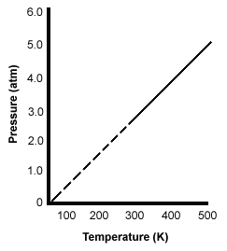

Gay-Lussac’s Law
$$\frac{P_{1}}{T_{1}}= \frac{P_{2}}{T_{2}}$$
Volume and # moles held constant
Direct relationship
If temperature goes ↑
Then pressure goes ↑
*note* Graph doesn’t go all the way to zero because at low temperatures and pressures it won’t be a gas anymore, it will turn into a solid or a liquid. We use a dotted line to show the portions that are not gas phase

Slide 17
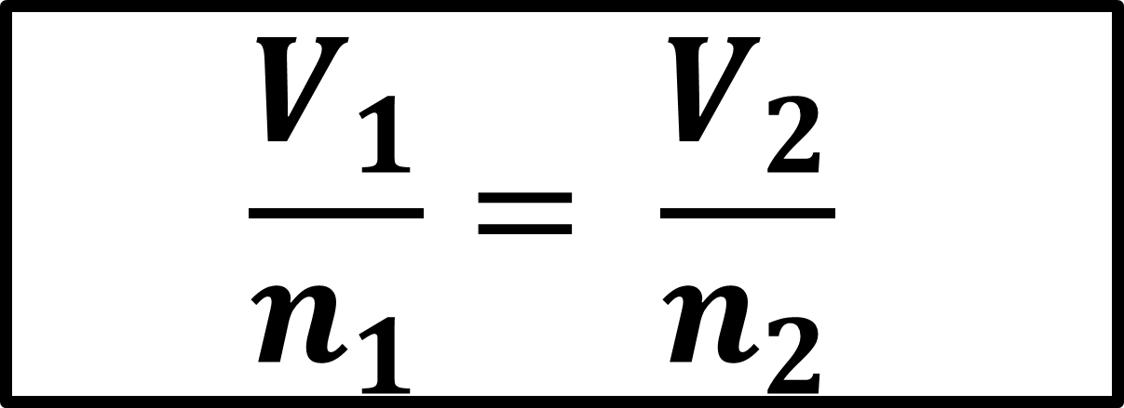
Avogadro’s Law
$$\frac{V_{1}}{n_{1}}= \frac{V_{2}}{n_{2}}$$

Slide 18

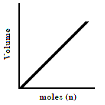
Avogadro’s Law
$$\frac{V_{1}}{n_{1}}= \frac{V_{2}}{n_{2}}$$
Pressure and temperature held constant
Direct relationship
If # of moles goes ↑
Then volume goes ↑

Slide 19
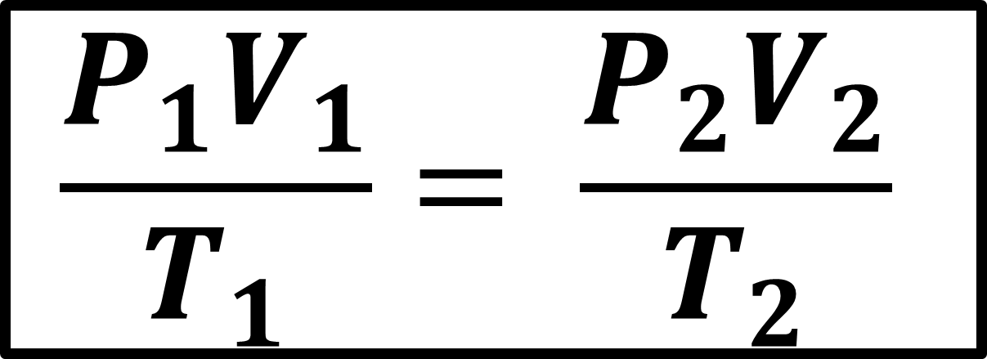
Combined Gas Law
$$\frac{P_{1}V_{1}}{T_{1}}= \frac{{P_{2}V}_{2}}{T_{2}}$$

Slide 20
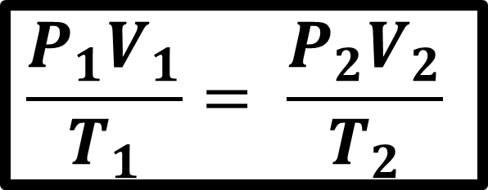
Combined Gas
$$\frac{P_{1}V_{1}}{T_{1}}= \frac{{P_{2}V}_{2}}{T_{2}}$$
# of moles held constant
Combines most common variables together – not common to change moles of gas

Slide 21
Combined Gas Law
Boyle’s !
$$\frac{P_{1}V_{1}}{T_{1}}= \frac{{P_{2}V}_{2}}{T_{2}}$$

Slide 22
Combined Gas Law
Charles’ !
$$\frac{P_{1}V_{1}}{T_{1}}= \frac{{P_{2}V}_{2}}{T_{2}}$$

Slide 23
Combined Gas Law
Gay-Lussac’s !
$$\frac{P_{1}V_{1}}{T_{1}}= \frac{{P_{2}V}_{2}}{T_{2}}$$

Slide 24
YouTube Link to Presentation
https://youtu.be/A1Uob8yAU5k
Need a “Crash Course on Gases and their Behaviors” ???
Watch this YouTube Video Presentation! It is often taught in middle school, but it would be a good refresher for those who learned it before, and if you didn’t learn it in middle school please for sure watch!
https://youtu.be/r7fBT_DJPsk

