Slide 1
N-32 Ideal Gas Law Equation

Slide 2
N-32 Ideal Gas Law Equation
Target: I can use the Ideal Gas law to solve for various conditions of a gas.
Link to YouTube Presentation: https://youtu.be/Bksd_GhLpt8

Slide 3
Remember! Use Kelvins!
K = °C + 273

Slide 4
Ideal Gas Law
$$PV=nRT$$
“Piv-nert”

Slide 5
Ideal Gas Law
$$PV=nRT$$
P = pressure
V = volume
n = number of moles
R = ideal gas constant
T = temperature
But what the heck is R ???

Slide 6
Ideal Gas Constant
It is a “proportionality constant”
Allows us to use various units and relate them together – if we had the perfect set of units we wouldn’t need this constant to adjust them!
The specific R number you choose to use varies based on which units you are using.
If we were dealing with a “real gas” then we would need to use a “specific gas constant.” – We wont be!

Slide 7
Ideal Gas Constant
Common R values can be found on your reference sheet R-35
(kPa, atm, mmHg on equation sheet on the back of the quiz periodic table)
Two choices:
Memorize the common ones
Memorize JUST ONE of them, and then convert all pressure units to that R value!
You decide which you would rather do!

Slide 8
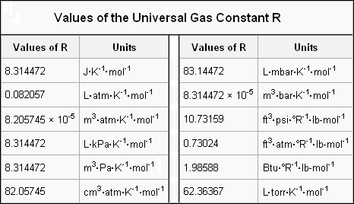
Ideal Gas Constant

Slide 9
Ideal Gas Constant

Slide 10
In this class…
Most answer keys will be done with the R value for atmospheres:
0.0821 $\frac{L • atm}{K • mol}$
Tip! If you keep track of your units, everything should cancel correctly thanks to the R value’s crazy units!

Slide 11
Is the Ideal Gas Law perfect? No!
Its’s only going to work for “ideal gases”
Imaginary perfect gases with no volume and no attractive or repulsive forces
Can use “correction values” to account for the real behaviors of gases – beyond what we do here!

Slide 12
Density and Molar Mass of a Gas Calculations
Equations on your reference sheet! Memorize them! We don’t use them often and people forget to study them. They are still important!

Slide 13
Or… You can Rearrange Ideal Gas Law to Solve for Them!
Whatever works!
Future AP Chem students…you will want to be comfortable rearranging not just memorizing!

Slide 14
Abbreviations to Know
P = pressure
V = volume
n = number of moles
R = ideal gas constant
T = temperature
M = molar mass
m = sample mass
D = density

Slide 15
Molar Mass
$$PV=nRT$$
$$Molar mass=$$
$$\frac{grams}{moles}$$
substitute
$$M=\frac{m}{n}$$
$$PV= \frac{m}{M}RT$$
$$n= \frac{m}{M}$$
rearrange
$$M=\frac{mRT}{PV}$$

Slide 16
Density
$$PV=nRT$$
$$n= \frac{m}{M}$$
substitute
$$PV= \frac{m}{M}RT$$
$$D= \frac{m}{V}$$
rearrange
$$D= \frac{MP}{RT}$$
$$\frac{m}{V}=\frac{MP}{RT}$$

Slide 17
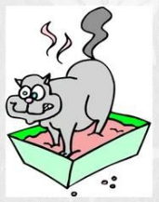
Molar Mass
$$D= \frac{MP}{RT}$$
$$M=\frac{mRT}{PV}$$
substitute
$$D= \frac{m}{V}$$
Or...
rearrange
substitute
$$M= \frac{DRT}{P}$$
Molar Mass Kitty always puts DIRT over its PEE

Slide 18
WS #3, Q#5
Determine the volume occupied by 2.34 g of carbon dioxide gas, at 1.09atm and 68°C
P = 1.09 atm
V = ?
+ 273 = 341 K
T =
68°C
2.34 g
1 mol
n =
= 0.0532 mol
44.01 g
R =
Get from R-35! Use # with atm! = 0.0821 $\frac{L•atm}{k•mol}$
(V)
(0.0532 mol)
( 0.0821 $\frac{L•atm}{K•mol}$)
(1.09atm)
=
(341 K)

Slide 19
WS #3, Q#5
Determine the volume occupied by 2.34 g of carbon dioxide gas, at 1.09atm and 68°C
(V)
(0.0532 mol)
(0.0821 $\frac{L•atm}{K•mol}$)
(341 K)
(1.09atm)
=
(1.09atm)
(1.09atm)
= 1.366 L

Slide 20
YouTube Link to Presentation
https://youtu.be/Bksd_GhLpt8

