Slide 1
Mrs. Farmer’s Example Composition Notebook Honors Chemistry
Please note
This is just an example of what your notebook should look like. Yours may have different warmups, different notes –depends on the year. Please use this as a general guide only. Read the reference sheets in your 3-ring binder for more specifics

Slide 2
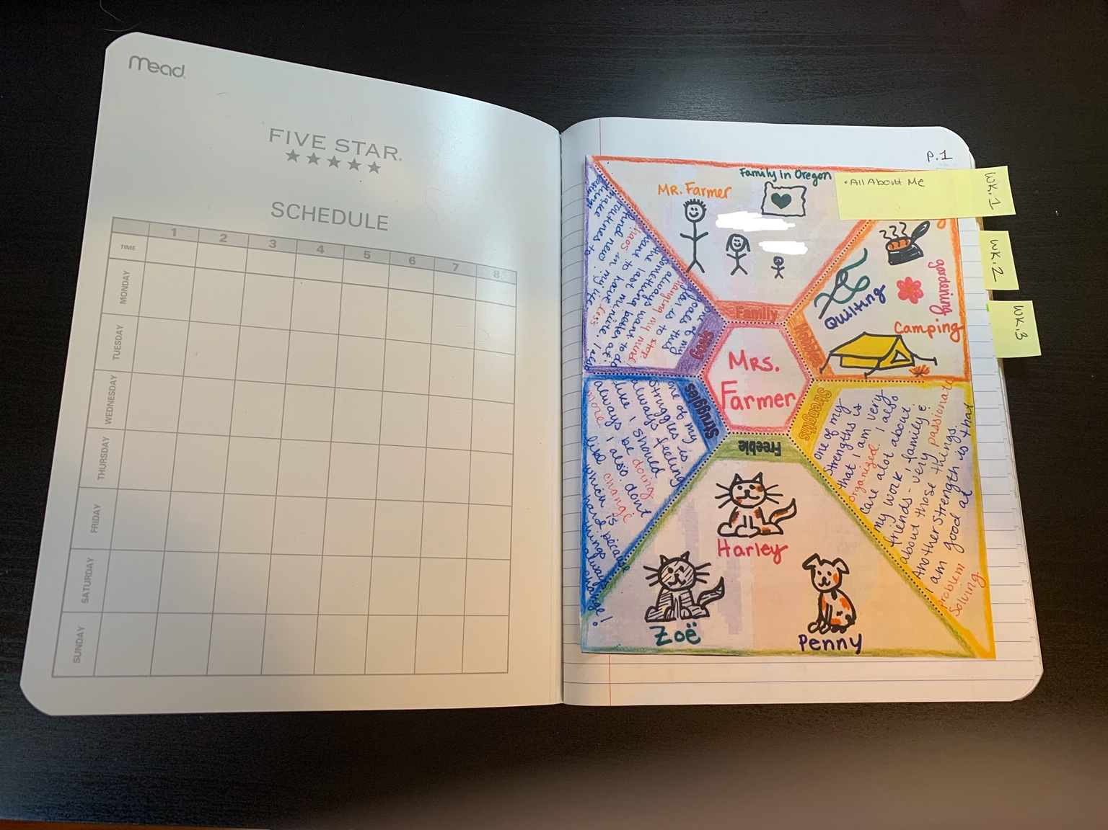
All About Me Page 1

Slide 3
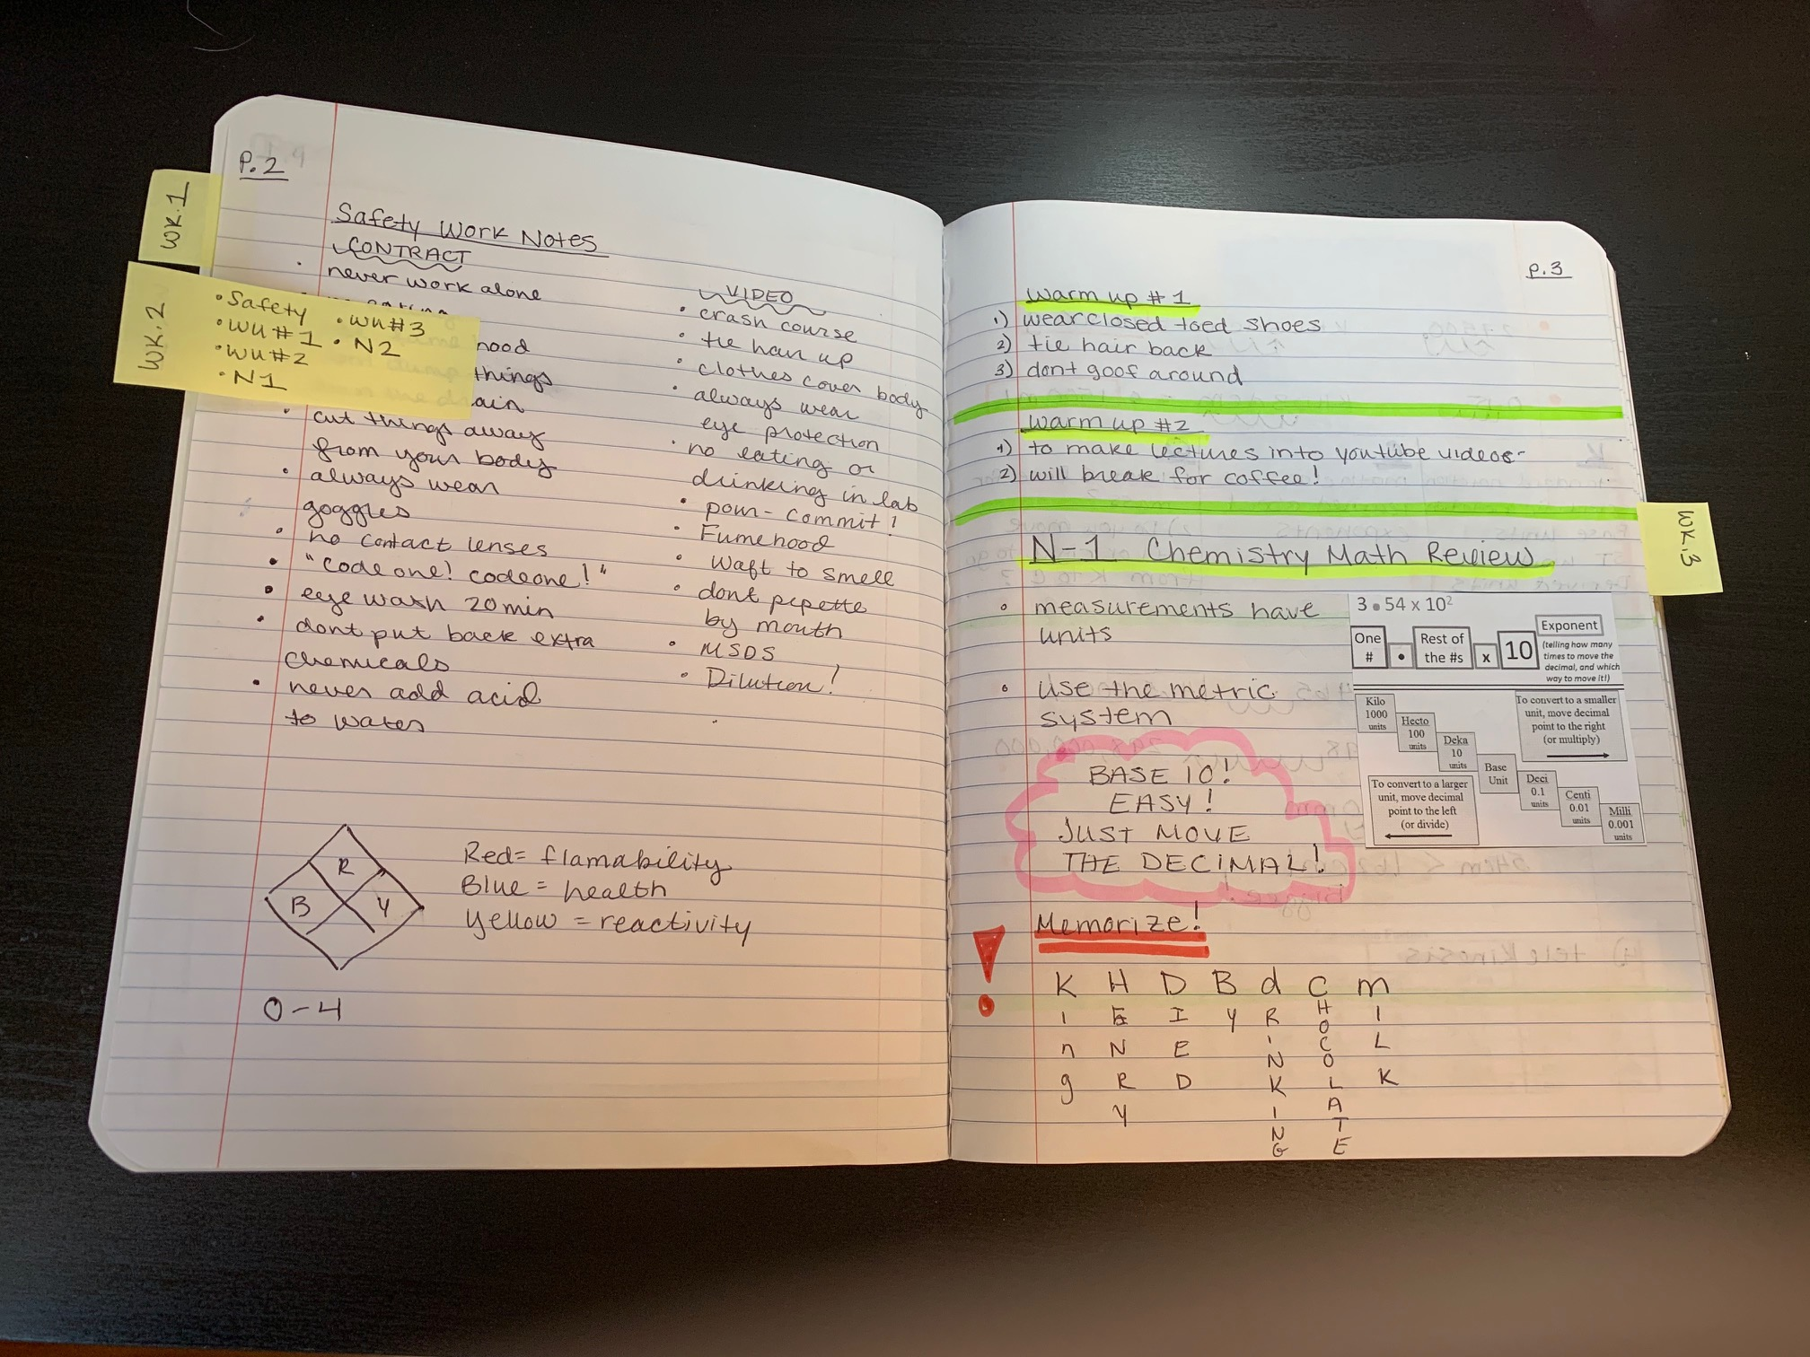
Safety Work Page 2 First Warmup Page 3

Slide 4
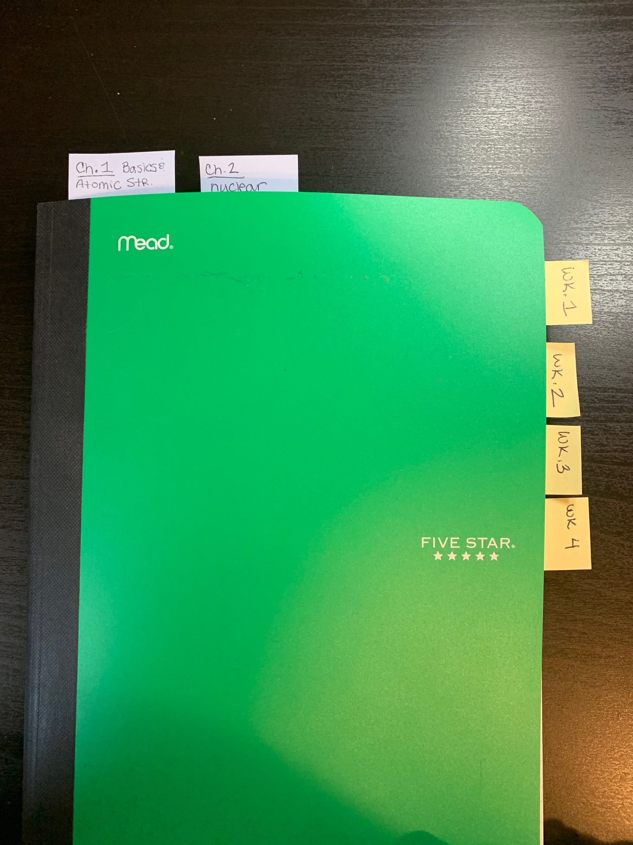
Feel Free to add tabs, bookmarks, etc to your notebook! Make it work for you!

Slide 5
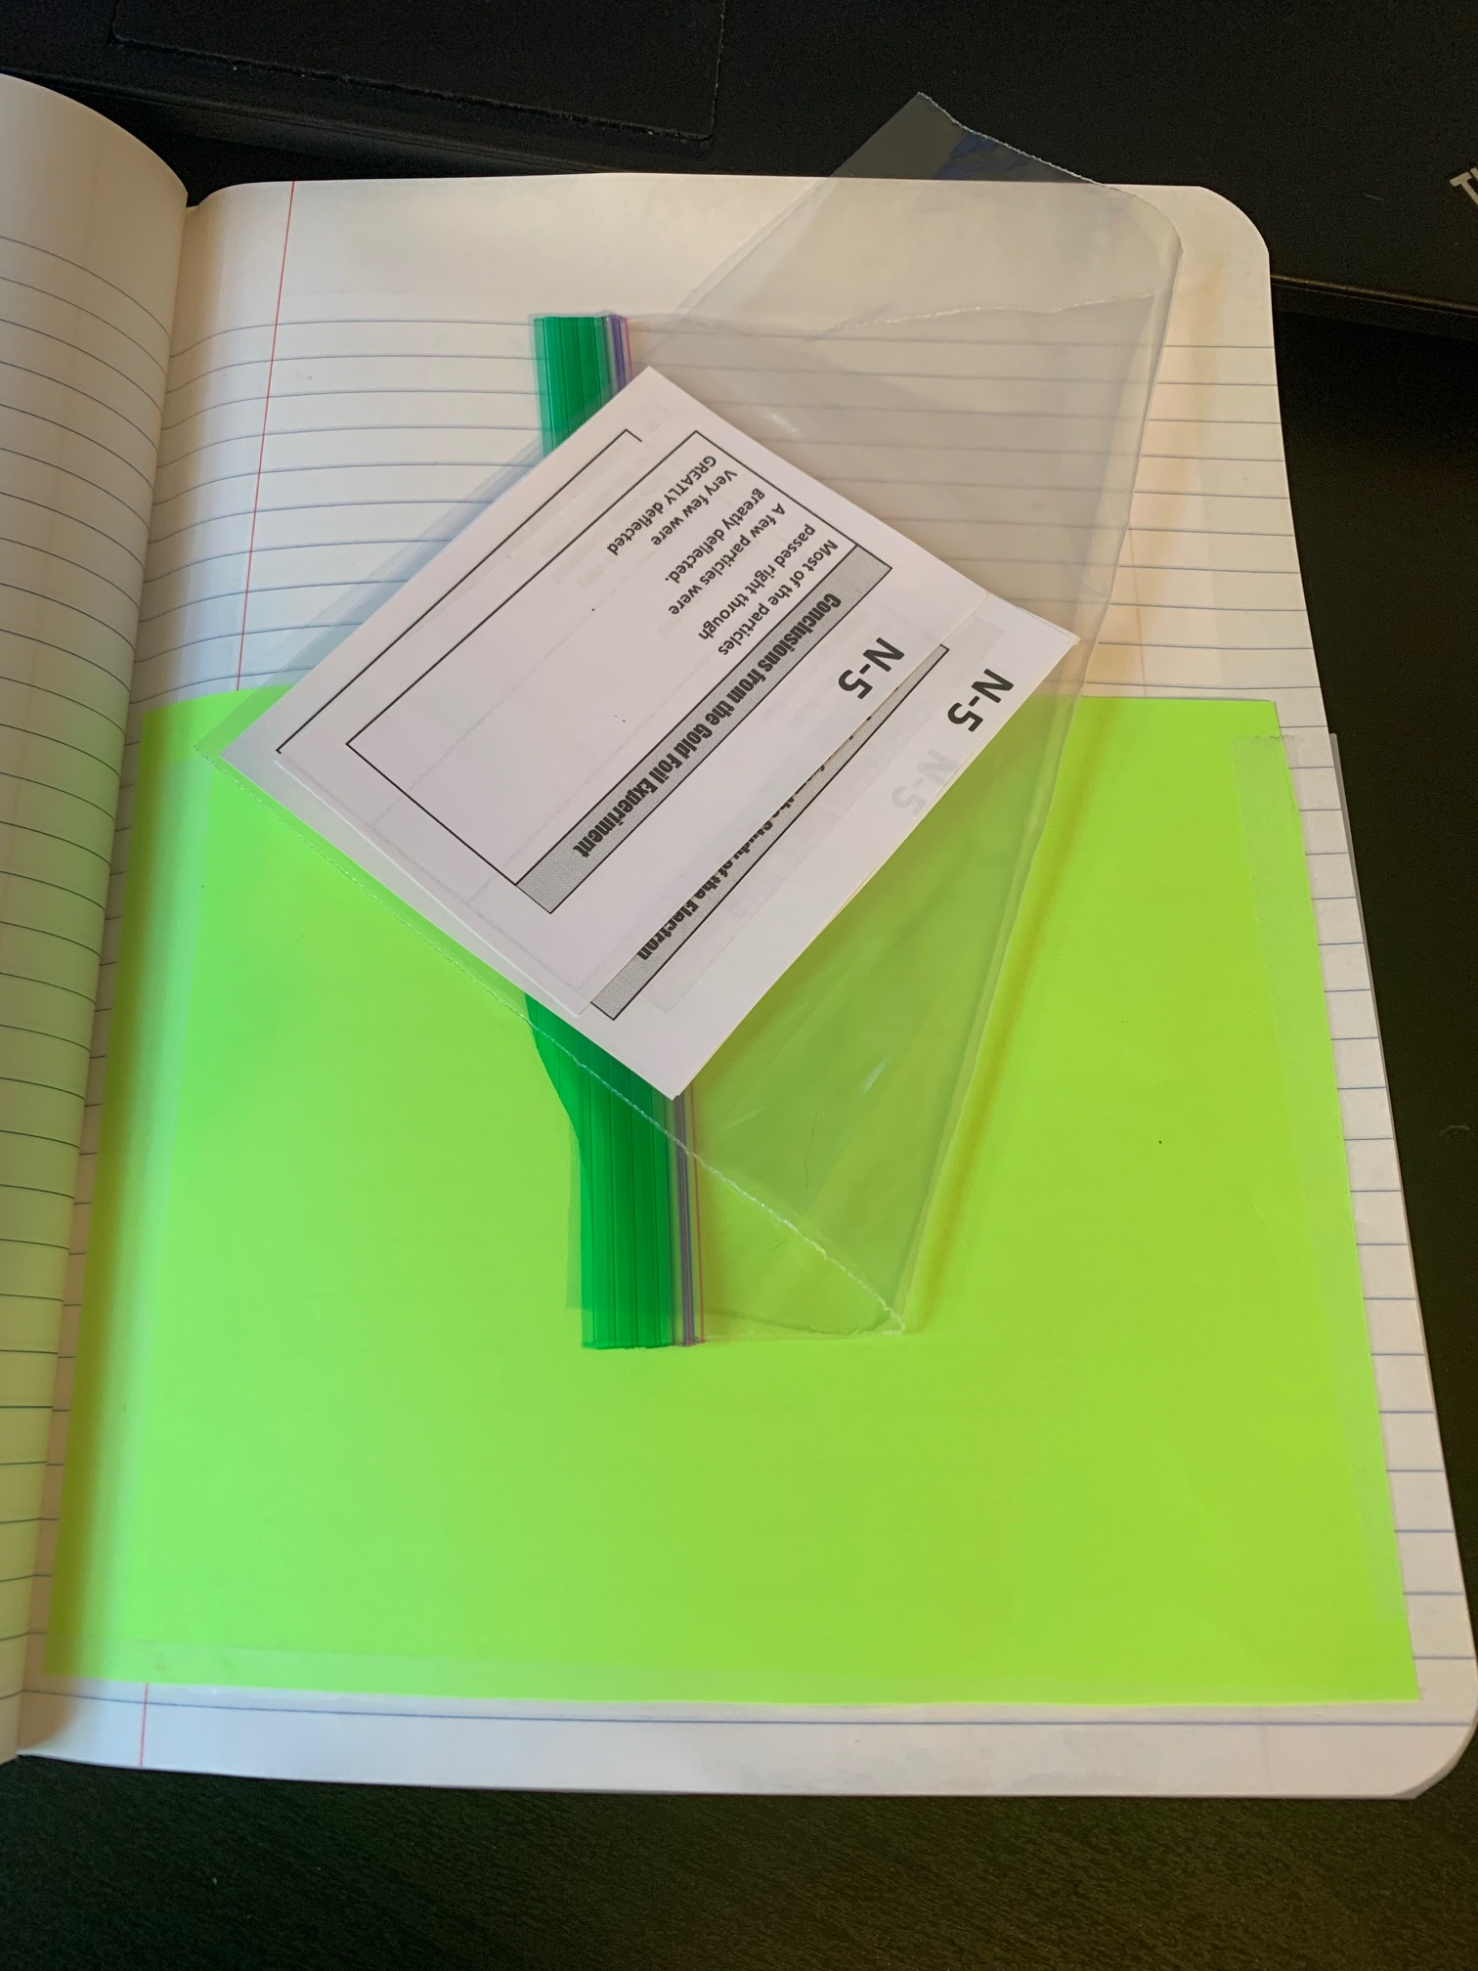
I like to make a pocket in the back to hold a little ziplock bag filled with my Glue Ins for my notes. That way I can print them all at once, cut them to size, and not lose them!

Slide 6
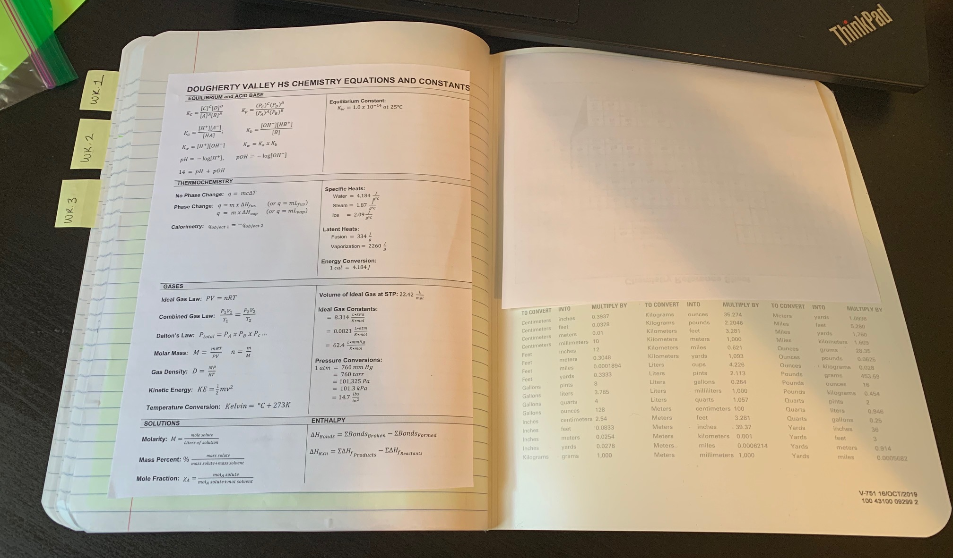
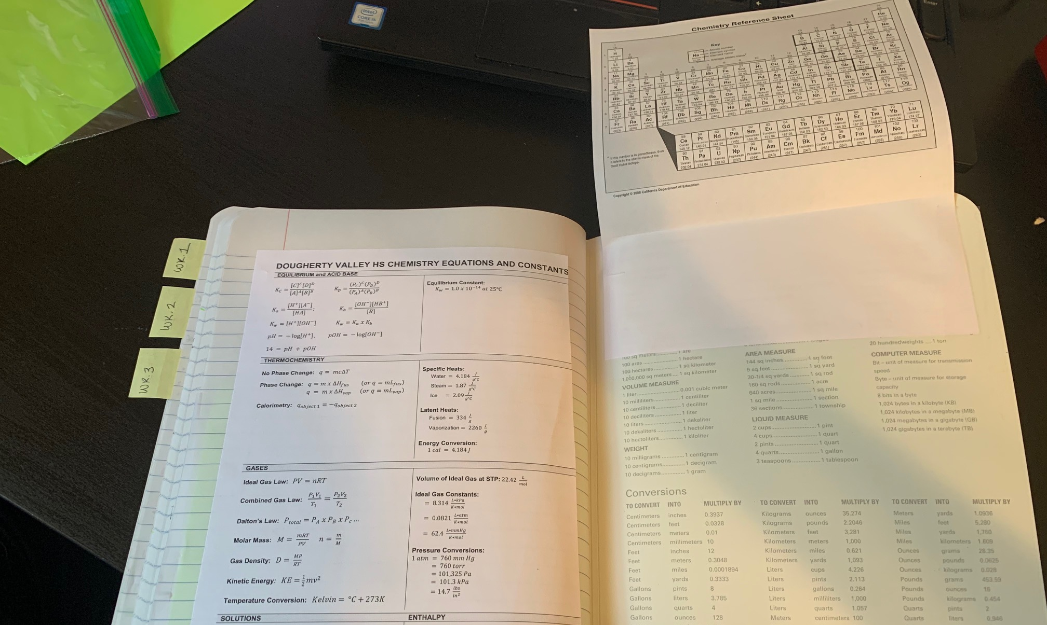
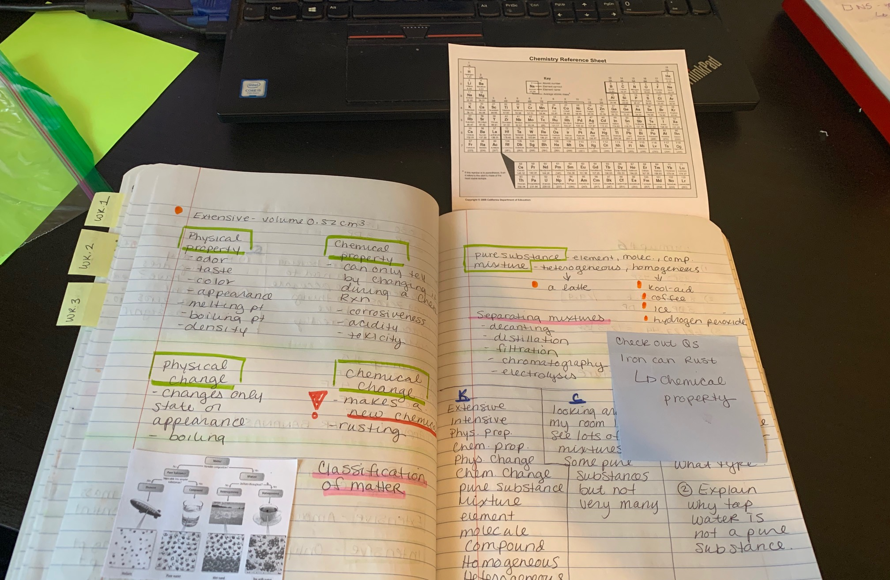
I like to print a small periodic table (you can shrink it down to 75% in the print menu) and then I glue/tape it onto the back inside cover so it flips out of my notebook! Very handy!

Slide 7
The next set of slides are just examples of the first few weeks of warmups and notes. Try to look for the following things.
Large clear numbering and titles on warmups and notes.
Highlighter lines separating the different assignments.
Warmups have numbered questions, show all your work not just an answer!
Space left in the notes around important points – do not crowd your notes! We have lots of space in our notebooks, use it!
You can just start the next assignment directly under the highlighter divider – you do not need to start on a new page!

Slide 8
The next set of slides are just examples of the first few weeks of warmups and notes. Try to look for the following things.
Color Annotations adding a minimum of three additional colors to the notes.
Color Annotations done in a meaningful way – I didn’t just scribble the background or highlight every word a different color.
More is not always better!
Be careful to not focus on “decorating” or “coloring” your notes – you are supposed to be doing color “annotations.” Sometimes people have beautiful notes but they spent more time on what they look like than thinking about what the notes say!

Slide 9
The next set of slides are just examples of the first few weeks of warmups and notes. Try to look for the following things.
KCQ Boxes added to the end of each set of notes
Make the boxes fit the work that needs to be in them, don’t draw the boxes and then squeeze in the information! Use as much space as needed.
All key terms, not just words that’re new to you!
Connections can be to previous classes, things you saw on TV etc – but they should be specific. Don’t just write “7th grade”
Questions – two questions, one lower level, one higher level. You do not have to answer them!

Slide 11
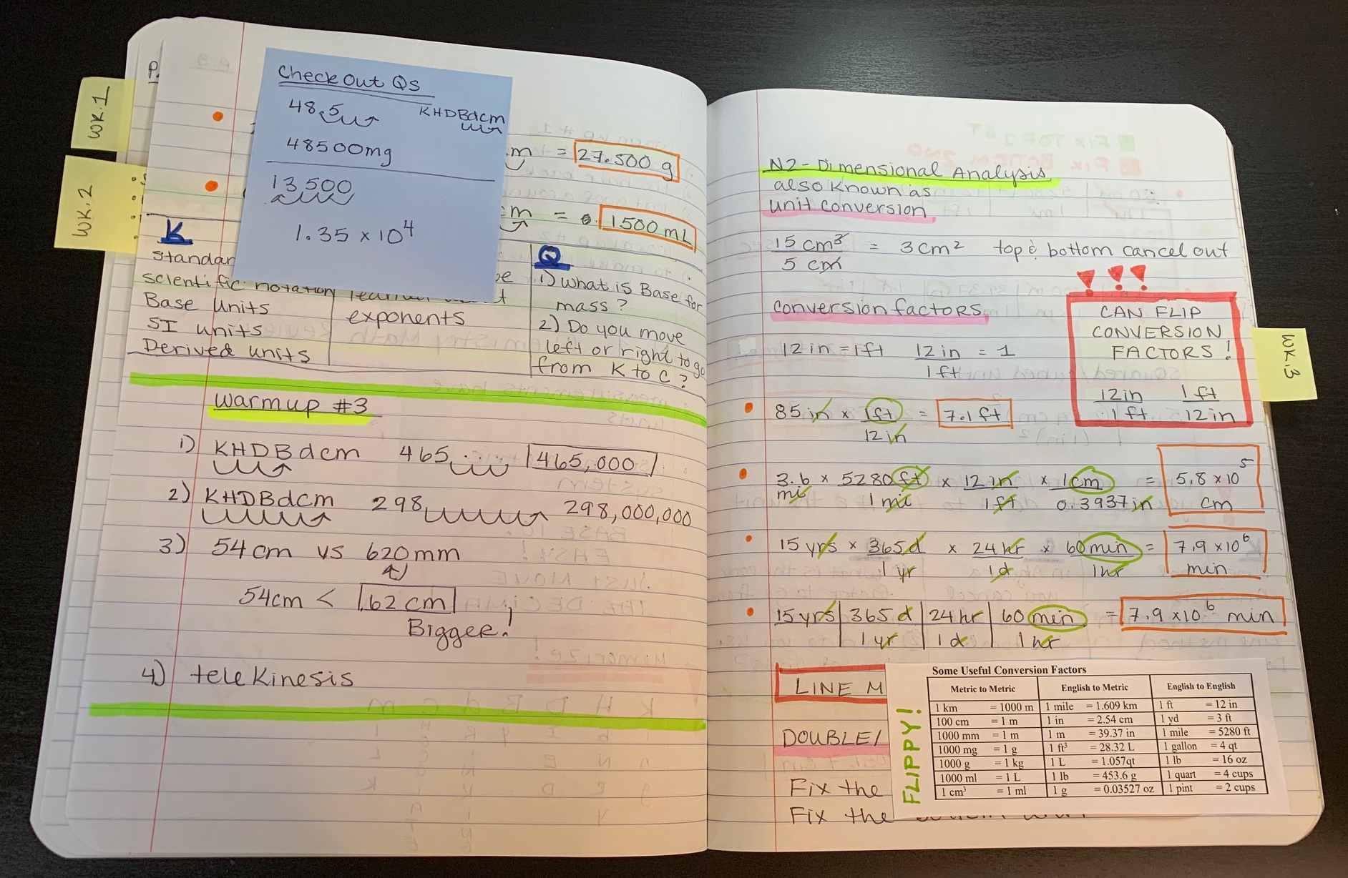

Slide 12
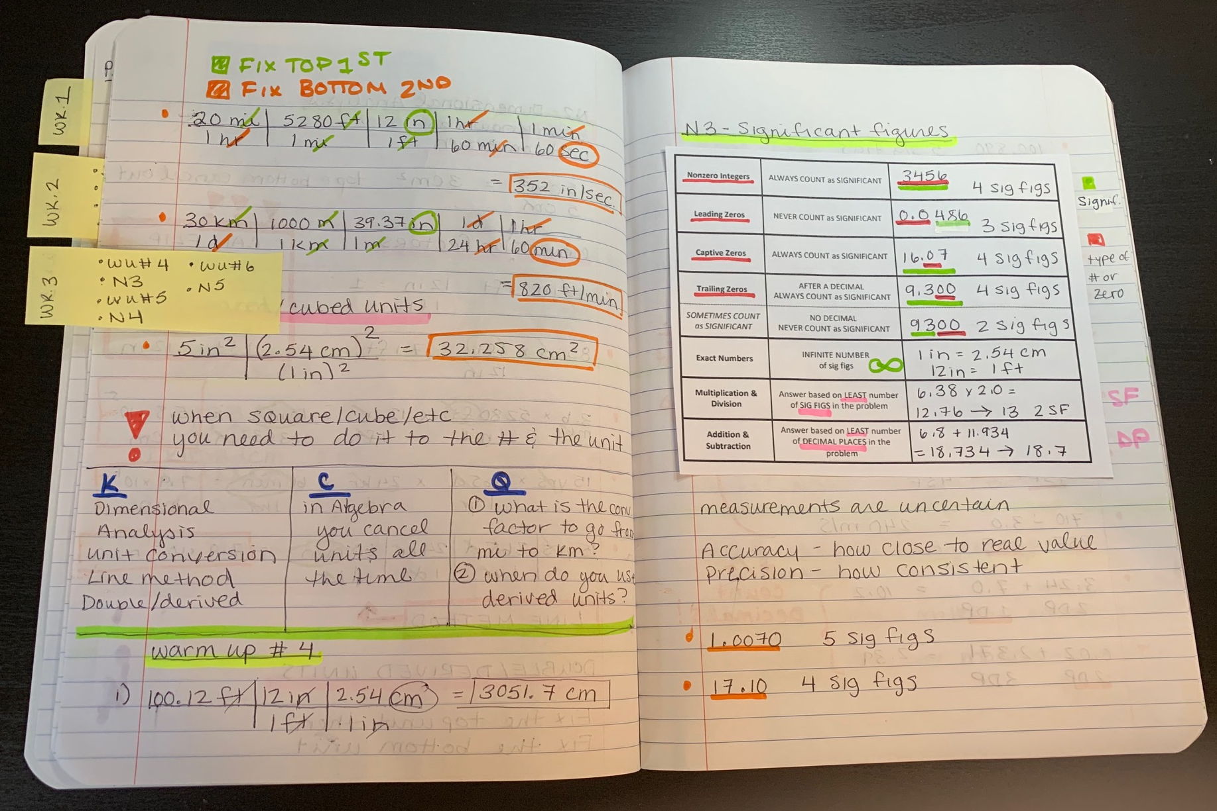

Slide 13
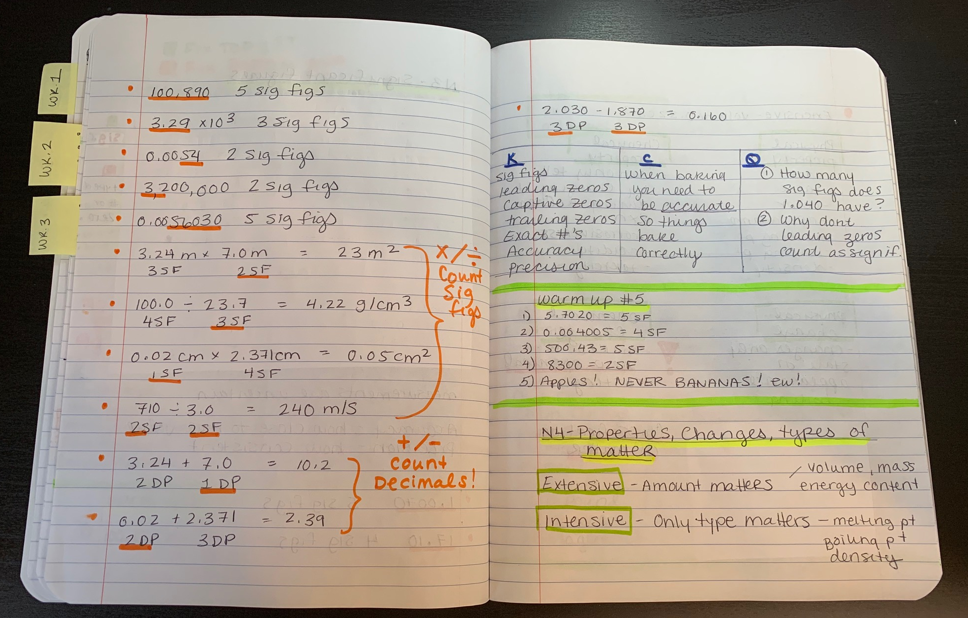

Slide 14
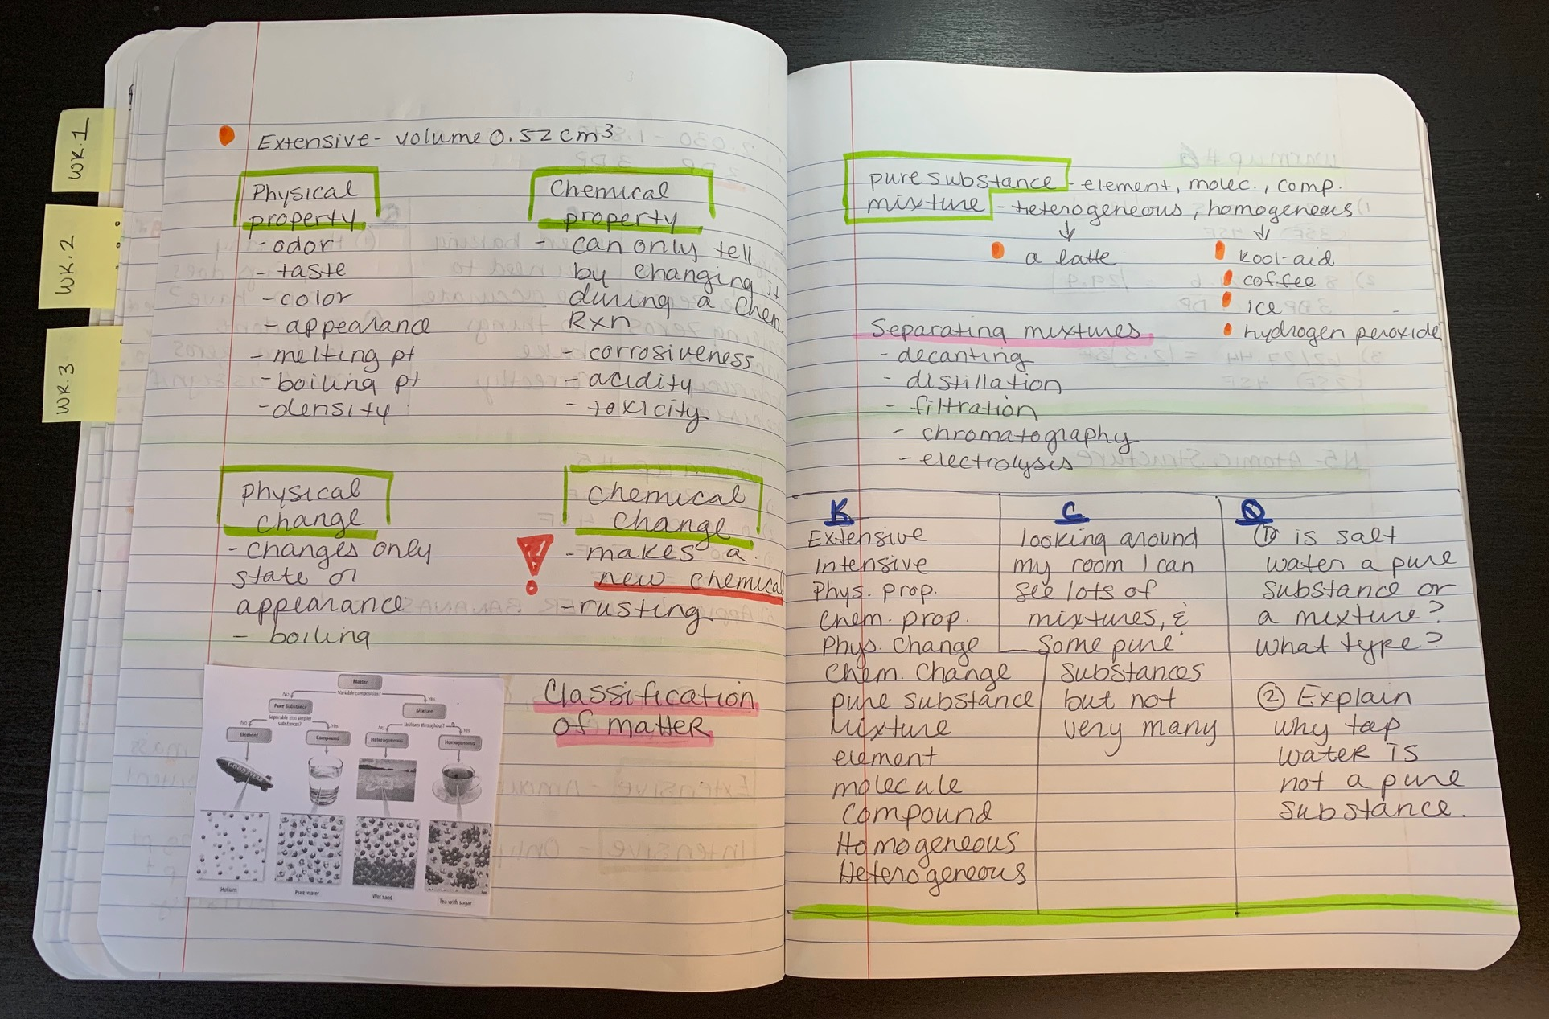

Slide 15
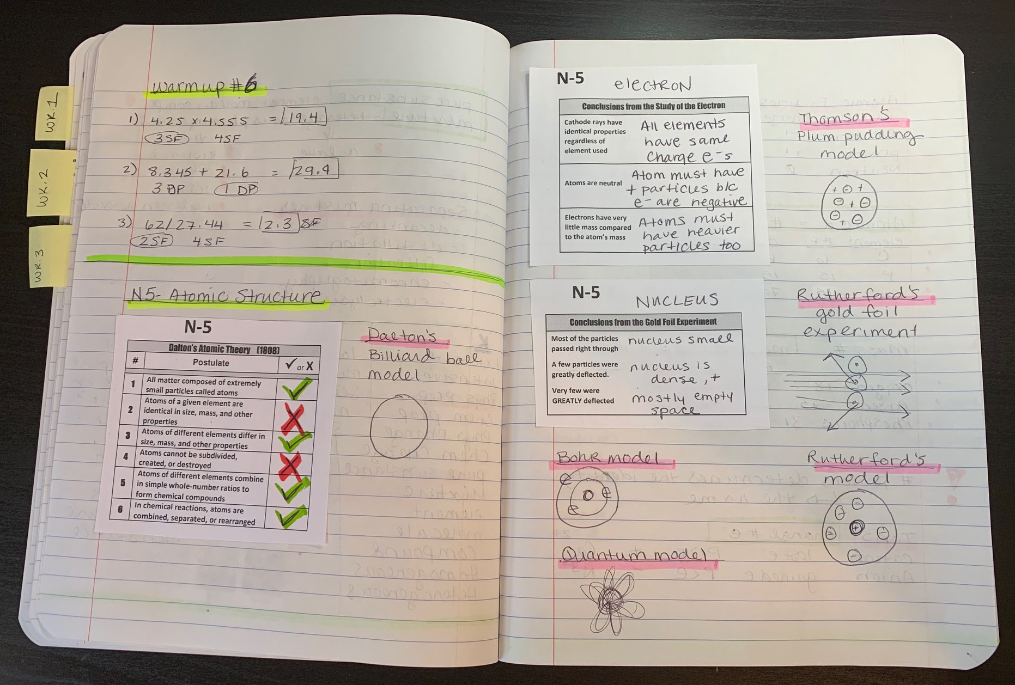

Slide 16
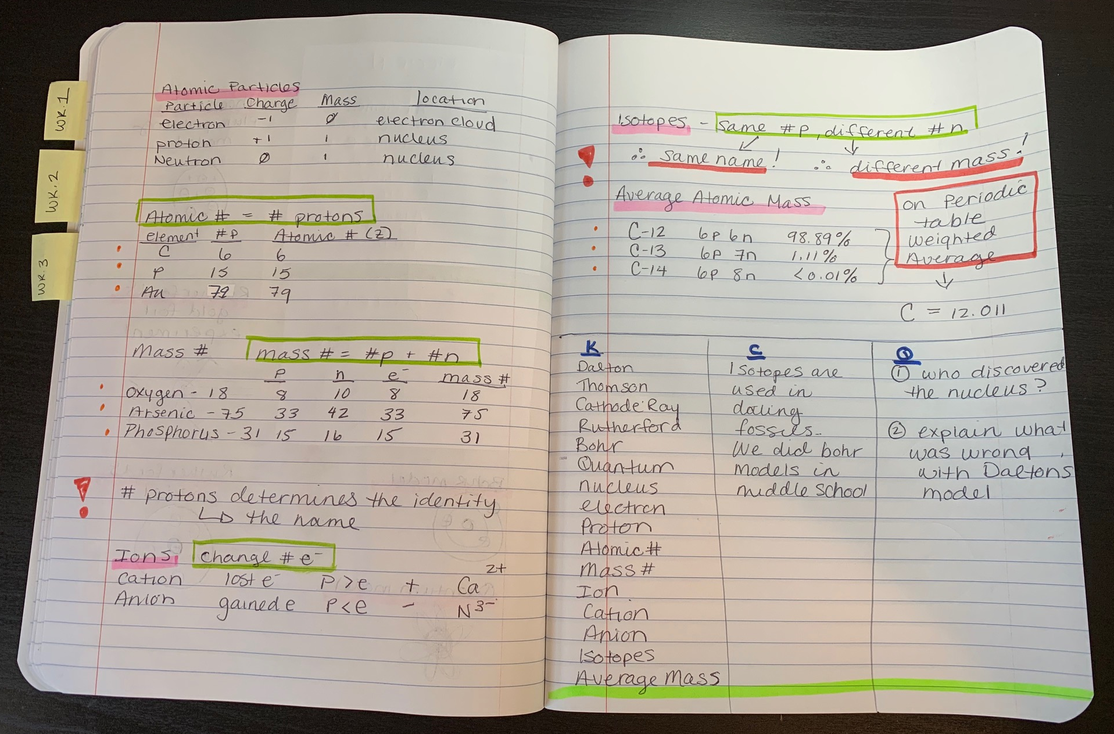

Slide 17
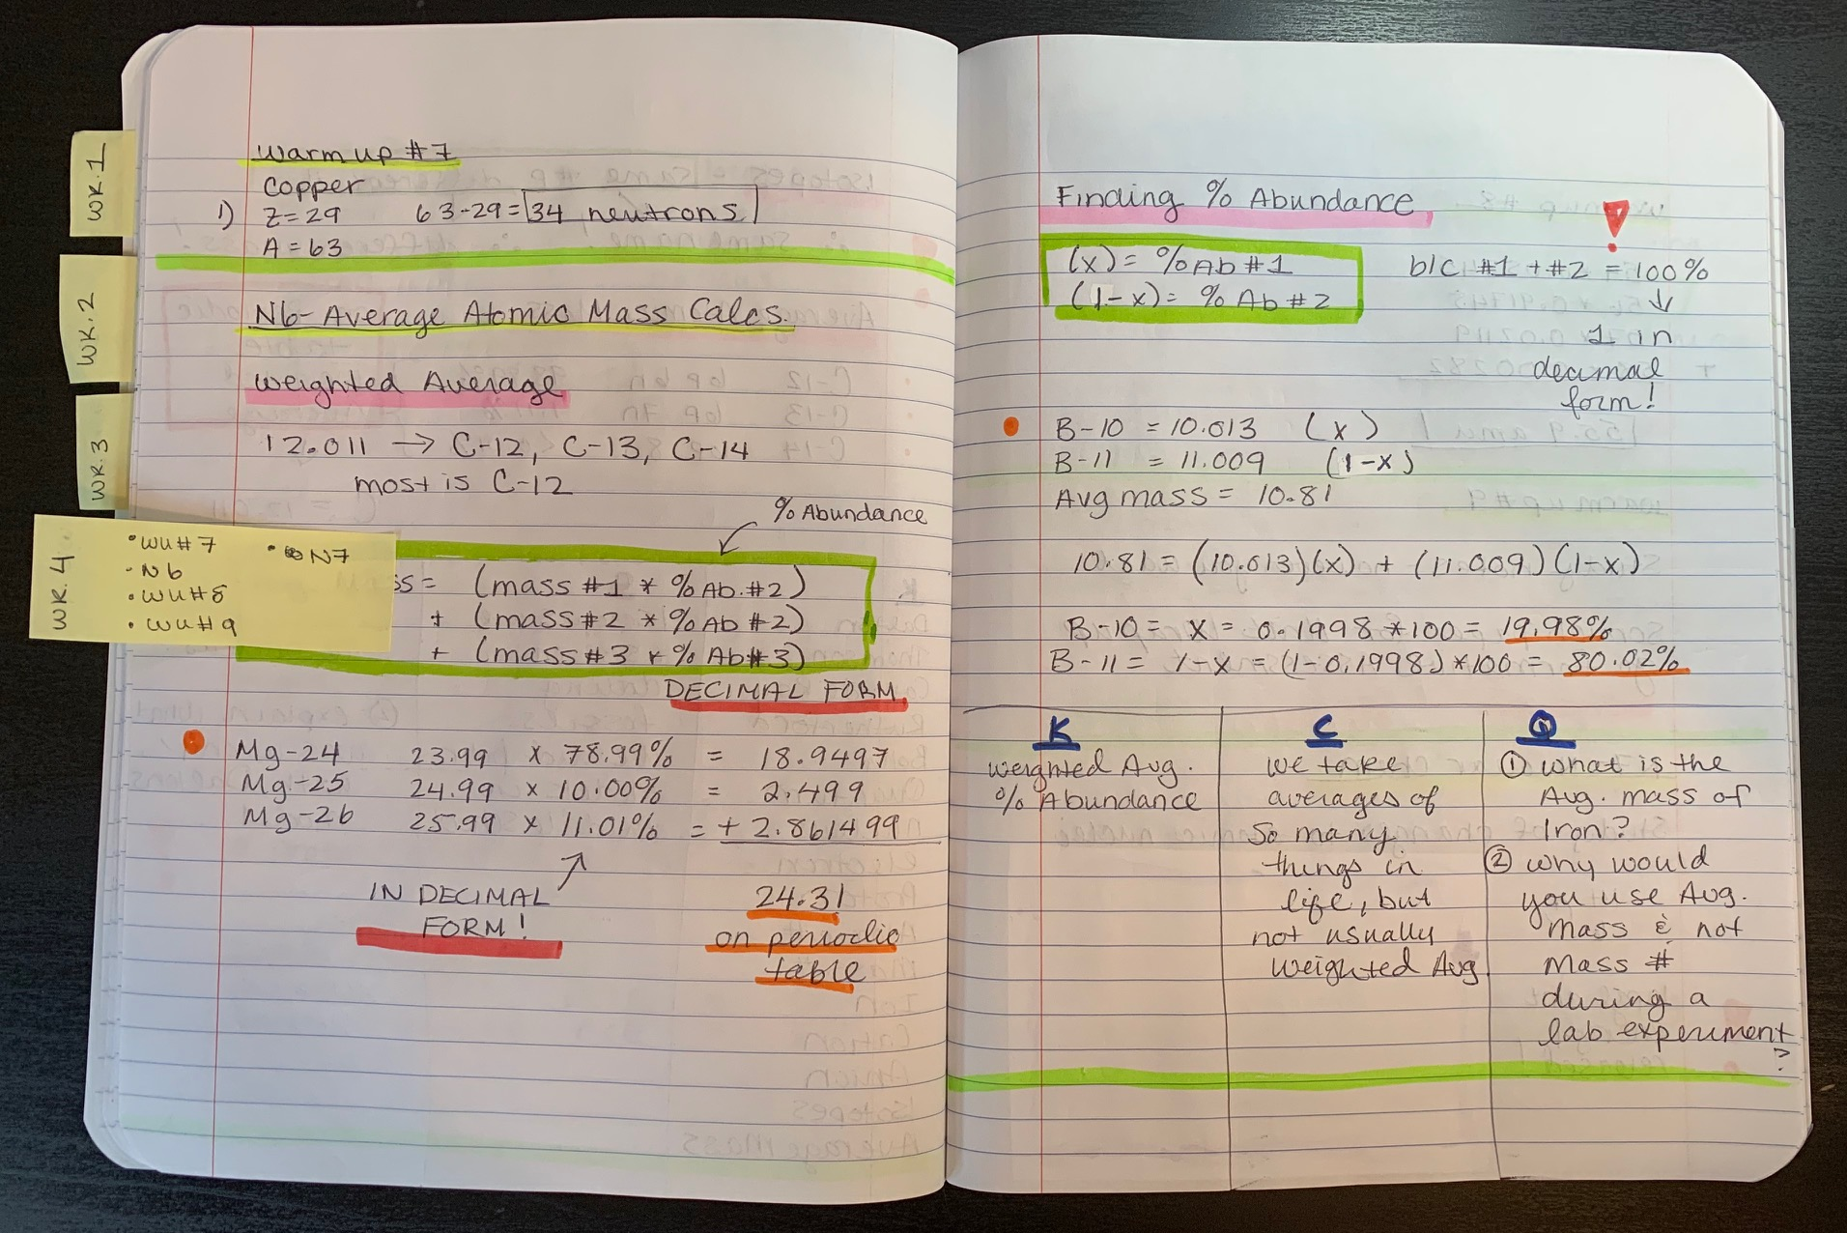

Slide 18
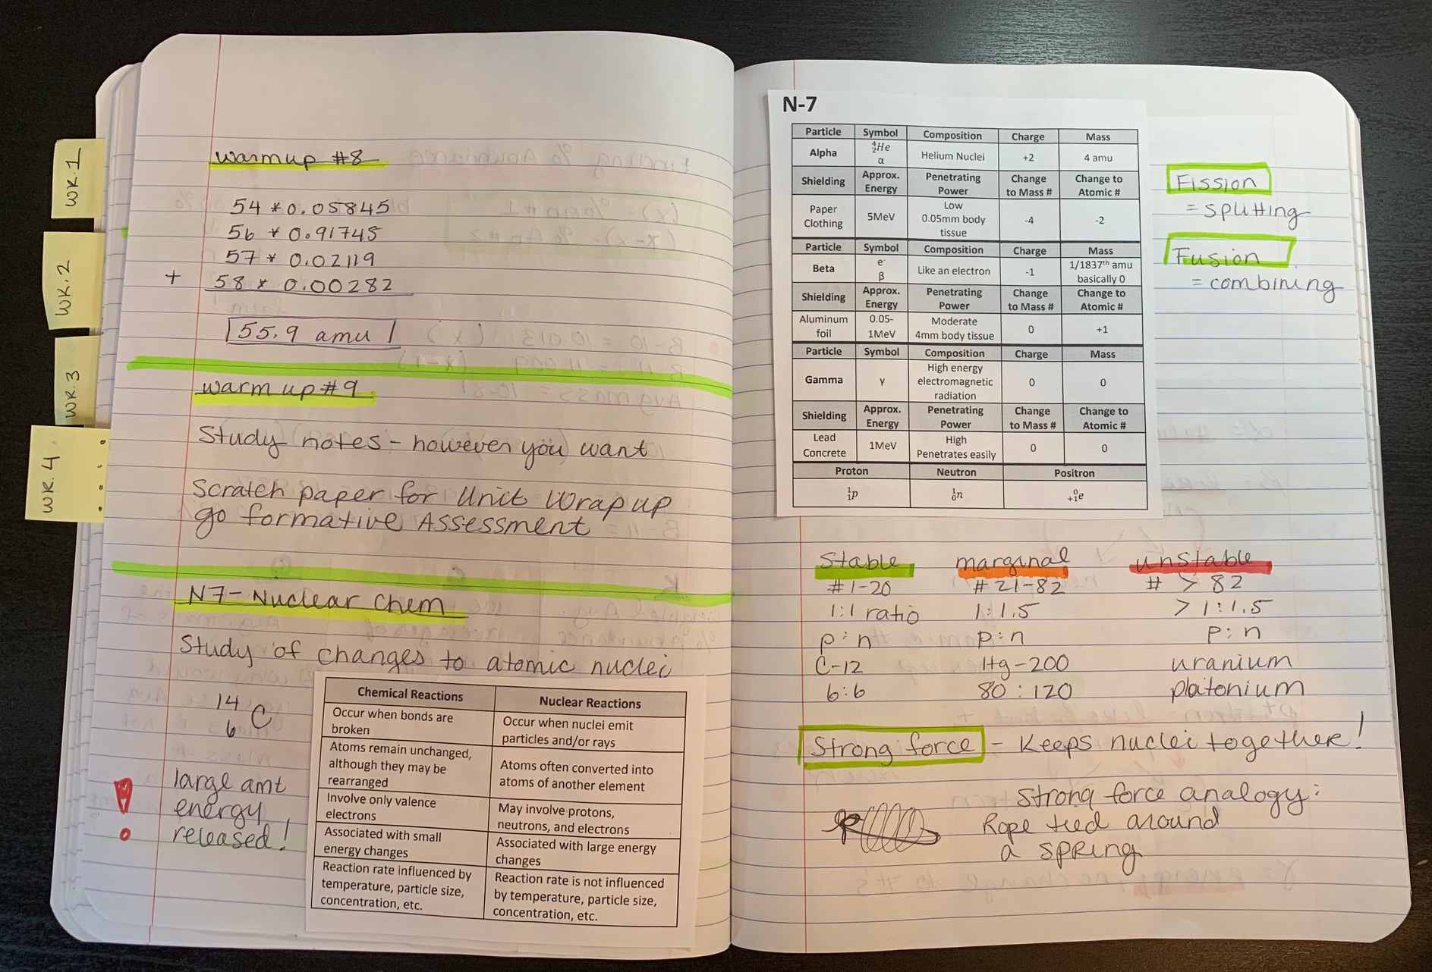

Slide 19
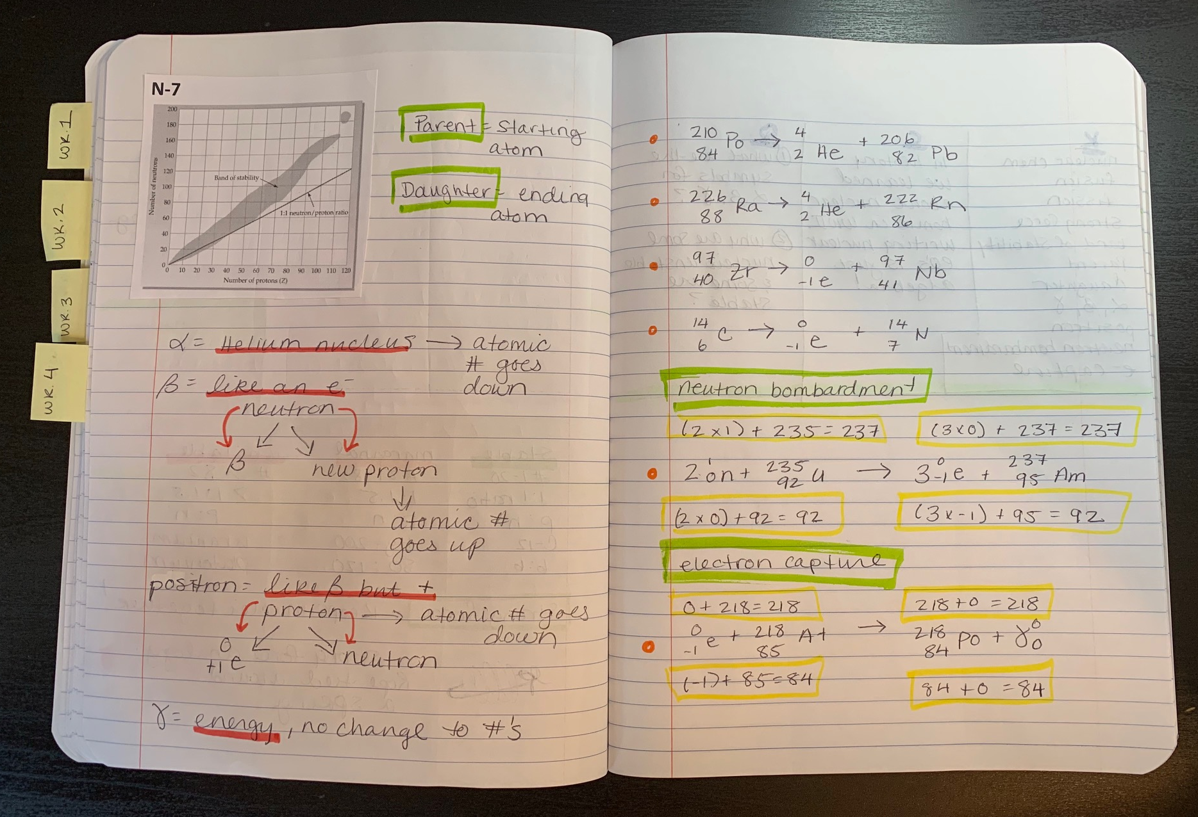

Slide 20
