Slide 1
QUESTION TEMPLATE
answer
#

Slide 2
QUESTION TEMPLATE
answer
#

Slide 3
QUESTION TEMPLATE
answer
#

Slide 4
Bing-Bing-Toe !!!
Match #1:
Chemistry Basics & Atomic Structure,
Nuclear

Slide 5
Bing-bing-toe game rules
Clock Side = even #s – X Window side = odd #s – O
2 players from each team go head to head
(standing by opposite team)
Team may not help! Teams lose points for trying to distract the other team or help their team with answers.
1st to hold up board with correct answer gets to play a square.
Each BING-TOE = 1 point

Slide 6
BING-BING-TOE GAME RULES
 |  | FREE Space

Slide 7
Bing-bing-toe game rules
Window side = odd #s – O Clock Side = even #s – X
NO SITTING AT TABLE 1 or TABLE 8
ODD # - O team will send someone to Table 1
EVEN # - X team will send someone to Table 8

Slide 8
How many atoms are in one
molecule of Al(OH)3 ?
Seven (7)
1

Slide 9
What particle did Thompson discover and which experiment proved it?
Electron →
Cathode Ray Tube Experiment
2

Slide 10
What parts of Dalton’s theory remain true today?
All matter is composed of atoms
Atoms of an element are identical in mass/properties, etc
Different elements differ in mass/properties
Atoms cannot be subdivided, created, or destroyed
Atoms combine to form whole # chemical compounds
In chemical rxns atoms combine, separate,
or rearrange
3

Slide 11
What parts of Dalton’s theory remain true today?
All matter is composed of atoms
Atoms of an element are identical in mass/properties, etc
Different elements differ in mass/properties
Atoms cannot be subdivided, created, or destroyed
Atoms combine to form whole # chemical compounds
In chemical rxns atoms combine, separate,
or rearrange
3

Slide 12
Which TWO of these atoms are isotopes of each other? WHY?
e-
e-
e-
e-
e-
e-
e-
e-
e-
e-
e-
e-
e-
e-
e-
Atom A
5 protons
5 neutrons
5 electrons
e-
Atom C
5 protons
6 neutrons
5 electrons
e-
e-
e-
e-
e-
Atom B
6 protons
5 neutrons
5 electrons
Atom D
5 protons
5 neutrons
6 electrons
4

Slide 13
Which TWO of these atoms are isotopes of each other? WHY?
e-
e-
e-
e-
e-
e-
e-
e-
e-
e-
e-
e-
e-
e-
e-
Atom A
5 protons
5 neutrons
5 electrons
e-
Atom C
5 protons
6 neutrons
5 electrons
e-
e-
e-
e-
e-
Atom B
6 protons
5 neutrons
5 electrons
Atom D
5 protons
5 neutrons
6 electrons
4

Slide 14
What Two parts of Daltons theory Have been proven false?
All matter is composed of atoms
Atoms of an element are identical in mass/properties, etc
Different elements differ in mass/properties
Atoms cannot be subdivided, created, or destroyed
Atoms combine to form whole # chemical compounds
In chemical rxns atoms combine, separate,
or rearrange
5

Slide 15
What Two parts of Daltons theory Have been proven false?
All matter is composed of atoms
Atoms of an element are identical in mass/properties, etc
Different elements differ in mass/properties
Atoms cannot be subdivided, created, or destroyed
Atoms combine to form whole # chemical compounds
In chemical rxns atoms combine, separate,
or rearrange
5

Slide 16
Name the phases of matter
(four answers, NOT aqueous...)
Solid, liquid, gas, and plasma
6

Slide 17
Name the 6 phase changes and what phases the change is between
Melting – Solid to Liquid Freezing – Liquid to Solid
Condensing – Gas to Liquid Vaporizing – Liquid to gas
Sublimation – Solid to Gas Deposition – Gas to Solid
7

Slide 18
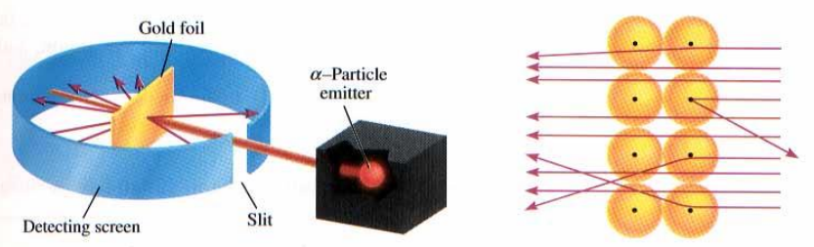
Draw a diagram for Rutherford’s Experiment. Explain what FOUR things it proved about atomic structure
Atom mostly empty space
Nucleus in center
Dense and small nucleus
Positive nucleus
8

Slide 19
Name an element with similar properties to Iodine.
Fluorine, Chlorine, any halogen
9

Slide 20
How do you calculate mass number?
Protons + neutrons = mass number
10

Slide 21
How many valence Electrons do the Halogen elements have?
Seven
11

Slide 22
Define chemical change and physical change. Give an example of each.
Physical change is same substance
before and after (boiling water).
Chemical change involves the making and breaking of chemical bonds to make a new substance (combustion, rusting, etc)
12

Slide 23
Name the three subatomic particles and give their relative masses.
Proton – 1 amu
Neutron – 1 amu
Electron – almost no mass at all
13

Slide 24
Convert 15mi/day into in/sec
11 in/sec
14

Slide 25
Classify Each Substance Below as:
Pure Substance (element or compound) Mixture (homogeneous or heterogeneous).
Calcium
Cookies and Cream Ice Cream
Carbon Dioxide
Tap Water
Neon
Kool Aid Punch
H2O
Italian Salad dressing
15

Slide 26
Pure Substance Mixture
Element Pure Comp Homogeneous Heterogeneous
H2O
CARBON DIOXIDE
KOOL AID
TAP WATER
CALCIUM
NEON
SALAD
DRESSING
COOKIES AND CREAM ICE CREAM

Slide 27
How many valence electrons do the alkali metals have and what is the charge of their ions?
1 valence electron
1+ charge
16

Slide 28
What radioactive emission changes a neutron into a proton?
Beta particle
17

Slide 29

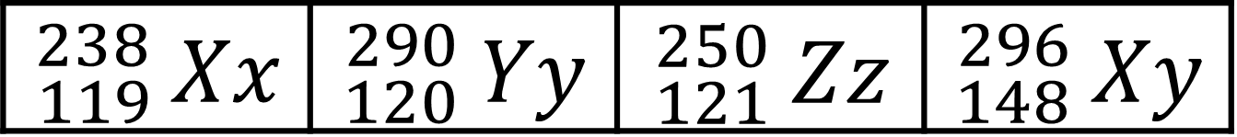
Scientists discover some new elements. Using the data below, which is most likely to be radioactive?
$${}_{119}^{238}{ Xx}$$ | $${}_{120}^{290}{ Yy}$$ | $${}_{121}^{250}{ Zz}$$ | $${}_{148}^{296}{ Xy}$$
$${}_{120}^{290}{ Yy}$$
18

Slide 30
What radioactive emission changes a neutron into a proton?
Beta Emission
19

Slide 31
How many protons and neutrons are in the nuclei of Tl-204 atoms?
81 protons and 123 neutrons
20

Slide 32
Uranium-235 undergoes alpha emission. What is the balanced eq.?
235
92
4
2
231
90
U → He + Th
21

Slide 33
Neutron initiated fission of U-235 results in the release of 4 beta particles, the formation of Sr-90 and the release of another nucleus. What is the other nucleus?
Cerium - 146
22

Slide 34
Calculate the average atomic mass of Magnesium from these data. Magnesium occurs in nature in three isotopic forms:
Mg-24 (78.70% abundance)
Mg-26 (11.17% abundance)
Mg-25 (10.13% abundance)
24.31 amu
23

Slide 35
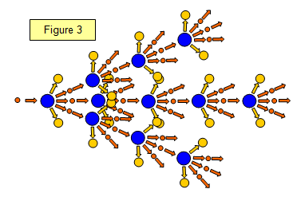
What is nuclear fission?
A large, unstable nucleus breaking apart into smaller more stable nuclei. Sometimes the result is a chain reaction.
24

Slide 36
A substance has a density of 1.39g/ml. You have 10g of the substance. What volume (in L) do you have?
7.2 x 10⁻³ L
25

Slide 37
How many decigrams are in 437 kg?
Write in scientific notation!
4.37 x 10⁶ dg
26

Slide 38
How many sig. figs are in the following values?
612 kg 0.00067 ml 309.4 g
612 kg → 3 s.f.
0.00067 ml → 2 s.f.
309.4 g → 4 s.f.
27

Slide 39
Perform the calculation using accurate sig figs
1.31 cm x 2.3 cm =
3.0 cm
28

Slide 40
Perform the calculation using accurate sig figs
8.264 g - 7.8 g =
0.5 g
29

Slide 41
What holds the nucleus together so the repulsion between protons doesn’t make the atom fly apart?
Strong Force
30

Slide 42
Each team gets 10Xs
- Teams will take a turn answering a review Q
- Correct answer
= 2Xs to take from any team (splitting is ok) and a shot at the hoop.
Successful shot from the:
1 point line = +1X (3 total)
2 point line = +2X (4 total)
3 point line = +3X (5 total)
GRUDGE BALL RULES

Slide 43
Grudge Ball !!!
Match #2:
Electrons
Periodic Table

Slide 44
Each team gets 10Xs
- Teams will take a turn answering a review Q
- Correct answer
= 2Xs to take from any team (splitting is ok) and a shot at the hoop.
Points
1 point basket = +1X (3 total)
2 point basket = +2X (4 total)
3 point basket = +3X (5 total)
GRUDGE BALL RULES

Slide 45
No More Xs?
Gain back 2Xs by answering the Q correctly.
Incorrect Answer?
If team gets incorrect answer, random choice gets to steal the Q, so BE READY!
Winning
Most Xs at the end of game wins!
GRUDGE BALL RULES

Slide 46
Which element is this?
1s² 2s² 2p⁶ 3s² 3p⁶ 4s² 3d⁵
Manganese
1

Slide 47
Give name and write out noble gas notation:
1s² 2s² 2p⁶ 3s² 3p⁶ 4s² 3d¹⁰ 4p⁶ 5s² 4d²
Zirconium
[Kr] 5s² 4d²
2

Slide 48
What does the Pauli Exclusion Principle say?
No two electrons can have the same set of quantum numbers – they can’t occupy the “same space” - they can’t have the same “address.” In other words, one e- spin up, one spin down in an orbital.
3

Slide 49
What does the Aufbau Principle say?
Electrons are lazy!
They want to occupy the lowest energy orbitals first.
4

Slide 50
Draw the orbital diagram for nitrogen. How many unpaired e- does it have?
5

Slide 51
Draw the orbital diagram for nitrogen. How many unpaired e- does it have?
__ __ __
__
__
5

Slide 52
What is the noble gas configuration for calcium?
[Ar] 4s²
6

Slide 53
How many unpaired electrons are in chromium?
Four
7

Slide 54
How many orbitals in a set of each type/shape orbital?
s - 1
p - 3
d - 5
f - 7
8

Slide 55
What is the highest energy level in the element below:
1s² 2s² 2p⁶ 3s² 3p⁶ 4s² 3d¹⁰ 4p⁶
Fourth energy level
9

Slide 56
Which element might form a ion by losing electrons from the s and d orbitals F, S, Li, Ti
Ti
10

Slide 57
What is the atomic radius?
Measure of the distance from the center nucleus to the valence electron.
11

Slide 58
Atomic radius increases as you go (left or right?) and (up or down?)
Left
Down
12

Slide 59
Atomic radius decreases going right because of ______________ and increases going down because there are _____________
Greater effective nuclear charge = more protons pulling electrons in closer
More energy levels and increased shielding cause nucleus to not pull electrons in as hard
13

Slide 60
Order these elements from smallest to largest?
Se, S, Cl Na
Cl, S, Se, Na
14

Slide 61
Of the elements in the alkaline earth metals which has the highest electronegativity
Beryllium
15

Slide 62
Why does it take less energy to remove e- as you go down a group?
More energy levels, so electron is further from the nucleus, and more shielding which means the nucleus isn’t able to attract as well.
16

Slide 63
Describe the trend for reactivity of halogens. They get more reactive as you go ______.
Reactivity increases as you move UP the periodic table.
17

Slide 64
What is the sum of the charges from the atoms below when they are ions? Calcium, nitrogen, and strontium
1
(+2) + (-3) + (+2) =1
18

Slide 65
How many electrons are in a set of p orbitals?
6 electrons
19

Slide 66
What is the term for the ability of metals to be pounded and shaped into sheets?
malleability
20

Slide 67
What is the definition of ionization energy?
The amount of energy needed to remove one electron from a neutral atom.
21

Slide 68
Predict the ions of the following atoms and then rank the ions from smallest to largest radius
S , P , Cl , Ca , K
Ca²⁺> K⁺ > Cl⁻ > S²⁻ > P³⁻
22

Slide 69
Electronegativity increases going (left or right?) and increases going (up or down?)
Right
Up
23

Slide 70
Which element is in period 4 group 3B
Scandium
24

Slide 71
Draw a diagram for absorption
and emission.
25

Slide 72
What is the e- configuration for
copper (II)?
1s² 2s² 2p⁶ 3s² 3p⁶ 3d⁹
26

Slide 73
How many electrons can fit in a d orbital?
2
27

Slide 74
Electronegativity
(increases or decreases?) as you move down a group.
WHY?
DECREASES
More energy levels → more shielding
→ further from nucleus harder to
attract electrons
28

Slide 75
Does Metallic Character (reactivity) increase or decrease going down a group?
Increases
29

Slide 76
Define “effective nuclear charge.”
The attractive positive charge of nuclear protons acting on valence electrons.
30

Slide 77
Give an example of two ions that each have a larger atomic radius than their neutral parent atom.
Anions are larger than neutral parent atom.
31

Slide 78
Board Game Review !!!
Match #3:
Bonding
Reactions
Stoichiometry

Slide 79
What is the name of the compound SrO?
Strontium oxide

Slide 80
What is the molar mass for the hydrocarbon
C₂₄H₃₇O₆
421.61 g/mol

Slide 81
What happens to the electrons during a metallic bond?
Sea of electrons, delocalized electrons etc.

Slide 82
What type of bond forms between two nonmetals share electrons?
Covalent bond

Slide 83
Balance the following reaction and identify the mole ratio between the two reactants.
CH₄ + O₂ →
2 mol O₂ : 1 mol CH₄

Slide 84
What are the dominant intermolecular forces present in water?
Hydrogen bonding
Remember H-NOF!

Slide 85
Rank the bulk forces in order of strength from weakest to strongest.
Metallic < Ionic Lattice < Network Covalent

Slide 86
What is the formula for copper (IV) sulfate?
Cu(SO₄)₂

Slide 87
What kind of a reaction is this?
Na + CaSO₄ →
Single replacement/single displacement

Slide 88
Which molecule has covalent bonding and does not require a double or triple bond?
CO₂, CO, N₂, CI₂
CI₂

Slide 89
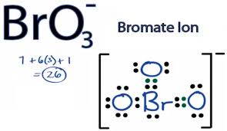
Draw the Lewis dot structure for BrO₃⁻

Slide 90
What is the VSEPR geometry for carbon tetrachloride?
tetrahedral

Slide 91
What is the molar mass of (NH₄)₂S?
68.15 g/mol

Slide 92
What is the VSEPR geometry for ammonia?
trigonal pyramidal

Slide 93
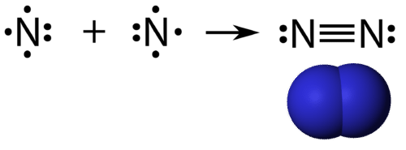
Draw the Lewis Dot structure for nitrogen gas.

Slide 94
What kind of a reaction requires O₂ as a reactant?
Combustion!

Slide 95
Predict the products and balance the following reaction:
aluminum phosphate plus rubidium nitrite
2AlPO₄ + 3Rb(NO₂)₂ → 2Al(NO₂)₃ + Rb₃(PO₄)₂

Slide 96
In a 'polar' bond, the elements involved are sharing the electron(s)...
Unequally!

Slide 97
If you have 10 mol of Zn, how many mols of ZnO can be produced?
3Zn + Al₂O₃ → 3ZnO + 2Al
10 mol ZnO!
Same molar ratio!

Slide 98
If you have 25g of Zn, how many g of ZnO can be produced?
3Zn + Al₂O₃ → 3ZnO + 2Al
31.1g ZnO

Slide 99
Name the seven diatomic elements.
H2 F2 Cl2
Br2 I2 O2
N2

Slide 100
What is the molar mass of Al(OH)3?
77.98 g/mol

Slide 101
If you have 38L of O₂ at STP, how many L of H₂O can you produce, assuming your water is gaseous.
2H₂ + O₂→ 2H₂O
L of A → mols A → mols B → L of B
76L H₂O

Slide 102
If you have 38L of O₂ at STP, how many L of H₂O can you produce, assuming your water is gaseous.
2H₂ + O₂→ 2H₂O
L of A → mols A → mols B → L of B
76L H₂O

Slide 103
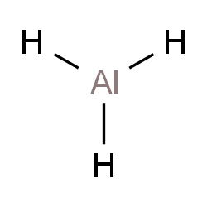
Draw the Lewis dot structure for AlH₃

Slide 104
What is the mole ratio of TNT to carbon monoxide in the following equation?
C₇H₅N₃O₆ → CO + C + H₂O + N₂
2 mole TNT : 7 mole CO

Slide 105
What is the formula of sodium carbonate?
Na₂ CO₃

Slide 106
What is the molar mass of sodium carbonate?
106g/mol

Slide 107
What is the molar mass of iron (III) sulfate
Fe₂(SO₄)₃=400.1 g/mole

Slide 108
How many moles of iron (III) sulfate in 44.5g iron (III) sulfate? The molar mass is 400.1 g/mol.
0.111 moles Fe₂(SO₄)₃

Slide 109
How many grams potassium chloride are in 14.6 moles potassium chloride?
1 mole = 74.5 g
1087.7g KCl

Slide 110
How many grams of iron (III) carbonate are found in 5.46 moles iron (III) carbonate?
1592.68 gFe(CO₃)₃

Slide 111
Aqueous copper(II) bromide reacts with aqueous aluminum chloride. What type of reaction is this?
Double displacement.

Slide 112
Aqueous copper(II) bromide reacts with aqueous aluminum chloride. Balance this equation and predict the products.
3CuBr₂ + 2AlCl₃ → 3CuCl₂ +2AlBr₃

Slide 113
How many moles of sodium carbonate are in 10.9 g sodium carbonate?
Molar mass sodium carbonate 106 g
0.103 moles

Slide 114
What is the molar ratio of iron(III) sulfate to sodium sulfate when iron(III) sulfate reacts with sodium carbonate?
Fe₂(SO₄)₃ + 3Na₂CO₃ → Fe₂(CO₃)₃ + 3Na₂SO₄
1 mole Fe₂(SO₄)₃ = 3 moles Na₂SO₄

Slide 115
If 10 moles iron (III) sulfate reacts, how many moles sodium carbonate will form?
Fe₂(SO₄)₃ + 3Na₂CO₃ → Fe₂(CO₃)₃ + 3Na₂SO₄
1 mole Fe₂(SO₄)₃ = 3 moles Na₂SO₄

Slide 116
If 15 g oxygen is reacted with hydrogen, then how many moles water will be produced?
2H₂ + O₂ → 2H₂O
0.94 moles water

Slide 117
What are three of the four indications that a chemical reaction has occurred?
Production of heat and light
Production of a gas
Formation of a precipitate
Change in color

Slide 118
If 46 g sodium metal reacts completely, then how many moles chlorine gas will be required to make sodium chloride?
2Na + Cl₂ → 2NaCl
1 mole Cl₂

Slide 119
If 100 g sodium chloride reacts completely with barium, then how many grams sodium metal will be obtained?
2NaCl + Ba → BaCl₂ + 2Na
2NaCl + Ba → BaCl₂ + 2Na
39.32 g Na

Slide 120
How many liters fluorine gas in .87 moles of fluorine gas?
1 mole gas at STP (standard temperature and pressure, O degrees C and 1 atm pressure) = 22.4 L gas
19.52L F₂

Slide 121
How many grams of oxygen gas are in .69L of oxygen gas? (22.4 L/1 mole)
.99g

Slide 122
2 H₂S + 3 O₂ → 2 SO₂+ 2 H₂O
How many moles of H₂S are required to form 8.20 moles of SO₂?
8.2 mol

Slide 123
2 NaClO₃ → 2 NaCl + 3 O₂ How many molecules of oxygen are produced when 80.0 grams of sodium chloride are produced?
1.23 x 10²⁴ molecules

Slide 124
Na₂S₂O_{3(aq)} + 4Cl_{2(g)} + 5H₂O_{(aq)} → 2NaHSO_{4(aq)} + 8HCl_{(aq)}
How many moles of H₂O react if 5.24 x 10¹⁹ molecules of HCl are formed?
5.44 x 10⁻⁵ mol B

Slide 125
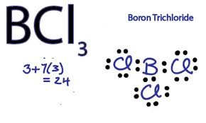
Draw the Lewis structure and identify the VSEPR geometry for BCl₃.
Trigonal Planar

