Slide 1
Bing-Bing-Toe !!!
Match #1:
Chemistry Basics & Atomic Structure,
Nuclear

Slide 2
BING-BING-TOE GAME RULES
 |  | FREE Space

Slide 3
Bing-bing-toe game rules
Clock Side = even #s – X Window side = odd #s – O
2 players from each team go head to head
(standing by opposite team)
Team may not help! Teams lose points for trying to distract the other team or help their team with answers.
1st to hold up board with correct answer gets to play a square.
Each BING-TOE = 1 point

Slide 4
Bing-bing-toe game rules
Window side = odd #s – O Clock Side = even #s – X
NO SITTING AT TABLE 1 or TABLE 8
ODD # - O team will send someone to Table 1
EVEN # - X team will send someone to Table 8

Slide 5
How many atoms are in one
molecule of Al(OH)3 ?
Seven (7)
1

Slide 6
What particle did Thompson discover and which experiment proved it?
Electron →
Cathode Ray Tube Experiment
2

Slide 7
What parts of Dalton’s theory remain true today?
All matter is composed of atoms
Atoms of an element are identical in mass/properties, etc
Different elements differ in mass/properties
Atoms cannot be subdivided, created, or destroyed
Atoms combine to form whole # chemical compounds
In chemical rxns atoms combine, separate,
or rearrange
3

Slide 8
What parts of Dalton’s theory remain true today?
All matter is composed of atoms
Atoms of an element are identical in mass/properties, etc
Different elements differ in mass/properties
Atoms cannot be subdivided, created, or destroyed
Atoms combine to form whole # chemical compounds
In chemical rxns atoms combine, separate,
or rearrange
3

Slide 9
Which TWO of these atoms are isotopes of each other? WHY?
e-
e-
e-
e-
e-
e-
e-
e-
e-
e-
e-
e-
e-
e-
e-
Atom A
5 protons
5 neutrons
5 electrons
e-
Atom C
5 protons
6 neutrons
5 electrons
e-
e-
e-
e-
e-
Atom B
6 protons
5 neutrons
5 electrons
Atom D
5 protons
5 neutrons
6 electrons
4

Slide 10
Which TWO of these atoms are isotopes of each other? WHY?
e-
e-
e-
e-
e-
e-
e-
e-
e-
e-
e-
e-
e-
e-
e-
Atom A
5 protons
5 neutrons
5 electrons
e-
Atom C
5 protons
6 neutrons
5 electrons
e-
e-
e-
e-
e-
Atom B
6 protons
5 neutrons
5 electrons
Atom D
5 protons
5 neutrons
6 electrons
4

Slide 11
What Two parts of Daltons theory Have been proven false?
All matter is composed of atoms
Atoms of an element are identical in mass/properties, etc
Different elements differ in mass/properties
Atoms cannot be subdivided, created, or destroyed
Atoms combine to form whole # chemical compounds
In chemical rxns atoms combine, separate,
or rearrange
5

Slide 12
What Two parts of Daltons theory Have been proven false?
All matter is composed of atoms
Atoms of an element are identical in mass/properties, etc
Different elements differ in mass/properties
Atoms cannot be subdivided, created, or destroyed
Atoms combine to form whole # chemical compounds
In chemical rxns atoms combine, separate,
or rearrange
5

Slide 13
Name the phases of matter
(four answers, NOT aqueous...)
Solid, liquid, gas, and plasma
6

Slide 14
Name the 6 phase changes and what phases the change is between
Melting – Solid to Liquid Freezing – Liquid to Solid
Condensing – Gas to Liquid Vaporizing – Liquid to gas
Sublimation – Solid to Gas Deposition – Gas to Solid
7

Slide 15
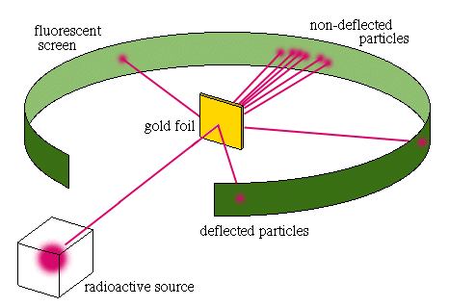
Draw a diagram for Rutherford’s Experiment. Explain what it proved about atomic structure
Atom mostly empty space
Dense, central, positive core - nucleus
8

Slide 16
Name an element with similar properties to Iodine.
Fluorine, Chlorine, any halogen
9

Slide 17
How do you calculate mass number?
Protons + neutrons = mass number
10

Slide 18
How many valence Electrons do the Halogen elements have?
Seven
11

Slide 19
Define chemical change and physical change. Give an example of each.
Physical change is same substance
before and after (boiling water).
Chemical change involves the making and breaking of chemical bonds to make a new substance (combustion, rusting, etc)
12

Slide 20
Name the three subatomic particles and give their relative masses.
Proton – 1 amu
Neutron – 1 amu
Electron – almost no mass at all
13

Slide 21
Convert 15mi/day into in/sec
11 in/sec
14

Slide 22
Classify Each Substance Below as:
Pure Substance (element or compound) Mixture (homogeneous or heterogeneous).
Calcium
Cookies and Cream Ice Cream
Carbon Dioxide
Tap Water
Neon
Kool Aid Punch
H2O
Italian Salad dressing
15

Slide 23
Pure Substance Mixture
Element Pure Comp Homogeneous Heterogeneous
H2O
CARBON DIOXIDE
KOOL AID
TAP WATER
CALCIUM
NEON
SALAD
DRESSING
COOKIES AND CREAM ICE CREAM

Slide 24
How many valence electrons do the alkali metals have and what is the charge of their ions?
1 valence electron
1+ charge
16

Slide 25
What radioactive emission changes a neutron into a proton?
Beta particle
17

Slide 26

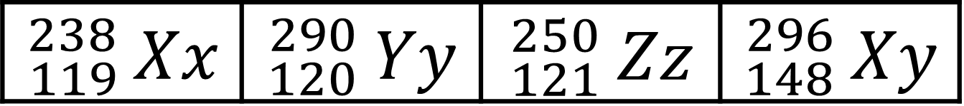
Scientists discover some new elements. Using the data below, which is most likely to be radioactive?
$${}_{119}^{238}{ Xx}$$ | $${}_{120}^{290}{ Yy}$$ | $${}_{121}^{250}{ Zz}$$ | $${}_{148}^{296}{ Xy}$$
$${}_{120}^{290}{ Yy}$$
18

Slide 27
What radioactive emission changes a neutron into a proton?
Beta Emission
19

Slide 28
How many protons and neutrons are in the nuclei of Tl-204 atoms?
81 protons and 123 neutrons
20

Slide 29
Uranium-235 undergoes alpha emission. What is the balanced eq.?
235
92
4
2
231
90
U → He + Th
21

Slide 30
Neutron initiated fission of U-235 results in the release of 4 beta particles, the formation of Sr-90 and the release of another nucleus. What is the other nucleus?
Cerium - 146
22

Slide 31
Calculate the average atomic mass of Magnesium from these data. Magnesium occurs in nature in three isotopic forms:
Mg-24 (78.70% abundance)
Mg-26 (11.17% abundance)
Mg-25 (10.13% abundance)
24.31 amu
23

Slide 32
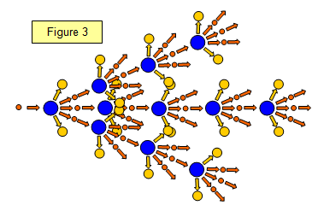
What is nuclear fission?
A large, unstable nucleus breaking apart into smaller more stable nuclei. Sometimes the result is a chain reaction.
24

Slide 33
A substance has a density of 1.39g/ml. You have 10g of the substance. What volume (in L) do you have?
7.2 x 10⁻³ L
25

Slide 34
How many decigrams are in 437 kg?
Write in scientific notation!
4.37 x 10⁶ dg
26

Slide 35
How many sig. figs are in the following values?
612 kg 0.00067 ml 309.4 g
612 kg → 3 s.f.
0.00067 ml → 2 s.f.
309.4 g → 4 s.f.
27

Slide 36
Perform the calculation using accurate sig figs
1.31 cm x 2.3 cm =
3.0 cm
28

Slide 37
Perform the calculation using accurate sig figs
8.264 g - 7.8 g =
0.5 g
29

Slide 38
What holds the nucleus together so the repulsion between protons doesn’t make the atom fly apart?
Strong Force
30

