Slide 1
Whiteboard: Make one column for each team, put 10 Xs in each column. Three baskets: closest = 1pt, middle = 2pts, far = 3pts Weight down with beanbags Tables: Big whiteboards, markers, erasers Random # generator: Picking groups when a team gets it wrong.

Slide 2
Each team gets 10Xs Teams will take a turn answering a review question. Correct answers get you 2Xs to take from any team (splitting is ok) and a shot at the hoop. Successful shot from the: 1 point line = +1x (3 total) 2 point line = +2X (4 total) 3 point line = +3X (5 total)
Grudge Ball Rules

Slide 3
Most Xs at the end of game wins. If your team has no Xs left, can gain back Xs by answering the question correctly. If team gets incorrect answer, random choice gets to steal the Q, so BE READY!
Grudge Ball Rules

Slide 4
Grudge Ball! X X X X X X X X X X
Spring Final Exam Review Semester 1 + Chapter 8

Slide 5
#1 - How many atoms are in one molecule of Mg₃(PO₄)₂ ?
T
A
B
L
E
1
Thirteen (13)

Slide 6
#2 - What particle did Thompson discover and name his experiment that proved it.
T
A
B
L
E
2
Electron → Cathode Ray Tube Experiment

Slide 7
#3 - What is the empirical formula for the following molecule: C₁₂H₂₂O₁₁ ?
T
A
B
L
E
3
C₁₂H₂₂O₁₁

Slide 8
#4 - This is the electron configuration for what element? 1s² 2s² 2p⁶ 3s² 3p⁶ 4s² 3d⁶
T
A
B
L
E
4
Iron (Fe)

Slide 9
#5 - This is the electron configuration for what ion? 1s² 2s² 2p⁶ 3s² 3p⁶ 3d⁶
T
A
B
L
E
5
Iron (II), (Fe²⁺)

Slide 10
#6 - Do any of the following atoms represent isotopes of Atom A? If so, which one(s) and why?
T
A
B
L
E
6
Same protons, different neutrons.
e-
e-
e-
e-
e-
e-
e-
e-
e-
e-
e-
e-
e-
e-
e-
e-
e-
e-
e-
e-
e-
Atom A
5 protons
5 neutrons
5 electrons
Atom B
6 protons
5 neutrons
5 electrons
Atom C
5 protons
6 neutrons
5 electrons
Atom D
5 protons
5 neutrons
6 electrons

Slide 11
#7 - What is the percent composition of CH₄?
T
A
B
L
E
7
C: 74.9%
H: 25.1%

Slide 12
#8 - Give the name and write out the noble gas notation for the element below. 1s² 2s² 2p⁶ 3s² 3p⁶ 4s² 3d¹⁰ 4p⁶ 5s²
T
A
B
L
E
1
[Kr] 5s² (Strontium)

Slide 13
#9 - Adipic acid contains 49.32% C, 43.84% O, and 6.85% H by mass. What is the empirical formula of adipic acid?
T
A
B
L
E
2
C₃H₅O₂

Slide 14
#10 - Name the FOUR states of matter (not phases!)
T
A
B
L
E
3
Solid, liquid, gas, and plasma

Slide 15
#11 - Name the SIX phase changes Bonus X: give an example of each.
T
A
B
L
E
4
Melting – Solid to Liquid
Freezing – Liquid to Solid
Condensing – Gas to Liquid
Sublimation – Solid to Gas
Deposition – Gas to Solid
Vaporizing – Liquid to gas

Slide 16
#12 - Draw a diagram for Rutherford's Experiment and Explain what it proved about the atomic model.
T
A
B
L
E
5
Nucleus is small, dense, +
Atom mostly empty space

Slide 17
#13 - What does Hund’s Rule say about electron orbitals?
T
A
B
L
E
6
Orbitals of the same energy must have one electron in each before any can have two (siblings want their own rooms before they have to share!)

Slide 18
#14 - Name an element with similar properties to Magnesium.
T
A
B
L
E
7
Beryllium, Calcium, Strontium, Barium, Radium
(any alkaline earth metal)

Slide 19
#15 - How do you calculate mass number?
T
A
B
L
E
1
Protons + neutrons = mass number

Slide 20
#16 - How many valance Electrons do the alkali metal elements have?
T
A
B
L
E
2
One

Slide 21
#17 – Draw the energy level diagram for carbon and say how many unpaired electrons it has.
T
A
B
L
E
3
__ __ __
__
__
Two unpaired

Slide 22
#18 - Compare and Contrast a chemical and physical change and give an example of each.
T
A
B
L
E
4
Physical change is same substance before and after (boiling water), but a chemical change involves the making and breaking of chemical bonds (combustion, rusting, etc)

Slide 23
#19 - If you have 29.5 moles of sodium and 27.0 moles of chlorine gas, how many moles of sodium chloride can you produce?
T
A
B
L
E
5
Beware of diatomic molecules!
2Na + Cl₂ → 2NaCl
Limiting reagent problem!
Can make 29.5 moles NaCl

Slide 24
#20 - Classify all of the following Substances as Pure (element or compound) or a mixture (homogenous or heterogeneous).
T
A
B
L
E
6
Calcium
Cookies and Cream Ice cream
Carbon Dioxide
Tap Water
Neon
Kool aid
H₂o
Salad dressing

Slide 25
Pure Substance Mixture Element Pure Comp Homog. Heterog.
H₂O
Carbon dioxide
Calcium
Neon
Salad dressing
Cookies and cream ice cream
Kool aid
Tap water

Slide 26
#21 - What is an alpha particle? Provide the symbol, mass, charge, and an example of an element undergoing an alpha decay.
T
A
B
L
E
7
4
He
Mass: 4 amu
Charge: 2+
Example: U → He + Th
2
238
4
234
92
2
90

Slide 27
#22 - How many orbitals in the s,p,d,f shapes?
T
A
B
L
E
1
1, 3, 5, 7

Slide 28
#23 - How many valence electrons do the halogens have and what is the charge of their ions?
T
A
B
L
E
2
7, 1-

Slide 29
#24 - What radioactive emission changes a proton into a neutron?
T
A
B
L
E
3
Positron

Slide 30
#25 - The half-life of thorium-227 is 18.72 days How many days are required for three-fourths of a given amount to decay?
SKIP
37.44 days

Slide 31
#26 - What radioactive emission changes a neutron into a proton?
T
A
B
L
E
4
Beta Emission

Slide 32
#27 - How many protons and neutrons are in the nuclei of Tl-204 atoms?
T
A
B
L
E
2
81 protons and 123 neutrons

Slide 33
#28 - What does the Pauli Exclusion Principle say?
T
A
B
L
E
3
No two electrons can have the same set of quantum numbers – they can’t occupy the “same address”

Slide 34
#29 - How many unpaired electrons are in gold?
T
A
B
L
E
4
One

Slide 35
#30 - Magnesium chloride reacts with sodium hydroxide. Predict the products, identify what type of reaction is taking place, and balance the reaction.
T
A
B
L
E
5
Double displacement
MgCl₂ + 2NaOH → 2NaCl + Mg(OH) ₂

Slide 36
#31 - Neutron initiated fission of U-235 results in the release of 4 beta particles, the formation of Sr-90 and the release of another nucleus. What is the other nucleus?
T
A
B
L
E
6
Cerium - 146

Slide 37
#32 - What is the highest energy level in the electron config below. 1s² 2s² 2p⁶ 3s² 3p⁶ 4s² 3d¹⁰ 4p⁶
T
A
B
L
E
7
Fourth energy level

Slide 38
#33 - 2.5 grams of MgCl₂ is used in the following reaction. How many grams of sodium chloride can you make? MgCl₂ + 2NaOH → 2NaCl + Mg(OH) ₂
T
A
B
L
E
8
3.07g NaCl

Slide 39
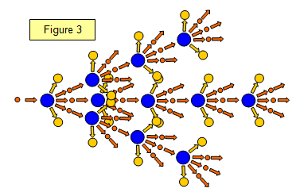
#34 - What is nuclear fission?
T
A
B
L
E
1
A large, unstable nucleus breaking apart into smaller more stable nuclei. Usually initiated by a neutron and results in three additional neutrons being released, sometimes the result is a chain reaction.

Slide 40
#35 - A substance is known to have a density of 1.39g/ml. If you have 10g of this substance, what volume in L would you have?
T
A
B
L
E
2
7.2 x 10⁻³ L

Slide 41
#36 - Which element might form a ion by losing electrons from the s and d orbitals F, S, Li, Ti
T
A
B
L
E
3
Ti

Slide 42
#37 - How many decigrams are in 437 kilograms? Write answer in scientific notation!
T
A
B
L
E
4
4.37x10⁶ dg

Slide 43
#38 - How many significant figures are in the following values? 612 kg 0.00067 ml 309.4 g
T
A
B
L
E
5
612 kg – 3 s.f. 0.00067 ml 2 s.f. 309.4 g 4 s.f.

Slide 44
#39 - What is the atomic radius and its trend on the periodic table? Explain
T
A
B
L
E
6
Measure of the distance from the center nucleus to the outer electron. Smaller left to right larger top to bottom nuclear charge and outer energy levels.

Slide 45
#40 - Order these elements from smallest to largest? Se, S, Cl Na
T
A
B
L
E
7
Cl, S, Se, Na

Slide 46
#41 - Of the elements in the alkaline earth metals which has the highest electronegativity
T
A
B
L
E
8
Beryllium

Slide 47
#42 - Why does it take less energy to remove an electron as you move down a group?
T
A
B
L
E
1
More energy levels, so electron is further from the nucleus, which means the nucleus isn’t able to attract as well.

Slide 48
#43 - Describe the trend for reactivity of halogens.
T
A
B
L
E
2
Reactivity increases as you move UP the periodic table.

Slide 49
#44 - What is the sum of the charges from the following atoms when they form ions? Calcium, nitrogen, and strontium
T
A
B
L
E
3
1
2+(-3)+2 =1

Slide 50
#45 - What is the molar mass for the hydrocarbon C₂₄H₃₇O₆
T
A
B
L
E
4
421.61 g/mol

Slide 51
#46 - Which molecule has covalent bonding and does not require a double or triple bond? CO₂, CO, N₂, CF₄
T
A
B
L
E
5
CF₄

Slide 52
#47 - What is the formula for copper (IV) sulfate?
T
A
B
L
E
6
Cu(SO₄)₂

Slide 53
#48 - What is the name of the compound SrO?
T
A
B
L
E
7
Strontium oxide

Slide 54
#49 - What type of bond forms between two non metals share electrons?
T
A
B
L
E
8
Covalent bond

Slide 55
#50 - What happens to the electrons during a metallic bond?
T
A
B
L
E
1
Sea of electrons, Delocalized electrons,
Free flowing electrons etc.

Slide 56
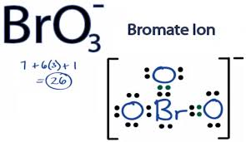
#51 - Draw the Lewis dot structure for BrO₃⁻
T
A
B
L
E
2

Slide 57
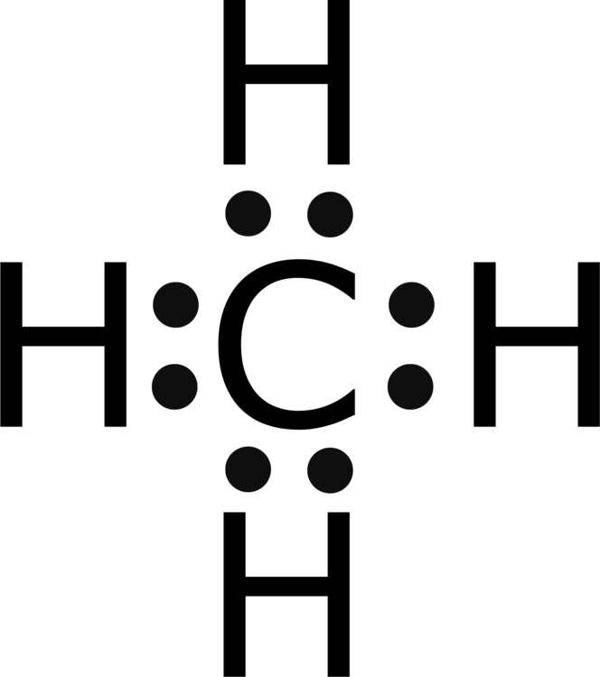
#52 - Draw the Lewis dot structure for CH₄
T
A
B
L
E
3

Slide 58
#53 - What pathway must you take in order to convert grams of substance A to moles of substance B?
T
A
B
L
E
4
Grams → moles A → moles B
Molar Mass of A
Mole Ratio

Slide 59
#54 - What kind of reaction is taking place below? Zn + CuCl₂ → ZnCl₂ + Cu
T
A
B
L
E
5
Single replacement

Slide 60
#55 - Sodium chloride comes apart. Name the type of reaction, predict the products, and balance the reaction.
T
A
B
L
E
6
2NaCl → 2Na + Cl₂
Decomposition

Slide 61
#56 - What kind of reaction is taking place below? Br₂ + FeF₂ → FeBr₂ + F₂
T
A
B
L
E
7
Single replacement

