Slide 1
Things to Remember for Exam #2
Honors Chemistry

Slide 2
#1 When Calculating molarity, the volume needs to have what unit?
Liters (L)

Slide 3
#2 The maximum amount of solute dissolved is called ___________.
Saturated solution

Slide 4
#3 Less than the maximum amount of solute dissolved is called ____________________.
Unsaturated solution

Slide 5
#4 More than the maximum amount of solute dissolved is called ____________________.
Supersaturated solution

Slide 6
#5 The solubility of solids goes __________ as the temperature is increased.
Up

Slide 7
#6 The solubility of gases goes __________ as the temperature is increased.
Down

Slide 8
#7 If you’re trying to make a Diluted solution, you use the equation:
M₁V₁=M₂V₂

Slide 9
#8 When making a diluted solution the water added to the new solution is found by subtracting which two numbers?
Water added = V₂ – V₁

Slide 10
#9 Factors that affect Rate are:
Temperature
Concentration/Pressure
Surface area
Catalysts

Slide 11
#10 Factors that affect Equilibrium position:
Temperature
Concentration/Pressure/Volume

Slide 12
#11 Only _________ changes the equilibrium constant (K_{eq})
Temperature

Slide 13
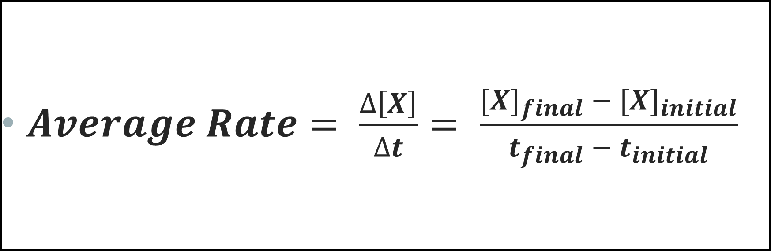
#12 What is Average rate?
$Average Rate= \frac{∆\left[X\right]}{∆t}= \frac{{[X]}_{final} − {[X]}_{initial}}{t_{final} − t_{initial}}$
Delta over Delta!

Slide 14
#13 What is a rate expression?
What is it used for?
Relates rate of a reactant or product to another reactant or product
-Δ[N₂] = -Δ[H₂] = Δ[NH₃]
Δt 3 Δt 2 Δt
N₂ + 3 H₂ → 2 NH₃
Entire thing is the RATE EXPRESSION
REMEMBER!
Reactants are negative, Products are positive.

Slide 15
#14 When you want the rate of one substance but you only have the rate for another substance, you can use the _____to solve for the missing rate.
Practice Q: Solve rate of H₂ in terms of N₂
Rate Expression
N₂ + 3 H₂ → 2 NH₃
3 Δ[N₂] = Δ[H₂]
Δt Δt
-Δ[N₂] = -Δ[H₂] = Δ[NH₃]
Δt 3 Δt 2 Δt

Slide 16
#15 The rate law only includes the concentrations of the _________________.
Reactants!

Slide 17
#16 The equilibrium expression is ___________ divided by ___________
[Products]
[Reactants]

Slide 18
#17 The rate law EXPONENTS ARE CALLED _____. ARE THEY FROM THE BALANCED EQUATION COEFFICIENTS OR FOUND EXPERIMENTALLY?
Orders
FOUND EXPERIMENTALLY!
If they reaction is a single step reaction, then yes they will match…but you have to be told that! Never assume the exponents will be the coefficients!

Slide 19
#18 ARE THE exponents in an equilibrium expression from THE BALANCED EQUATION COEFFICIENTS OR FOUND EXPERIMENTALLY?
Balanced equation coefficients

Slide 20
#19 Solids and liquids Do or Do Not affect equilibrium?
DO NOT!

Slide 21
#20 A LARGE VALUE FOR K INDICATES THAT THE ____________ SIDE IS FAVORED AND A SMALL VALUE FOR K INDICATES THE ___________ SIDE IS FAVORED.
Products (right) – “equilibrium lies to the right”
Reactants (left) – “equilibrium lies to the left”

Slide 22

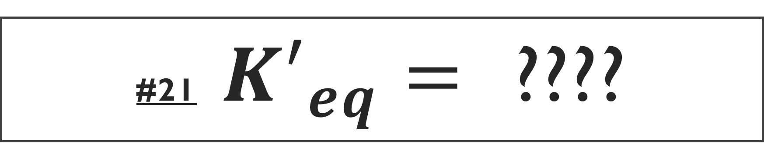
#21 ${K′}_{eq}=$ ????
$$\frac{1}{Keq}$$

Slide 23
#22 If Q is bigger than K, than the reaction will shift to the ___________________.
Left (towards the reactants)
Numerator is too big! You have too many products!

Slide 24
#23 If Q is smaller than K, than the reaction will shift to the ___________________.
Right (towards the products). Denominator is too big! You have too many reactants!

Slide 25
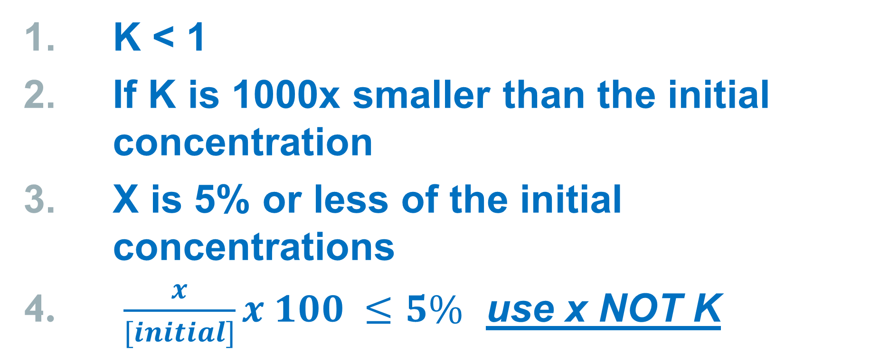
#24 I CAN USE THE 5% RULE WHEN:
K < 1
If K is 1000x smaller than the initial concentration
X is 5% or less of the initial concentrations
$\frac{x}{[initial]}x 100 ≤5\%$ use x NOT K

Slide 26
#25 ALSO…
CAREFUL WITH SCIENTIFIC NOTATION!
CAREFUL WITH METRIC CONVERSIONS!
PUNCH YOUR CALCULATOR CORRECTLY!
USE PARENTHESES!
ANSWER THE QUESTION THAT IS ACTUALLY ASKED!!!
SHOW ENOUGH WORK TO PROVE YOU DID THE PROBLEM…BUT DON’T WASTE ALL YOUR TIME DOING SO!
STUCK? MOVE ON AND COME BACK LATER! CAREFUL ON YOUR BUBBLE SHEET!!!!!
TAKE A BREATH AND JUST ANSWER ONE QUESTION AT A TIME ☺

