Slide 1



Video Link to Presentation

Slide 2
Pre-Labs, Post-Labs &
Post-Lab Two Pagers

Slide 3




Table of Contents - hyperlinks
General Guidelines
Pre-labs
Post-labs
Post-lab Two Pagers

Slide 4



Parts of Lab Work
Pre-labs
  In lab notebook
  Due before lab starts
  (due date posted)
During lab
  In lab notebook
  Data/observations
  (lab done by end of period!
  No late passes to class!
  Work quickly/efficiently!)
Post-labs
  In lab notebook
  Due 1+ day after lab
  (due date posted)
Post-lab Two Pagers
  On printed handout
  Due 1+ day after lab
  (due date posted)

Slide 5


Lab Notebook Rules
ONLY BLACK/BLUE PEN IN LAB NOTEBOOK.
  NO PENCIL or ERASABLE PEN!
Can use color to annotate
  Majority of the writing needs to be in black or blue pen.
Make a mistake?
  Cross out with a SINGLE line.
  NO WHITE OUT – EVER!

Slide 6


Pre-labs – General Guidelines
Done in your Lab Notebook. Will physically turn in Lab Notebook and/or submit photos digitally.
Prelab due prior to the beginning of lab (data tables must be created as part of the prelab, will be filled out later).
You may not participate in a lab without having it completed.
The top of your lab handout will tell you which sections need to be completed each time.

Slide 7

Pre-labs – General Guidelines
Do NOT do extra sections than what is asked for at the top of your lab handout.
Sections must be done in the order listed here unless the lab handout says otherwise.
Sections must be clearly labeled.
Headers must be filled out at the top of each lab, and you must initial and circle your initials in the bottom right-hand corner of every page. The sticker in the front of your lab notebook shows you how to set up the headers.

Slide 8
Pre-labs – General Guidelines
Will sometimes be graded for completion and/or accuracy. Not all completed sections will necessarily be graded every time, one section might be chosen, or all might be chosen for grading.
Professionalism matters – If I can’t read it, if it looks like you did it last minute walking to class, if it looks like you put no thought, effort, care, detail into your work, that will be reflected in your score.

Slide 9
Pre-labs – General Guidelines
Must use adequate spacing between sections to keep your work clear and understandable. Do NOT try to save space. You have plenty of pages in your lab notebook. Clearly communicating your work matters more than saving a few pages in your lab notebook. Worst case, I get you a second lab notebook if you run out of space!

Slide 10
Pre-labs – Section Guidelines
PURPOSE/GOAL/QUESTION OF THE EXPERIMENT
a. State the general chemistry principle being studied.
b. State any specific results to be obtained.

Slide 11
Pre-labs – Section Guidelines
HYPOTHESIS
Must be done BEFORE the lab starts – we never come up with a hypothesis after we do the lab!
Must have the three required parts:
  If _____ (If I add fertilizer to the soil…)
    What are you physically doing in the lab. Be specific. Include chemicals that are being used. Include named techniques you are using.
  Then _____ (…then the tomato plants will grow taller than the plants without fertilizer…)
    What results do you expect to see/obtain? If you have been paying attention to the lessons in class this shouldn’t be hard to predict! Our labs are demonstrating concepts we are learning!
  Because _____ (…because fertilizer has extra nutrients to promote growth than the control soil has.)
    Needs to be a scientific explanation. It is showing you understand what we have learned in class and which scientific principle/concept is the explanation for what you are seeing in lab!
These do not literally have to use the words if/then/because – you can use more sophisticated or varied verbiage if you would like.

Slide 12
Pre-labs – Section Guidelines
PRE-LAB QUESTIONS/TASKS
Complete any listed pre-lab questions.
Number all questions.
Must show all work for calculations.
Do not recopy the question. Paraphrase it into your answers so a reader can infer what the question was.
Full sentence answers are not needed, but complete, detailed and Honors level answers are required!
Box any final numerical or short phrase like answers.

Slide 13
Pre-labs – Section Guidelines
MATERIALS
List all needed chemicals, and equipment in a bullet list.
Yes this will match your lab handout – that is ok.
Make sure you include relevant concentrations, states of matter, etc.

Slide 14




Pre-labs – Section Guidelines
REAGENT TABLE
a. Any chemicals with a * need to be included.
b. Provide the above info for the state (s, l, g, aq) that is being used in the lab. Sometimes
there is different information based on if we are using the solid, liquid, gas form.
c. Note safety/cleanup points (if provided on MSDS – BE DESCRIPTIVE!)
d. We don’t really use physical MSDS books anymore.
This is my “go-to” MSDS site, but if there is a chemical
not listed here then just Google “MSDS” and then the
chemical name, look for a free site that has it.
e. DO NOT squish your information into the table. DO NOT do this at the last minute.
SAFETY MATTERS!

Slide 15
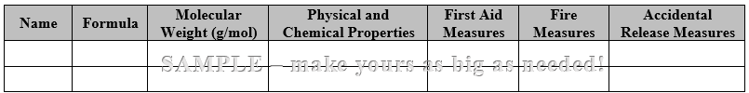
Pre-labs – Section Guidelines
REAGENT TABLE

Slide 16
Pre-labs – Section Guidelines
PROCEDURE
a. Rewrite the procedure in your own words and in FLOW CHART
STYLE! A flow chart is a highly visual representation of information.
It is not a bunch of sentences with boxes around them…
b. Do not copy directly from lab handout!
c. Full sentences not needed.
d. Do not combine steps. Keep the original numbering system in the
lab handout. This is important in case we make changes to the lab,
or if you need help you can tell me which step you are on.

Slide 17
Pre-labs – Section Guidelines
PROCEDURE
e. Included drawings of lab setups when applicable. Label the
drawings and equipment names.
f. Add reminders, equations, notes to yourself, etc.
g. The intention is to think about the steps by putting it in your own
shortened and more visual version.
h. You should be able to do the lab with nothing but your notebook!

Slide 18
Pre-labs – Section Guidelines
DATA TABLE SECTION
a. Setting up data table(s) BEFORE the lab starts is part of your pre-lab. The
setup may be checked even though you won’t be adding data until during
the lab. Finished version checked with Post-Lab.
• I will sometimes show you an example Data Table in the lab handout,
but it is not always a finished table! You must always make sure your
table is complete, has all the required parts, etc. You do not need to set
your table up the same as my sample table necessarily.
b. Must include sections for QUANTATATIVE and QUALITATIVE data.
c. Make it large – does not have to be an entire page, but it needs to be
sufficiently large.

Slide 19
Pre-labs – Section Guidelines
DATA TABLE SECTION
d. Give tables a descriptive title. It should specifically mention any rxn(s) that is
occurring as part of the title.
• If I found your data table on the floor, I should know exactly
which lab it is for.
• Bad titles – Data Table, Lab Data, Temperatures taken,
Taking temperatures of my reaction
• Better titles – Effect of Concentration on Absorbance, pH of Common
Household Substances, Temperature Change for the
Reaction of MgCl₂ + 2Na(OH) → Mg(OH)₂ + 2NaCl
e. Must have labels and units in the headers of the columns/rows.

Slide 20
Pre-labs – Section Guidelines
DATA TABLE SECTION
f. Data collection should reflect the significant figures that are appropriate for
each piece of equipment you are using. Remember that our equipment is
inherently limited in precision!
• Always record data with the appropriate sig figs for that device! Some
devices/equipment have more/less sig figs than others.
• Final calculations will be limited by the smallest number of sig figs from
the equipment. We worry about that when doing the calculations, not
when recording our data.
g. Qualitative observations must be descriptive and detailed. It is not sufficient
to say “it changed colors,” or “it reacted.” Qualitative data is as important as
quantitative data!

Slide 21


Post-labs – Section Guidelines
DATA TABLE SECTION
You started your data tables in your prelab and then filled them out during the lab.
They get turned in with Post-Lab Notebook Work.
Will be looking for:
  Descriptive title, all data recorded, labels and units where needed, data recorded with appropriate sig figs based on the equipment being used, detailed and descriptive qualitative observations, any notes if something went wrong during the lab, etc

Slide 22



Post-labs – Section Guidelines
CALCULATIONS
Not all labs will have calculations. However, if there are ANY calculations happening you need to show them.
Must show ANY calculation or manipulation of numbers done during and/or after the lab. If it is not a direct measurement there should be evidence of it in the calculation section.
Sometimes the results of calculations are also put into your data tables. You still need to show the calculations here!
Even “simple” calculations need to be shown. Includes adding, subtracting, metric conversions, averaging trials, etc.

Slide 23
Post-labs – Section Guidelines
CALCULATIONS
If the lab handout listed specific calculations in a numbered list then make sure to number the calculations in your lab notebook to match the lab handout.
Make sure to give a short label of what you are calculating so I know what the calculation is.
The “flow of work” must be clear – if I can’t follow what you are doing, if it is just random numbers scribbled on the page then I can’t/won’t grade it. Professionalism and clearly communicating thoughts matters even for calculations!
Make sure you include units EVERYWHERE!

Slide 24
Post-labs – Section Guidelines
POST-LAB QUESTIONS
Number all questions.
Do not recopy the question. Paraphrase into your answers so a reader can infer what the question was.
Complete sentences not needed unless asked for. Complete thoughts and answers ARE needed!
If it involves a calculation make sure to show all work, use units, sig figs, label and/or describe what you are doing etc.
Answer with the level of thought and detail expected of your level of chemistry!

Slide 25
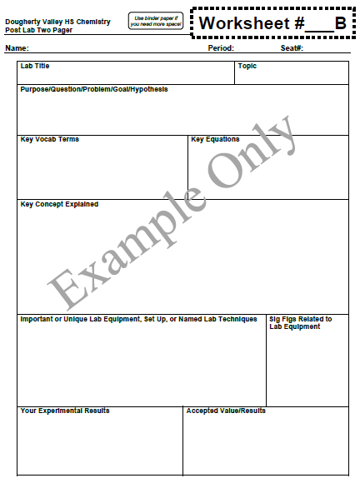
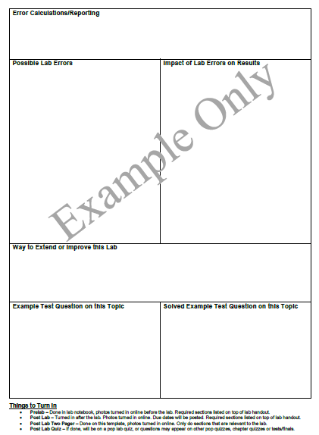

Post-Lab Two Pager – Layout

Slide 26


Two Pager – Section Guidelines
LAB TITLE
a. I am fine if you use the same lab title that is on your lab handout.
b. If you make your own lab title it should still be specific
TOPIC
a. Be careful to tell me the topic not the chapter or subtopic.
• Chapter = big broad category (Thermochemistry)
• Topic = the concept the lab is covering (Calorimetry)
• Subtopic = too specific, a fact or part of the topic (Specific heat)

Slide 27
Two Pager – Section Guidelines
PURPOSE/QUESTION/PROBLEM/GOAL/HYPOTHESIS
a. This should be the same one from your pre-lab, unless you wanted to
improve it.
b. You should have ONE of these, not several. Which one you do
depends on the lab we did!

Slide 28
Two Pager – Section Guidelines
KEY VOCAB TERMS
a. This should be a bullet list of all the key terms related to the topic,
not just words you haven’t heard before!
b. Just list them, you do not need to define them.
KEY EQUATIONS
a. This is where you tell me equations that will be relevant to the lab,
not showing how you do your calculations.
b. Make sure you label the equation so people know what it is for.
Example – Density D = m/V

Slide 29
Two Pager – Section Guidelines
KEY CONCEPTS EXPLAINED
a. Written in complete sentences.
b. This is sometimes called a “Background Paragraph.”
c. It should be a summary of the topic the lab is about.
d. It should read like a very dense little textbook paragraph.
e. If I asked you to tell me everything you have learned about
“Intermolecular Forces” you should pack it full of detail and
specifics! I will be looking for specific key points.
f. You are NOT telling me the procedure of the lab. You should
connect it to the lab at the end of your paragraph.

Slide 30
Two Pager – Section Guidelines
IMPORTANT OR UNIQUE LAB EQUIPMENT, SET UP,
or NAMED LAB TECHNIQUES
a. You are NOT listing your materials section. NOT telling me the procedure.
b. You are showing me any special/new/unique equipment that is important
to the lab, and describing any special techniques that will be used in lab.
c. Label drawings, explain how special equipment works, how you do the
named lab techniques etc
d. Examples – If you are using a digital balance to weigh an object before
and after you do something to that object you would draw a picture of the
balance and explain that you will be “weighing by difference”

Slide 31
Two Pager – Section Guidelines
SIG FIGS RELATED TO LAB EQUIPMENT
a. Report how many sig figs the each piece of lab
equipment had and which one limited the sig figs in your
calculations.
b. Example – Digital Balance = 5 SF,
Graduated Cylinder = 4 SF, limited by graduated cylinder
c. Your calculations should reflect the appropriate number
of sig figs based on the equipment used in lab.

Slide 32
Two Pager – Section Guidelines
YOUR EXPERIMENTAL RESULTS
a. List the final results you obtained.
• You are NOT listing all your data or individual trials – we average
trials together, we don’t report every single one.
b. Include all relevant results. Often students will be testing multiple
things and only report one of the results.
c. Clearly label what your results are and have units on them. Do NOT
just put a number in the box.
d. Your experimental results may not always be numerical.
That is fine! Depends on the lab.

Slide 33
Two Pager – Section Guidelines
ACCEPTED VALUE/RESULTS
a. What value/result should you have gotten? What is
considered the “correct” answer?
b. This will either be given to you in the lab handout, during class,
or you will look it up online.
c. It is fine if you didn’t get this! Your experimental results don’t
always match the accepted ones - labs aren’t perfect!

Slide 34
Two Pager – Section Guidelines
ERROR CALCULATION/REPORTING
a. Sometimes we calculate Percent Errors, or Percent Yields, or
describe in words what the error was, etc.
b. If it is a calculation (percent error, percent yield, etc) then make
sure to show the calculation.
c. If it is not a calculation make sure you are being detailed in
your written description.

Slide 35
Two Pager – Section Guidelines
POSSIBLE LAB ERRORS
a. This is one of the hardest and most important sections.
Take it seriously!
b. Number the errors so that you can refer to them easily in the
next box.
c. I will be looking for very specific key errors that are “big deals” to
the lab. Yes, you have figure out what those are!
d. Do not ever say “human error” – that isn’t a “thing!” Obviously we
are humans, not aliens or cats.

Slide 36
Two Pager – Section Guidelines
POSSIBLE LAB ERRORS
e. ONLY say errors that did or may have reasonably happened. If you
didn’t knock over your beaker, or mix up your test tubes, of have
Godzilla come break your scale, don’t list those as error!
Don’t list all sorts of crazy things!
f. You are listing errors that are built into the way we did the lab or
things that truly happened. Example – We did not maintain a
constant temperature during the reaction, we did not specify how
long to let the reaction stir for, we did not use real filter paper when
filtering our product we just used coffee filters, etc.

Slide 37
Two Pager – Section Guidelines
POSSIBLE LAB ERRORS
g. If you list a source of error you should be able to brainstorm a way to fix it!
Example – change lab procedure to specify how long to stir the rxn for, use
better filter paper to trap more particles, etc. I can/will ask you for your ideas!
h. If you really did make an error that is ok – as long as you tell me about it. If you
forgot to heat your reaction like the procedure said then list that. But make sure
you can tell me what affect that might have had on your final results. Example –
reaction mixture was not heated, you should be able to tell me that means you
will make less product if I ask you. AND you should be more careful next time!
• If an error you make ever impacts your data to the point that it is useless -
you will either get data from another group or use sample data that I
provide. Talk to me and we will decide which is best based on which lab it is.

Slide 38
Two Pager – Section Guidelines
MATHEMATICAL IMPACT OF LAB ERRORS
ON RESULTS
a. One of the other hardest and most important sections!
Take it seriously!
b. For each error you listed in your Lab Error box you need to tell
me what the impact on your results were.
• Example: If Error #1 was that some of your solid product
slipped under the filter paper then your Mathematical Impact
box would say: Error #1 = Final yield of product will be lower
than accepted.

Slide 39
Two Pager – Section Guidelines
EXAMPLE TEST QUESTION ON THIS TOPIC
a. Brainstorm a question related to the lab topic that you think I might put on a
quiz/test.
b. You may NOT copy the question from a worksheet or the internet. Copying results
in a zero. Do not try to play games and “paraphrase” it by changing one word…that
counts as plagiarizing too! Actually think of your own question.
c. Write the Q out exactly as it would be on a quiz or test – if it needs data then make
up fake numbers and include them.
d. Make sure your question shows sufficient depth and complexity so that I can tell
that you have learned what is important from this chapter! Do NOT just say
something like “tell me everything you know about intermolecular forces.” Do NOT
say something specific to the lab like “what was the molar mass of the unknown in
the lab?”

Slide 40
Two Pager – Section Guidelines
SOLVED EXAMPLE TEST QUESTION ON THIS TOPIC
a. Show all your work and solve the question you came up with. If it is not a math question that is ok, but give a through and detailed answer with key terms/phrases etc.

