Slide 1
Things for Lab Set Ups

Slide 2
Unit 1 – Chemistry Basics and Atomic Structure

Slide 3
Types of Changes/Properties Card Sort

Slide 4
Phys/Chem Changes/Props Card Sort
Cards in Activity Cupboard
Physical Prop | Chemical Prop. | Physical Change | Chemical Change | Separation Techn
8 | 5 | 8 | 13 | 4
Color | Ability to rust | Melting | Change in color | Distillation
Density | Smell | Tearing | Corrode | Filtration
Solid | Taste | Freeze | Produces odor | Crystallization
Liquid | No rxn to acid | Cut | Burn | Chromatography
Shape | Corrosive resistant | Boiling | Explode
Light weight |  | Breaking | Produce gas
Conducts heat |  | Vaporize | Rusting
White |  | Candle wax melting | Candle Burning
 |  |  | Mold Growing
 |  |  | Oxidize
 |  |  | Forms precipitate
 |  |  | Fermentation
 |  |  | Apple turning brown

Slide 5
Isotopes of Pennies

Slide 6
PRE-1982 = 3.11g POST-1982 = 2.5g
Container # | Mass of Empty Container (g)
1 | 8.1187
2 | 7.6484
3 | 7.8361
4 | 7.8835
5 | 8.0357
6 | 8.0336
7 | 7.8451
8 | 7.5627
Container # | Mass of Empty Container (g)
9 | 7.9787
10 | 8.0644
11 | 7.9453
12 | 8.0522
13 | 7.8718
14 | 7.6190
15 | 7.9929
16 | 7.9297

Slide 7
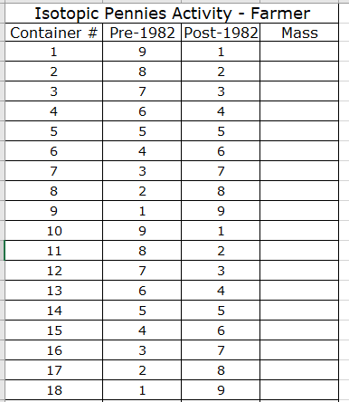
Isotopes of Pennies
Canisters in Activity Cupboard

Slide 8
Isotopes of Pennies
Canisters in Activity Cupboard

Slide 9
Unit 2 – Nuclear Chem

Slide 10
Detecting Ionizing Radiation with Cloud Chamber

Slide 11
Cloud Chamber
Canisters in Activity Cupboard
Isopropyl alcohol
Pipette
Flashlight
Gas lantern mantle
Cloud chamber
Dry Ice
Lantern Mantles from Carolina
Item: SPEC39822
Item description: Lantern Mantle
Price: $7.95 Each
Special Order so MUST CALL to order:
1 (800) 334-5551

Slide 12
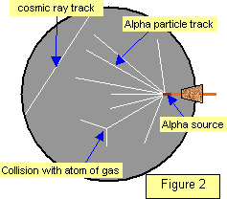
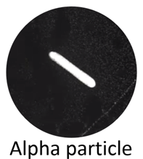
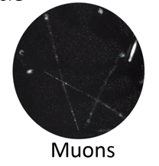
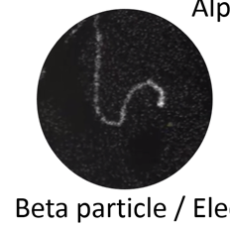
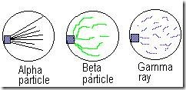

Slide 13
https://www.youtube.com/watch?v=pewTySxfTQk&feature=youtu.be
https://www.youtube.com/watch?v=e3fi6uyyrEs
https://www.symmetrymagazine.org/article/january-2015/how-to-build-your-own-particle-detector
Show if cloud chambers don’t work

Slide 14
Neat extension about cosmic rays and trying to find dark matter
https://www.sciencefriday.com/educational-resources/build-a-cloud-chamber/
If you’re looking for dark matter, background radiation is a major problem
Physicists have evidence that in addition to the known subatomic particles that make up most of the things we can see and touch, there is an entirely separate class of very small, potentially weakly interacting particles that make up the majority of our universe called dark matter. Though it comprises over 90 percent of our galaxy, dark matter is poorly understood.
Dark matter is difficult to study because it’s made of unimaginably small particles that we can’t see, and it interacts with other atoms very rarely. Detecting dark matter interactions that are so minute and rare is made especially difficult because they are grossly overshadowed by the background radiation that is constantly pouring down on our planet from cosmic rays. Our planet’s background radiation makes the search for dark matter like trying to hear a shy, whispering child in a party of shouting adults. Science Friday’s video producer, Luke Groskin, visited with scientists looking for dark matter, who describe this conundrum in the video “4850 below.”
Science Friday Documentary: “4850 Below”
In an effort to quiet the “noise” of background radiation, a long-running dark matter experiment called the LUX dark matter experiment (LUX stands for Large Underground Xenon) was built inside a giant water tank in an old mine a mile below the surface of the earth. The tank of water and mile of rock and dirt shield the experiment from background radiation by effectively putting a lot of other atoms – in the form of lots of dense materials like rock and water – between sources of radiation and the experiment.
https://www.youtube.com/watch?v=YxMGWQMoR10&feature=youtu.be

Slide 15
Unit 3 – Electrons

Slide 16
Flame Test

Slide 17
Flame Lab
SPRAY BOTTLES NEEDED
Calcium Chloride | CaCl₂
Copper (II) Chloride | CuCl₂
Barium Chloride | BaCl₂
Potassium Chloride | KCl
Sodium Chloride | NaCl
Lithium Chloride | LiCl
Strontium Chloride | SrCl₂
Calcium Nitrate | Ca(NO₃)₂
Copper (II) Nitrate | Cu(NO₃)₂
Barium Nitrate | Ba(NO₃)₂
Potassium Nitrate | KNO₃
Sodium Nitrate | NaNO₃
Lithium Nitrate | LiNO₃
Strontium Nitrate | Sr(NO₃)₂
UNKNOWN #1 | Cu(NO₃)₂
UNKNOWN #2 | Sr(NO3)₂
Bunsen burner
Gas hose
Matches
50 mL beaker with a little water in it.
Cardboard dividers to protect the wall.
TURN GAS ON!
Plenty of paper towels in the room
Lysol spray to clean desks with

Slide 18
Flame Lab Preparation
0.1 M for all solutions
Compound | Formula | Molar Mass | Grams Needed to Make 1 L of 0.1 M
Calcium Chloride | CaCl₂ | 110.98 g | 11.01 g
Copper (II) Chloride | CuCl₂ | 134.45 g | 13.45 g
Barium Chloride | BaCl₂ | 208.23 g | 20.82 g
Potassium Chloride | KCl | 74.55 g | 7.45 g
Sodium Chloride | NaCl | 58.44 g | 5.84 g
Lithium Chloride | LiCl | 42.39 g | 4.24 g
Strontium Chloride | SrCl₂ | 158.53 g | 15.85 g
Calcium Nitrate | Ca(NO₃)₂ | 164.09 g | 16.41 g
Copper (II) Nitrate | Cu(NO₃)₂ | 187.56 g | 18.78 g
Barium Nitrate | Ba(NO₃)₂ | 261.34 | 26.1 g
Potassium Nitrate | KNO₃ | 101.10 g | 10.11 g
Sodium Nitrate | NaNO₃ | 84.99 g | 8.50 g
Lithium Nitrate | LiNO₃ | 68.95 g | 6.90 g
Strontium Nitrate | Sr(NO₃)₂ | 211.63 g | 21.16 g
UNKNOWN #1 | Cu(NO₃)₂ | 187.56 g | 18.76 g
UNKNOWN #2 | Sr(NO3)₂ | 211.63 g | 21.16 g
Rinse 1 L volumetric flask with distilled water.
Weigh out the needed grams in a weigh boat.
Put solid into a 250 mL beaker.
Add DI water to dissolve.
Transfer to volumetric flask using a funnel.
CAREFULLY add DI water until the bottom of the meniscus touches the etched line on the neck of the volumetric flask. Use your squirt bottle to go carefully at the end!
Pour into a 1 L jug, cap jug, and invert to make sure it is mixed

Slide 19
BE SAFE.
NO 2ND CHANCES.
NONE.
Spray at a slight upward angle.
AWAY FROM PEOPLE.
Don’t waste chemicals!
NO WALKING AROUND THE ROOM!
GET QUIET WHEN YOU HEAR THE DOORBELL!
CLEAN UP
Make sure gas is OFF
Wipe down table really well

Slide 20
When done with the lab for the year –
Disassemble tubes, nozzles
Soak them in water
Rinse with DI water
Reassemble the tubes to the nozzles and put the tube into a beaker of distilled water. Spray several times to clear the whole system with DI water.
Reattach the tube/nozzle to the bottles.
Hang them on the edge of the tub so they stay upright.
Refill any that need refilling. Filling ½ -3/4 full is plenty

Slide 21
Unit 4 – Periodic Table

Slide 22
Periodic Trends
Chemicals needed:
Magnesium ribbon
Calcium metal chunks
Phenolphthalein bottles x8
1.0 M HCl
Weigh boat
Distilled water bottle
50 mL beakers – x4
125 mL Erlenmeyer flask – green tape
Pipette – green tape
Metal forceps

Slide 23
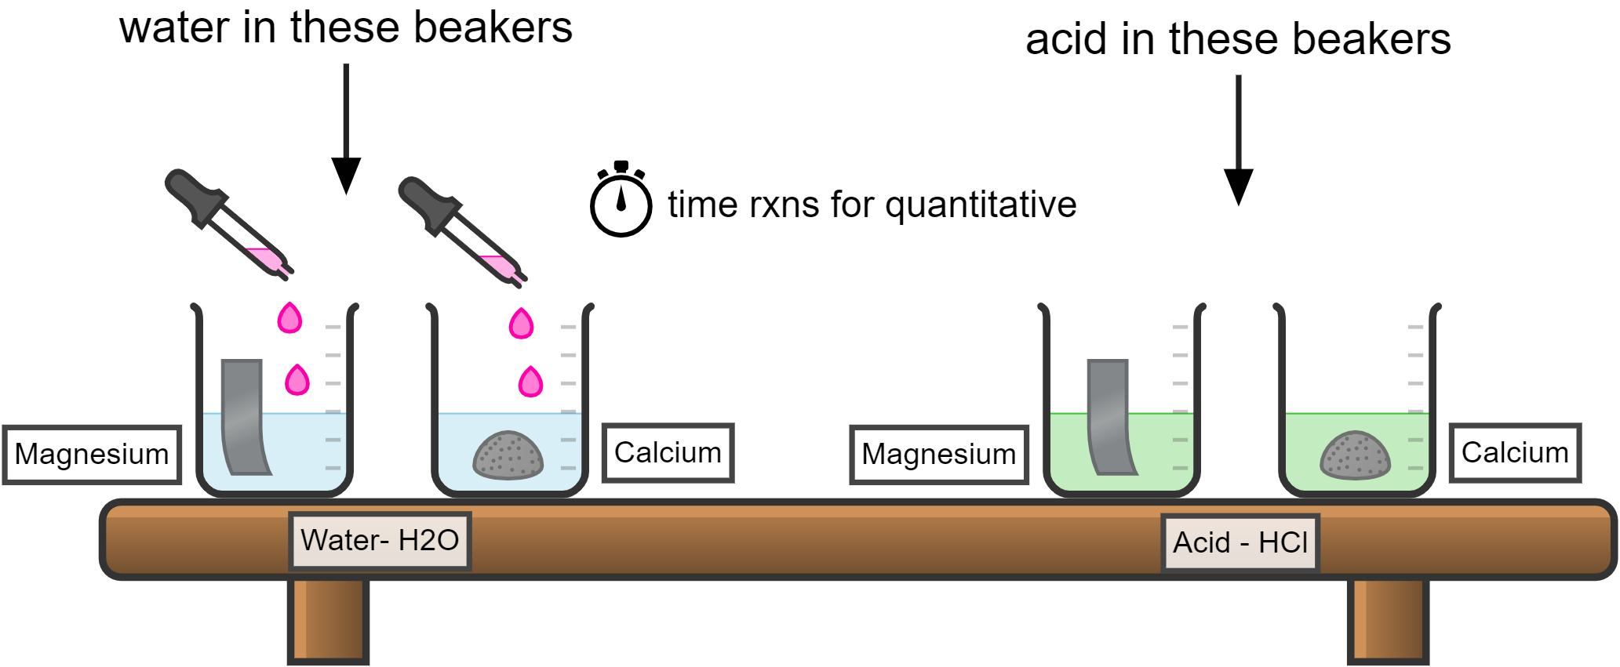
Liquids – down the drain with running water
Solids – in trash can – use forceps or paper towels, not your hands!

Slide 24
Unit 5 – Bonding and Structure

Slide 25
Unit 6 – Reactions

Slide 26
Types of Reactions Unit 2 – Reactions

Slide 27
Reactions Lab
CHEMICALS NEEDED
CuSO₄
0.15M SrCl₂
0.25M Na₂CO₃
Test Tube
Paper Clip – 1/period
Steel wool
White paper
100mL beaker x 1
50mL beaker x3
One with red tape, one with green tape, one with blue tape
Pipette x 3
One with red tape, one with green tape, one with blue tape
Graduated Cylinder
Squirt bottle H₂O
Bunsen Burner
Bunsen Burner Hose
Tongs
Gold paper with Reading

Slide 28
Unit 7 – Stoichiometry

Slide 29
Unit 8 – Advanced Chemical Ratios

Slide 30
Limiting Reagent Stoichiometry Lab

Slide 31
Limiting Reagent Stoichiometry Lab
Pipette with red tape
Pipette with yellow tape
150mL Beaker with red tape
150mL Beaker with yellow tape
One 50mL Beaker with purple tape per period (Farmer = 2, Kerr = 4)
Extra weigh boat for each period (Farmer = 2, Kerr = 4)
Filter paper for each period (Farmer = 2, Kerr = 4)
Scale
Distilled water bottle
Hot plate
Small graduated cylinder
Buchner funnel
Filter flask with hose
Rubber collar
Metal Scoopula

Slide 32
15 mL of each solution | x 8 groups | x 10 periods | = 1200 mL needed
1 L SrCl2 | 0.15 mol | 158.53 g | = 23.7795 g
 | 1 L | 1 mol | To make 1 L
1 L Na2CO3 | 0.25 mol | 105.99 g | = 26.4975 g
 | 1 L | 1 mol | To make 1 L

Slide 33
Sodium Carbonate Na₂CO₃ in RED
Strontium Chloride SrCl₂ in YELLOW
How to label Weigh Boat and Purple Beaker: 4th period BENCH #1
150mL beaker
Weigh Boat
15mL each
50 mL beaker
Hook up to aspirator
150mL beaker
Put in oven overnight

Slide 34
Combustion Analysis Lab

Slide 35
Combustion Analysis Lab
Each Lab Station Needs:
White tray
Magnesium Ribbon
Clay triangle
Bunsen burner
Bunsen burner hose
Balance
Crucible tongs
Wire gauze
Crucible and lid
Scissors
Ring stand
Ring clamp
Matches
Watch glass

Slide 36
Unit 9 – Gas Laws

Slide 37
Gas Law Stations Activity

Slide 38
Gas Stations Activity
CHEMICALS NEEDED
Cans
Marshmallows
Alka Seltzer
Balloons
Tea Candles
#1 – get several cans going at once Graduated cylinder Hot Plates x 3 Beaker Tongs Large beaker with water | #2 Cartesian Diver | #3 Marshmallows Syringe
#4 2L soda bottle Strip thermometer Fizz keeper | #5 Metal pie pan Food coloring Tea Candle Matches 100 mL beaker | #6 – set up two station #6’s (It’s the slowest station) Alka Seltzer Mortar pestle Balloon Erlenmeyer flask Scale Scissors Metal scoop

Slide 39
Molar Mass of Butane Lab

Slide 40
Molar Mass of Butane Lab
Each Lab Bench Needs:
White Tray
Thermometer
Plastic tub
Butane Lighter
50mL Graduated Cylinder
Scale
https://www.youtube.com/watch?v=joBSZi520Wc
https://www.youtube.com/watch?v=JlxyfE6YnsU&t=633s

Slide 41
Unit 10 – Thermochemistry

Slide 42
Calorimetry Lab

Slide 43
Calroimetry Lab
Brass
Aluminum
Lead
Steel
Calorimeter
Thermometer
Hot plate
Scale
Metal cube
100mL graduated cylinder
500mL beaker with water boiling

Slide 44
Q = mCΔT
Purpose of the lab: Solve for C (specific heat) of a metal
Energy absorbed→ Q = +
Energy released → Q = -
ENERGY IN = ENERGY OUT
beaker
calorimeter
Q_{metal} = -
Q_{water} = +
Q_{metal} = +
Q_{water} = -
Hot Water
Cold Water
Metal is heating up
Water is heating up
Energy transfer into METAL
Energy transfer into WATER

Slide 45
Q_{water} =
m_{water} =
C_{water} =
ΔT_{water} =
Q_{metal}=
m_{metal} =
C_{metal} =
ΔT_{metal} =
?
-Q_{water}
Energy IN must = energy OUT!
(opposite sign, not necessarily negative)
From the water you put in the calorimeter
1mL = 1g
From your scale
?
4.184 J/g°C
Tf – Ti
-
Tf – Ti
(From your thermometer readings)
Tf
From water
100°C
From boiling
(At the end the metal and water will be same temp)
(The metal was put in the boiling water so it reached 100°C)

Slide 46
Unit 11 – Solutions

Slide 47
Serial Dilution Lab

Slide 48
Serial Dilution Lab
Blue Stock Solution
Blue food coloring added to beaker of water until dark blue. 10drops/L
70 mL per group = 560 mL per period
620 nm
2023 Accepted Absorbance Values:
1.00 M = 0.636
0.70 M = 0.445
0.40 M = 0.064
2024 Accepted Absorbance Values:
1.00 M = 0.636
0.70 M = 0.445
0.40 M = 0.064
100 mL grad cylinder
150-250 beakers x3
100 mL beaker x1
100 mL volumetric flask
Pipette
Funnel
DI water bottle
Kim Wipes
Spec
Cuvette
DI water bottle up front with large beaker for rinsing cuvette

Slide 49
Jumpstart
Get WS #7 out and start reading and highlighting it! Stop when you get to the procedure.
Once we have talked about the procedure then you will do the calculations to determine what volumes you will need during the lab.

Slide 50
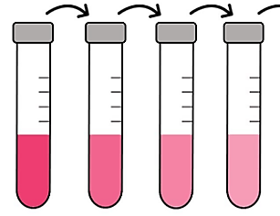
70 mL
57.14 mL
25 mL
1.0 M “Stock”
0.7 M
0.4 M
0.1 M

Slide 51
Unit 12 – Kinetics

Slide 52
Kinetics Lab Iodination of Acetone

Slide 53
Kinetics Lab
4.0M ACETONE
Each class period needs: 320mL
294mL → add water to 1000mL
1.0M HCl
Each class period needs: 320mL
82.6mL 12M HCl → add water to 1000mL
0.0050M IODINE SOLUTION
Each class period needs: 448mL
1.27g Iodine crystals → add Isopropyl Alcohol until 1000mL
Stir on stir plate, heat to 50C to help dissolve
10mL graduated cylinder
125mL Erlenmeyer flask
100mL beaker
400 mL beaker x 3
Pipettes x 3
Distilled water bottle
Stop watch
4M acetone
1M HCl
0.0050 M iodine in isopropyl alcohol

Slide 54
Jumpstart
Grab the lab handout from the teal cart and START READING IT!!!!!!!

Slide 55
Sample Data for Iodination of Acetone Kinetics Lab
Trial | Time | Rate
1 | 92 sec | 5.43 x 10⁻⁶ M/sec
2 | 151 sec | 6.62 x 10⁻⁶ M/sec
3 | 184 sec | 8.15 x 10⁻⁶ M/sec
4 | 264 sec | 9.35 x 10⁻⁶ M/sec

Slide 56
Unit 13 – Equilibrium

Slide 57
Equilibrium of CO2

Slide 58
Equilibrium Lab
BUY DRY ICE!!!!!!!!!!
100mL beaker x2
50mL beaker
White piece of paper
Squirt bottle of universal indicator
Dry ice
Hot plate
Hot plate cord
Tongs
Syringe w/ cap and nail
1M HCl
0.0050 M iodine in isopropyl alcohol

Slide 59
Unit 14 – Acid Base

Slide 60
Salts Activity

Slide 61
Salt Activity
3 small beakers
3 stir rods
pH paper
pH paper color key
0.1 M solutions
NaC2H3O2
NaHCO3
NH4Cl

Slide 62
Titration Lecture

Slide 63
Titrations
8 tables x 4 trials per table
x 12 period
= 384
NaOH - _0.1__M HCl = __0.1___M
384 x ___5mL____amount of NaOH needed to reach end point = __1.9 L__ NaOH to make (round up)
384 x ____5mL___amount of HCl in each flask to titrate = ___1.9 L____ HCl to make (round up)
8x burettes
8x burette clamps
8x ring stands
8x small beaker to keep under burette
8x 125mL flasks for HCl
8x Pheno bottles
8x Distilled water bottles
Funnel for NaOH (teacher only!)
2x small Graduated cylinder up front for HCl into their flask
2x 400mL beaker up front with HCl
2x Pipettes up front for HCl

