Slide 1
Lab Techniques

Slide 2
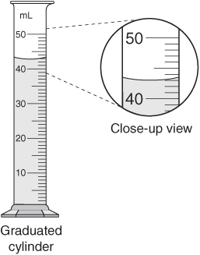
Using a graduated cylinder
Read from EYE LEVEL and from BOTTOM of MENISCUS

Slide 3
Volume of an irregular object???
Measure volume by water displacement
10 mL
30 mL
30 mL
- 10 mL
20 mL
= object volume!

Slide 4
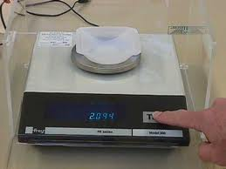
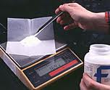
Using a digital scale
Make sure to hit the TARE button on the scale! Sometimes it is called the ZERO button
NEVER weigh chemicals directly on the plate. Make sure to use some container or piece of weigh paper.
Added too much of the chemical to the scale? DO NOT PUT BACK IN THE JAR!!! NO CONTAMINATION!

