Slide 1
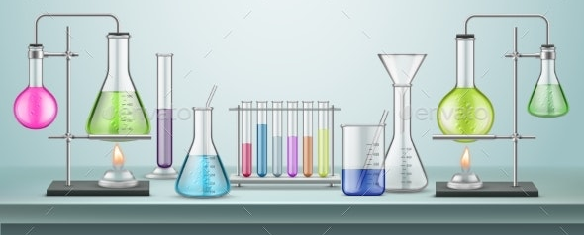
Common Laboratory Techniques
DVHS Chemistry – Mrs. Farmer

Slide 2
Table of Contents
Calorimetry
Using a volumetric flask
Making a solution
Performing a Serial Dilution
Setting up and Reading a Burette
Performing a titration
Gravimetric Analysis
UV-VIS Spectroscopy
Chromatography
Fractional distillation
% Comp/Formula of a Hydrate
Common Lab Equipment
Using a Graduated Cylinder
Volume of an Irregular Object
via Water Displacement
Using a digital scale
Weighing by difference
Lighting a Bunsen burner
Flame tests
Vacuum filtration
Collecting gas over water

Slide 3
COMMON LAB EQUIPMENT

Slide 4
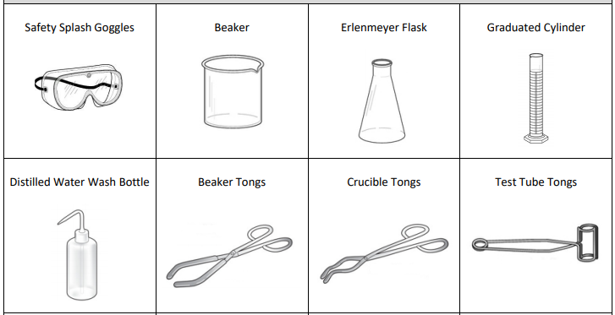
Common lab equipment
Slide #1 of 5

Slide 5
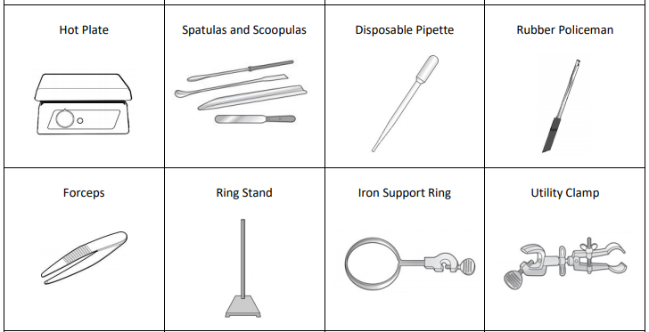
Common lab equipment
Slide #2 of 5

Slide 6
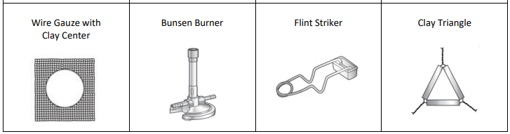
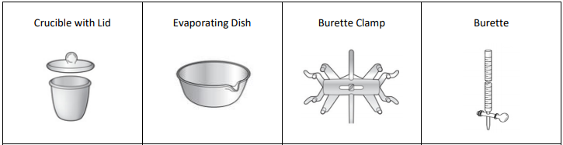
Common lab equipment
Slide #3 of 5

Slide 7
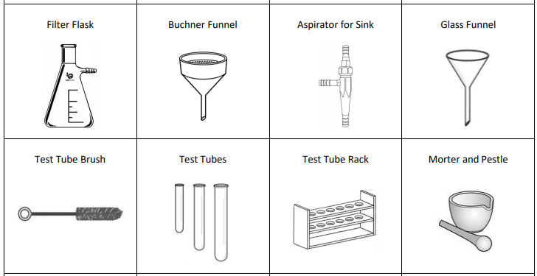
Common lab equipment
Slide #4 of 5

Slide 8
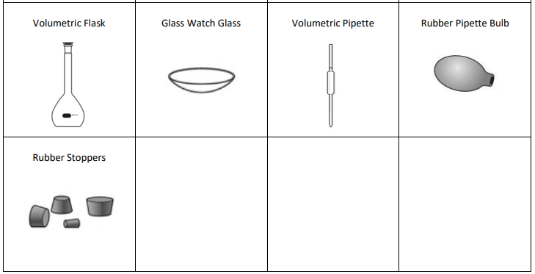
Common lab equipment
Slide #5 of 5

Slide 9
USING A GRADUATED CYLINDER

Slide 10
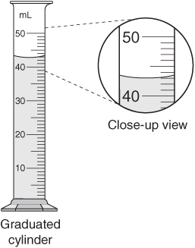
Using a graduated cylinder
Read from EYE LEVEL and from BOTTOM of MENISCUS

Slide 11
Using a graduated cylinder
This would be: 42.9 mL
It is somewhere between 42 and 43, my best guess is that it is 42.9 which means the 9 is my uncertain digit.
Always report one more digit than what you see on the cylinder markings – that last digit is your estimated, uncertain digit.

Slide 12

Using a graduated cylinder
https://youtu.be/eUIcebi1GVc

Slide 13
VOLUME OF AN IRREGULAR OBJECT VIA WATER DISPLACEMENT

Slide 14
Volume of an irregular object
Measure volume by water displacement
10 mL
30 mL
30 mL
- 10 mL
20 mL
= object volume!

Slide 15
Volume of an irregular object
Measure volume by water displacement
https://youtu.be/eUIcebi1GVc
(start at minute 3:09)

Slide 16
USING A DIGITAL SCALE

Slide 17
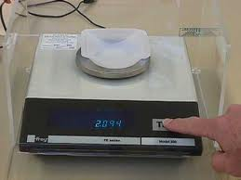
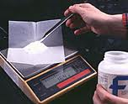
Using a digital scale
Make sure to hit the TARE button on the scale! Sometimes it is called the ZERO button
NEVER weigh chemicals directly on the plate. Make sure to use some container or piece of weigh paper.
Added too much of the chemical to the scale? DO NOT PUT BACK IN THE JAR!!! NO CONTAMINATION!

Slide 18
Using a digital scale
https://youtu.be/1vXGrTDN8sc

Slide 19
WEIGHING BY DIFFERENCE

Slide 20
Weighing by difference
This time do NOT hit Tare on the scale.
This time weigh the object/container
BEFORE you do something (like add or remove chemicals)
Then weight the object/container AFTER you do something.
Subtract the two numbers to find how much you added or removed.

Slide 21
Weighing by difference
https://youtu.be/1vXGrTDN8sc

Slide 22
LIGHTING A BUNSEN BURNER

Slide 23
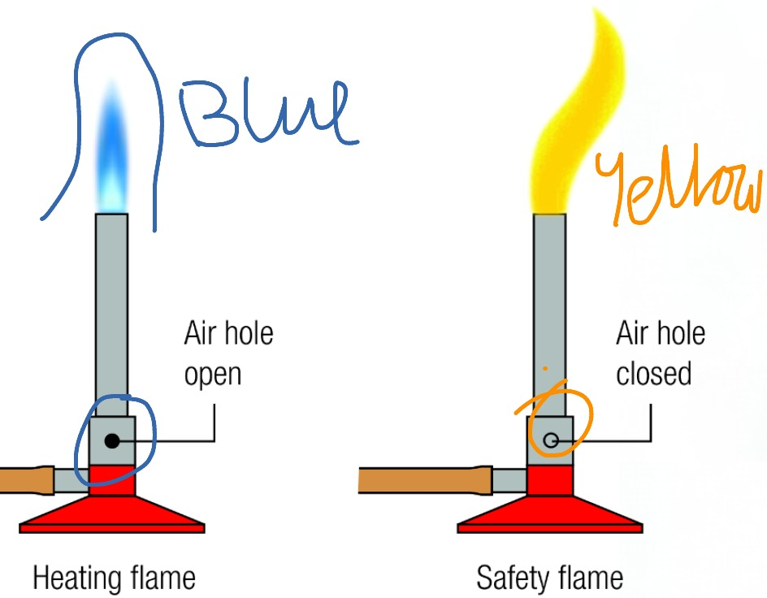
Lighting a Bunsen Burner
Connect the gas hose to the valve on the lab station.
Make sure the air regulator on the bottom of the Bunsen burner is open a little bit but not all the way.
Get your match or striker ready
Turn on the gas
Bring the match or striker close to the
Bunsen burner
  Do NOT have your hand up above the
  Bunsen burner…the flame goes up!
  Have your hand approaching from down below.
Gradually open the air regulator so that the flame
will turn from a yellow to more blue.
  A blue flame is hotter.

Slide 24
Lighting a Bunsen Burner
https://youtu.be/N7ssCM3qM3U

Slide 25
FLAME TESTS

Slide 26
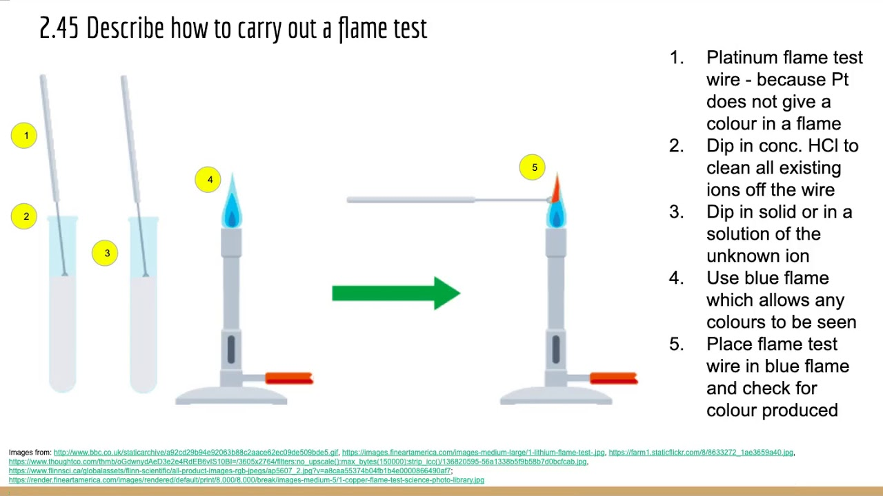
Flame Tests
*Important to use a blue flame on the Bunsen burner because it is hotter than an orange/yellow flame!

Slide 27
Flame Tests
https://youtu.be/1EXr_L7Ojqg

Slide 28
VACUUM FILTRATION

Slide 29
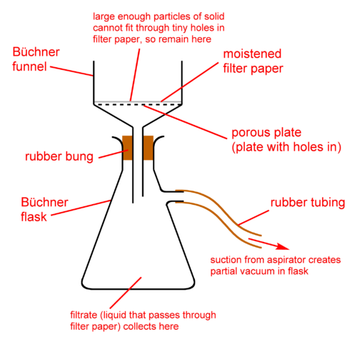
Vacuum Filtration
Vacuum filtration helps us filter a solid out from a liquid a lot faster than using just a normal funnel.
We attach the funnel to a Buchner flask which attaches to a hose, and the hose is attached to an aspirator on the sink faucet.
When you turn the water to the sink on, the water flows through the aspirator into the sink. This causes suction and a partial vacuum inside the flask.
The pressure in the flask ends up lower than in the room and so the higher air pressure helps push the liquid down through the filter paper into the flask.
Rubber stopper

Slide 30
Vacuum Filtration
https://youtu.be/1E4YmuSY4Ek

Slide 31
COLLECTING GAS OVER WATER

Slide 32
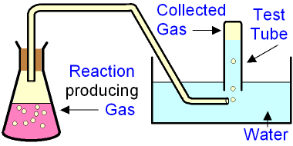
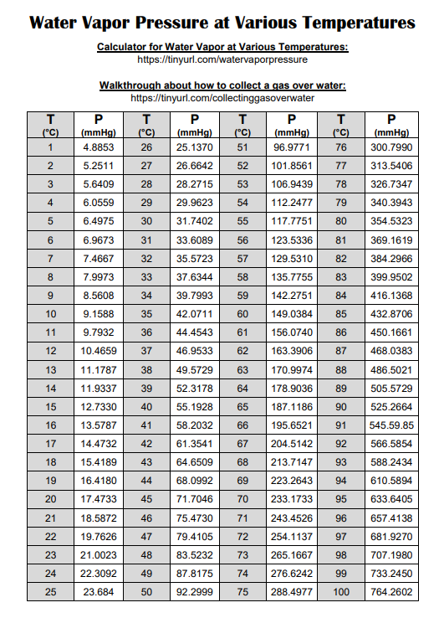
Collecting Gas Over Water
When you collect gas over water there is water
vapor mixed in with the gas you are trying to collect.
You need to subtract out the pressure that is
coming from the water vapor so you can find
the pressure that is just from the gas you are interested in.
You find the water vapor pressure from a chart. Take the temperature of the water and you find that row on the chart.
Gas + water vapor = “wet gas”
Gas with no water vapor = “dry gas”
P_{dry gas} = P_{wet gas} – P_{H2O Vapor}

Slide 33
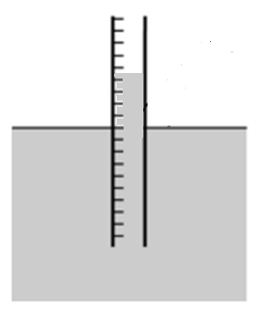
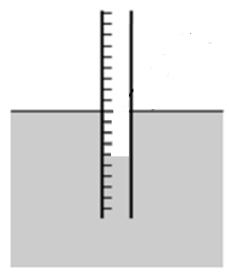
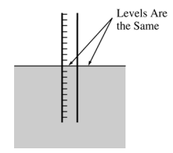
Collecting Gas Over Water
If you line up the water level line of the collection container, with the water level line of the water bath, then the pressure inside the collection
container will be the SAME as the pressure in the room!
Water lines don’t match, pressure inside not the same as pressure outside!
Water lines match, pressure inside is the same as pressure outside!

Slide 34
Collecting Gas Over Water
https://youtu.be/_C4tjmekAs0
*you should use a deep enough water basin so you can make the water line in the cylinder line up with the water in the basin – this makes the pressure inside and outside the cylinder equal. Important if you are doing calculations!

Slide 35
Collecting Gas Over Water
Common Mistakes
Not lining up water lines
  Pressure inside tube will not match the atmospheric pressure in the room
Using a soluble gas
  Results in less gas being collected since some will be dissolved in the water
Forgetting to take the temperature of the water bath
  Won’t have the temperature to plug into calculations
Not subtracting the pressure of the water vapor
  Results in pressure of desired gass *appearing* too high

Slide 36
Collecting Gas Over Water
Common Applications
Collecting gases that form in reactions like
Mg + 2HCl → MgCl₂ + H₂ (g)
2KClO₃ → 2KCl + 3O₂ (g)
Important to Remember
Take the temperature of the bath to get the temperature of the gas.
Use room temperature water for the bath.
  Gas solubility is minimized if you do not use cold water.
The volume of the gas must be read where the volume inside the eudiometer is at the same level as the water outside the bath.
  Allows the pressure inside to be equal to the atmospheric pressure
Pressure of atmosphere = Pressure of gas + Pressure of water vapor

Slide 37
CALORIMETRY

Slide 38
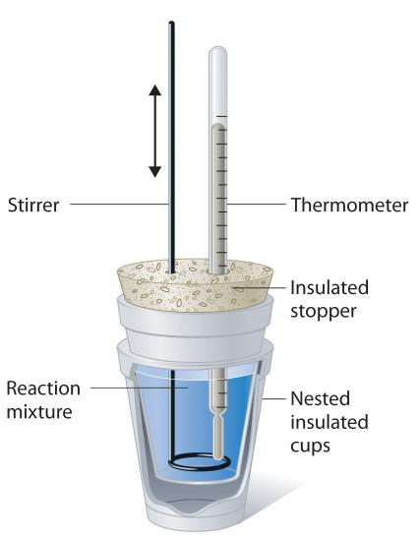
Calorimetry
Calorimetry exploits the fact that energy cannot be created or destroyed, it is only transferred. So if one object cools down, something else must have absorbed that energy.
We say Q_{absorbed} = -Q_{released}
Same magnitude but opposite in sign because one is absorbing and one is releasing.
If you put your object/substance in water, you can easily measure the change in temp of the water which allows you to calculate the energy the water absorbed or released.
Once you know how much energy the water absorbed or released you now know how much the object/substance released to the water or absorbed from the water.
We use insulated containers so the water traps as much of the energy as possible, we don’t want to lose energy to the surroundings!

Slide 39
Calorimetry
https://youtu.be/-VQEeqLVpGo

Slide 40
Calorimetry
Common Mistakes
Mixing up T_{final} and T_{initial}
  The final temperature is the highest (for exothermic)
  or lowest (for endothermic) temperature recorded during the rxn/process
Not stirring enough - hotter/colder in some parts of solution
Endothermic reaction: temperature doesn’t change enough
  Heat was absorbed by reaction from calorimeter/surroundings
  Lid not sealed tightly on calorimeter
Exothermic reaction: temperature doesn’t change enough
  Heat absorbed by calorimeter or lost to surroundings
  Lid not sealed tightly on calorimeter
Common Applications
Mixtures of solids – what % of the mixture/alloy is a specific substance
Determining the amount of a particular ion in a solution
Important to Remember
All sodium, nitrate, ammonia, potassium compounds are soluble – SNAP!
Net ionic equations should not include these spectator ions!

Slide 41

Calorimetry
Common Applications
Solving for the specific heat of a metal or the heat of reaction
Important to Remember
Endothermic processes have a decrease in temperature.
Exothermic processes have an increase in temperature.
The water is not part of the system. It is part of the surroundings.
q = mC∆T
  q = heat in Joules or calories
  m = mass of entire solution (reactants + water) OR object, grams or kg
  C = specific heat capacity, J/goC (or a variation of the above)
  ∆T = Tfinal – Tinitial
To calculate heat of solution: q/moles of salt
To calculate heat of reaction: ------------>

Slide 42
USING A VOLUMETRIC FLASK

Slide 43
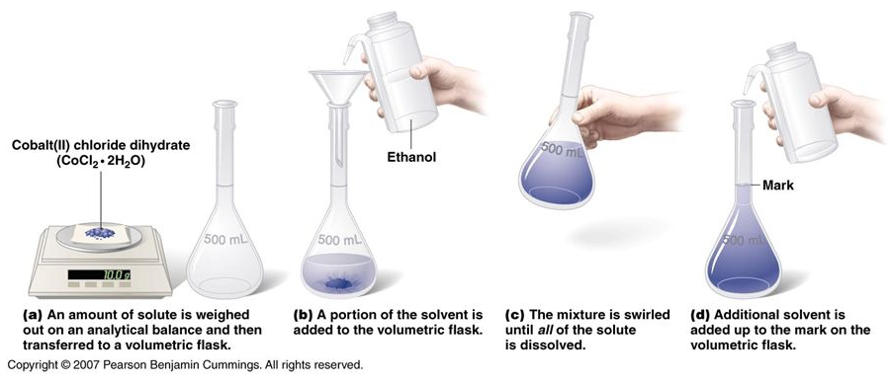
Using a Volumetric Flask
Don’t forget – you want the bottom of the meniscus to be at the line mark!
SOLUTE
SOLVENT

Slide 44
Using a Volumetric Flask
https://youtu.be/hrvXuX0Ow3s

Slide 45
MAKING A SOLUTION

Slide 46

Making a solution
Molarity = $\frac{moles solute}{liters of solution}$
We use molarity as our unit for concentration
Our scales do not measure in moles – we need to measure a certain # of grams on our scale and convert that to moles.
We need to make sure we are using the # of Liters of SOLUTION not just the water we added – the solute takes up some space!
If you know the molarity you want and the volume you want:
  Solve for moles solute needed.
  Then convert moles to grams using molar mass.
  Weigh that many grams out on your scale.
  Add the solute to your container.
  Fill with water until you reach the desired volume of solution

Slide 47
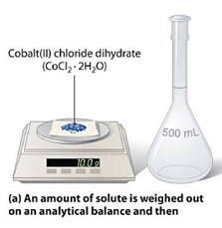
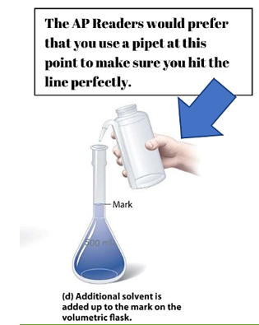
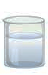

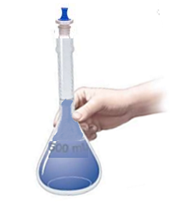
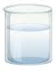

Making a solution
(c) Carefully pour the dissolved mixture into a volumetric flask, using a funnel.
(b) The solid is added to a beaker along with a portion of the solvent. (If diluting an acid make sure to add the acid to the water and not the other way around! Also make sure you are cautious – if it is exothermic the container can get hot. Make sure to swirl to ensure all the solid is dissolved.
(e) Put a stopper in the flask and invert several times to ensure it is well mixed. Pour into a proper storage bottle.

Slide 48
Making a solution
Common Mistakes
Solid gets stuck in the neck of the flask
    Use a beaker to dissolve solute in some solvent, then transfer to volumetric flask
Overfilling the volumetric flask
  Results in a dilute solution
Not using distilled water
  Other ions present in the tap water could affect the experiment the solution is eventually used for.
Not using a volumetric flask (using a beaker or Erlenmeyer instead)
  Loss of precision in concentration of prepared solution

Slide 49
Making a solution
Common Applications
Making solutions to dissolve substances for analysis, particularly titrations
Important to Remember
Molarity = (moles solute) / (L solution)

Slide 50
Making a solution
https://youtu.be/A2YyIo8vSCA

Slide 51
SERIAL DILUTION

Slide 52
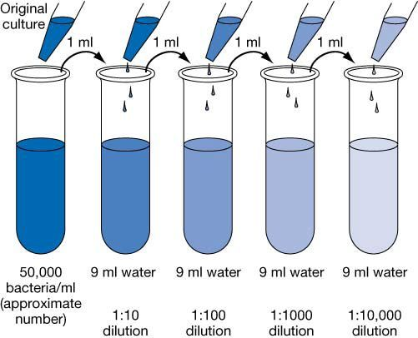
Serial Dilution
Serial dilutions do not need to
be 10 mL each time, this is
just an example image.
The idea is that you take a
small amount of the strong
stuff and water it down.
Then you take some of that
new solution and water it
down again.
Etc etc etc…
M₁V₁ = M₂V₂
Starting Concentration

Slide 53
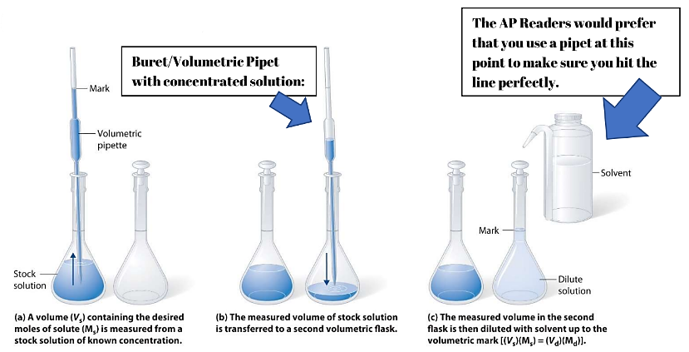
Serial Dilution

Slide 54
Serial Dilution
https://youtu.be/A2YyIo8vSCA
*you don’t have to do a 1mL + 9mL dilution but it is a very classic ratio to use.

Slide 55
Serial Dilution
Common Mistakes
Not adding the acid into the water (adding in reverse order)
  Solution can bubble up, steam from heat released, splattering could occur.
Overfilling the volumetric flask
  Results in a dilute solution
Not using distilled water.
  Other ions could affect the experiment for which the solution is used
Not using a volumetric flask (beaker or Erlenmeyer instead)
  Loss of precision in concentration of prepared solution
Common Applications
Making solutions to dissolve substances for analysis, particularly in titrations.
Important to Remember
Molarity = moles solute/L of solution

Slide 56
SETTING UP AND READING A BURETTE

Slide 57
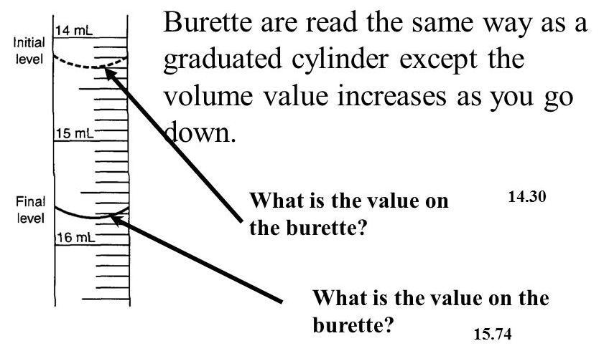
Setting up and Reading a Burette
Remember to estimate one decimal place past where the tick line marks are on the burette, just like on a graduated cylinder!
Final reading – Initial reading = volume that was dispensed

Slide 58
Setting up and Reading a Burette
Video #1
https://youtu.be/Lr1nLTCqZvM

Slide 59
Setting up and Reading a Burette
Video #2
https://youtu.be/qdmp4_Nwd-Q

Slide 60
PERFORMING A TITRATION

Slide 61
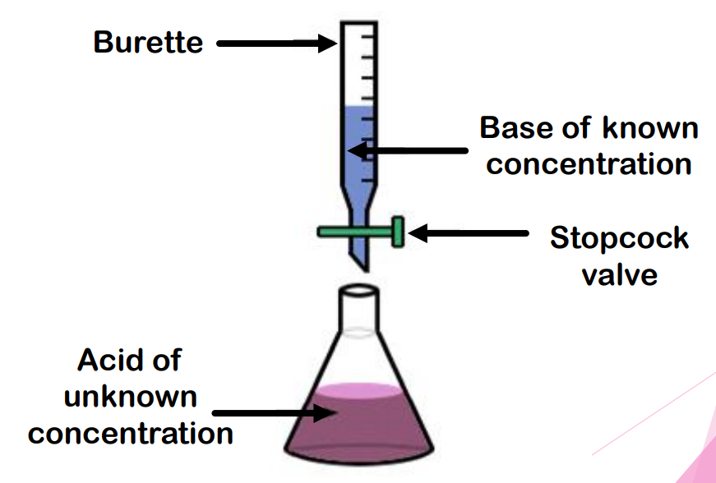
Preforming a Titration
A titration is used to help determine the unknown concentration of a substance, usually an acid or a base.
If you have an unknown acid concentration you slowly add a base with a known concentration until you reach the “equivalence point” which is when the moles of acid = moles of base.
You can then use stoichiometry to help you convert from the known moles of base added into the unknown concentration of the acid.
Or vice versa if you have an unknown base concentration and a known acid concentration.

Slide 62
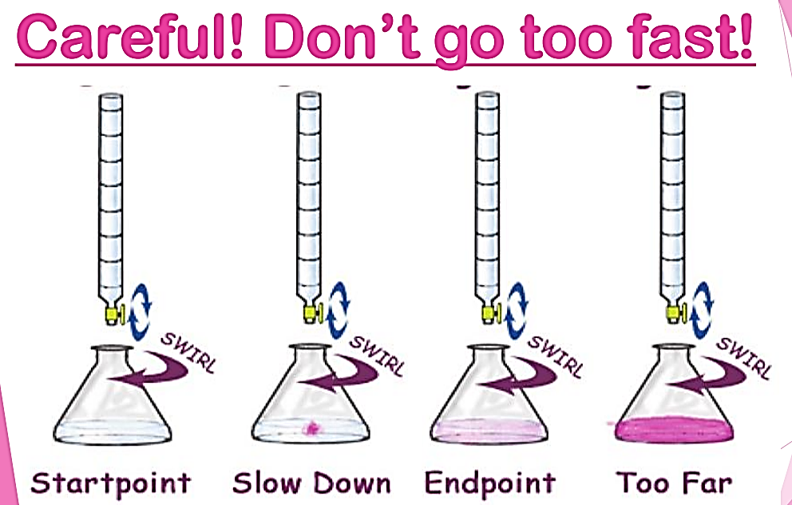
Preforming a Titration
You often use an “indicator” to determine when you have reached the equivalence point.
If you pick the right indicator, it will turn colors when the
moles acid = moles of base.
That tells you when to stop adding your known concentration acid or base

Slide 63
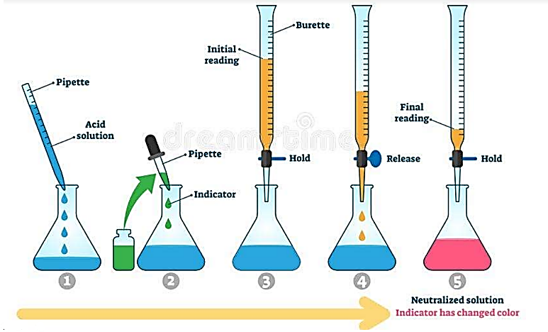
Preforming a Titration

Slide 64
Preforming a Titration
Video #1
https://youtu.be/tIbD8MG1qMM

Slide 65
Preforming a Titration
Video #2
https://youtu.be/sFpFCPTDv2w

Slide 66
Preforming a Titration
Video #3
https://youtu.be/YqfvRBJ-iPg

Slide 67
Performing a Titration
Common Mistakes
Overshooting the titration (too dark of a color at the end)
  Results in the concentration of the unknown solution in the flask *appearing* to be higher than it actually is, since more titrant was added.
Not using indicator. - No perceivable endpoint.
Using incorrect indicator. - pH at the equivalence point should be approximately equal to the pKa of the indicator.
Cleaning and preparing the buret incorrectly.
  Rinse buret with distilled water, add a small amount of titrant to buret, swirl, and let it out through the stem. Repeat again with more titrant. Be sure to rinse with titrant twice.
  Consequence of improper cleaning = a titrant that is more dilute, which will result in an analyte that *appears* to be more concentrated than it is
Reading buret incorrectly
  It should be read from the bottom of the meniscus. If on the line, add a 0, if inbetween, estimate the final digit

Slide 68
Performing a Titration
Common Applications
Solving for the concentration of an unknown substance (analyte).
Acid/Base, Redox
Important to Remember
Molarity = moles solute/L of solution
Analyte: substance in flask
Titrant: substance in buret
Standard solution: sol’n of known concentration, usually goes into the buret.
M1V1 = M2V2 is helpful for solving for the concentration of the analyte solution at the equivalence point (if the acid is monoprotic)
For polyprotic acids use stoich to determine concentration of unknown
Endpoint: point in titration where flask solution changes color
Equivalence point: point in the titration where the moles acid = moles of base

Slide 69
GRAVIMETRIC ANALYSIS

Slide 70
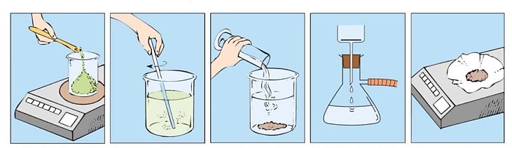
Gravimetric Analysis
*your ion of interest doesn’t have to be the cation, this is just an example
A technique to determine the quantity of an ion present by making it precipitate out of solution and then using stoichiometry to determine how much of the ion was originally present by comparing it to the mass of your new precipitated compound
Filter out new solid product AZ. Rinse ppt to remove soluble ions and excess reagent.
Add compound BZ – pick one that will make an insoluble product with A
Weigh AZ and do stoich to determine how much A ion you started with *
Dissolve comp. AX in an appropriate solvent
Weigh
compound AX

Slide 71
Gravimetric Analysis
https://youtu.be/kMeJj2YgwZw

Slide 72
Gravimetric Analysis
Common Mistakes
Precipitate is not dry when you take the final mass
    Results in the *appearance* of more precipitate than was actually produced because some mass is actually water
Common Applications
Mixtures of solids – what % of the mixture/alloy is a specific substance
Determining the amount of a particular ion in a solution
Important to Remember
All sodium, nitrate, ammonia, potassium compounds are soluble – SNAP!
Net ionic equations should not include these spectator ions!

Slide 73
UV-VIS SPECTROSCOPY

Slide 74
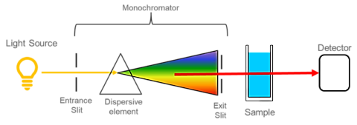
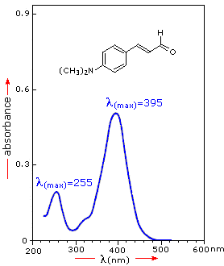
UV-VIS-Spectroscopy
Different types of bonds absorb different wavelengths of light.
If you pass light through a sample you can detect which wavelengths pass through the sample and which are absorbed.
You can use the wavelengths of light absorbed/detected to determine the structure, or the concentration of the sample.
In this class we will use Beer’s Law to find concentrations using UV-Vis Spectroscopy. Beers Law: A = ɛbC
(A = absorbance, = Molar absorptivity L/mol*cm, b = path length of cuvette , C = concentration
UV-Vis Spectrum
Light Source
Detector
Entrance slit
Exit
slit
Sample in a cuvette

Slide 75
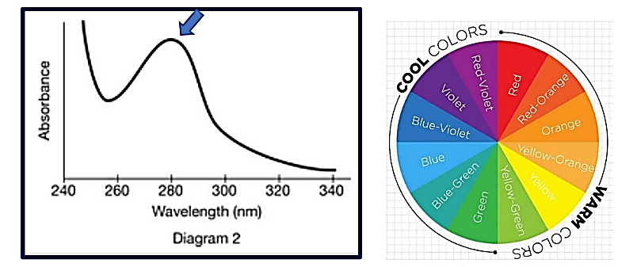
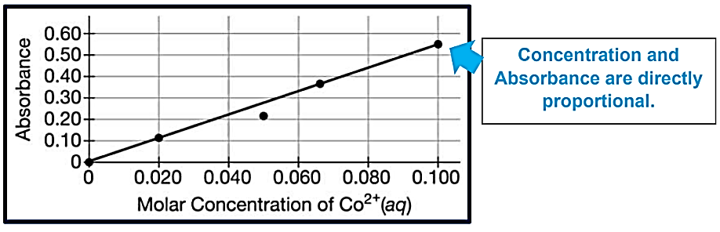
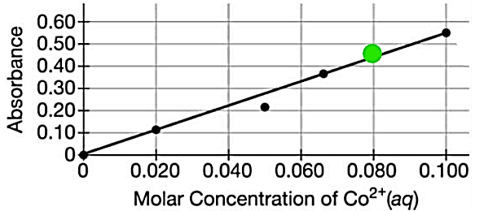
UV-VIS-Spectroscopy
Pick the wavelength for the solution where
absorbance is highest for the solute.
Complementary colors are usually best.
Measure absorbance for different concentrations
at that wavelength. Graph results. This is making your “standard curve.”
Measure the absorbance for your unknown
concentration solution. You can compare it’s
absorption to the concertation using your graph.

Slide 76
UV-VIS-Spectroscopy
Video #1
https://youtu.be/-et7jDXOLB4

Slide 77
UV-VIS-Spectroscopy
Video #2
https://youtu.be/dSEWkypbhLk

Slide 78
UV-VIS Spectroscopy
Common Mistakes
Absorbance is lower than it should be (point falls below the line)
  Cuvette was cleaned with distilled water and then immediately filled with solution, creating a more dilute solution
  Too little solute in the prepared solution
Absorbance is higher than it should be (point falls above the line)
  Cuvette is dirty with fingerprints/dust, etc.
  Too much solute in the prepared solution
  Contamination with a more concentrated solution
  Used a cuvette with a longer path for one data point
  Used frosted/ridged side of cuvette instead of the clear side
Did not use the correct wavelength of maximum absorbance for the solute.
  Absorbances could be too low especially for dilute solutions
Overfilled the cuvette - Should not have an impact on data
Picked a wavelength where it is high absorbance for the solvent
  Won’t be able to distinguish absorbance due to solvent vs. solute

Slide 79
UV-VIS Spectroscopy
Common Applications
Determining the concentration of a solution of unknown concentration using solutions of known concentration
Kinetics reactions (like bleach + blue food dye)
Important to Remember
Before using, you need to calibrate the spectrophotometer with a blank of just solvent (in order to account for any absorbance due to solvent and cuvette itself)
Molarity = moles solute/L of solution
Absorbance = amount of light the solution absorbs at a specific wavelength
Molar absorptivity (1/M*cm) describes how intensely a sample absorbs light at a specific wavelength (constant unique to the substance at a specific wavelength)
Path length of sample = length of the cuvette where the light will travel (cm)
Concentration is molarity

Slide 80
CHROMATOGRAPHY

Slide 81
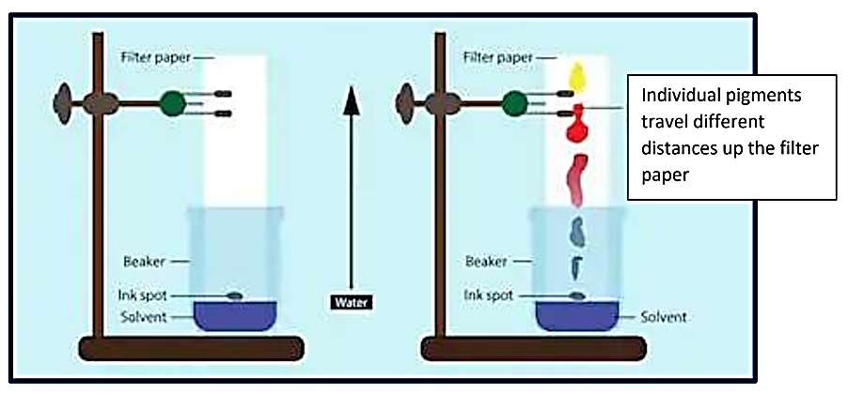
Chromatography

Slide 82
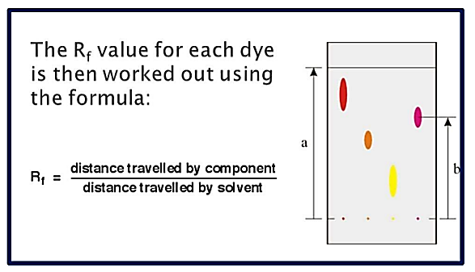
Chromatography

Slide 83
Chromatography
Common Mistakes
Solvent reaches the top of the paper strip.
  Rf values cannot be calculated as we do not know how far the solvent would have traveled had there been more paper.
No major difference in polarity between paper and solvent
  Substances cannot be adequately separated
No major differences in polarity of components of mixture
  Substances cannot be adequately separated
Common Applications
Determining the components of a mixture

Slide 84
Chromatography
https://youtu.be/eUIcebi1GVc

Slide 85
Chromatography
Important to Remember
The substance that travels further up the paper is more attracted to solvent.
The substance that travels the least is most attracted to the paper.
Paper is usually relatively nonpolar in comparison to the solvent.
Silica plates are usually relatively polar in comparison to the solvent.
If multiple trials are run, compare Rf values, not relative heights.
Polar substances tend to lack symmetry, have polar bonds, and have lone pairs on the central atom. They are most soluble in other polar substances.
Nonpolar substances tend to be symmetrical, have identical bonds, and have no lone pairs on the central atom. They are most soluble in other nonpolar substances.

Slide 86
FRACTIONAL DISTILLATION

Slide 87
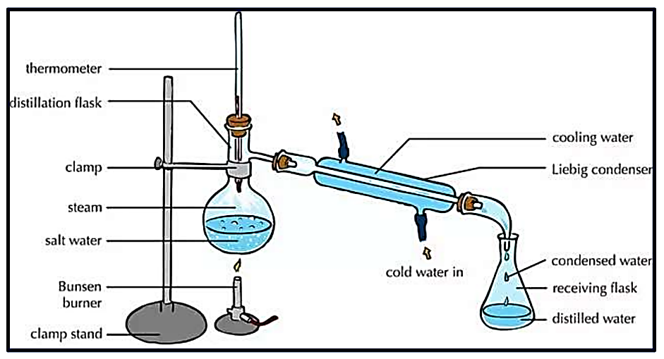
Fractional Distillation

Slide 88
Fractional Distillation
https://youtu.be/eUIcebi1GVc

Slide 89
Fractional Distillation
Common Mistakes
Components of the mixture have the same or very similar boiling points.
  Same boiling points – could not be separated
  Similar boiling points – difficult to control temp enough to separate
Thermometer touched bottom or side of the flask
  Solution will appear hotter than it actually is
Common Applications
Separating components in a solution/mixture based on different boiling points.
Important to Remember
Distillate - substance collected in the flask at the (substance with lower boiling point)
Lower boiling point substance has a greater vapor pressure and weaker IMFs
Higher boiling point substance has a lower vapor pressure and stronger IMFs
Temperature of the solution will remain constant while a component is boiling off.

Slide 90
PERCENT COMPOSITION OR FORMULA OF A HYDRATE

Slide 91
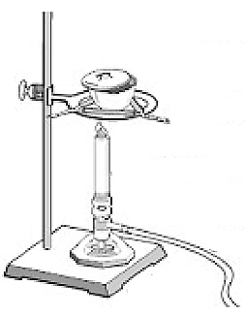
Percent Comp/Formula of a Hydrate
Take mass of hydrate.
Heat until all water has been driven off.
Cool, then weigh.
Heat again for a couple more minutes.
Cool, then weigh.
If constant mass has been reached,
experiment is complete.
Crucible with cover slightly off
Iron ring and clay triangle
Bunsen Burner
Ring Stand

Slide 92
Percent Comp/Formula of a Hydrate
https://youtu.be/eUIcebi1GVc

Slide 93
Percent Comp/Formula of a Hydrate
Common Mistakes
Not heating the hydrate enough
  Ratio of anhydrous salt: water will not be accurate, as water will remain in the sample
  Appears fewer moles of water and more moles of salt will be in the hydrate
Overheating the hydrate
  Anhydrous salt could decompose in the heat
  It will appear as though the salt is composed of more water than it is
Salt sticks to spatula or is spilled in the process of the lab
  It will appear as if there is more water in the sample than there actually is; more moles of water will appear to be in sample than there actually are
Crucible is weighed while still warm
  Inaccurate mass will be obtained

Slide 94
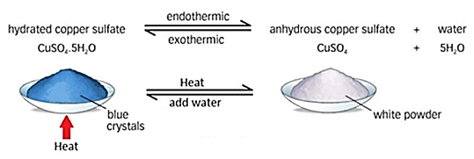
Percent Comp/Formula of a Hydrate
Common Applications
Empirical formula of hydrates, percent composition of hydrates
Important to Remember
Hydrated salt: before heating
Anhydrous salt: after heating
Moles of anhydrous salt: moles of water = ratio for hydrate

