Slide 1
We have an Sterling Silver alloy bead made up of Silver and Copper
Your goal is to determine the percent silver in the alloy bead through Gravimetric Analysis

Slide 3
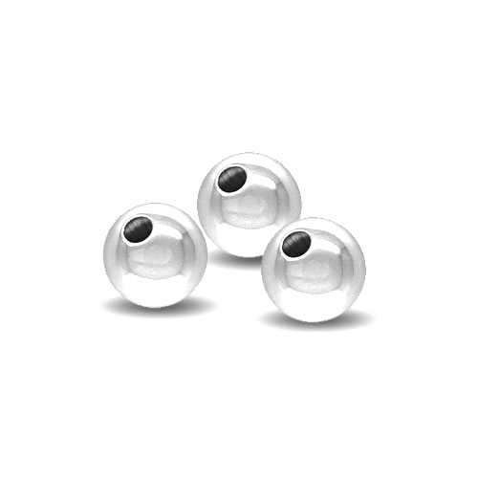
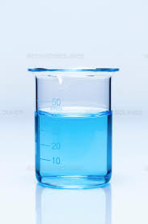
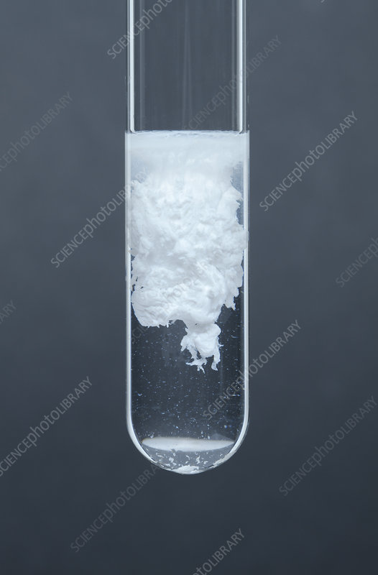
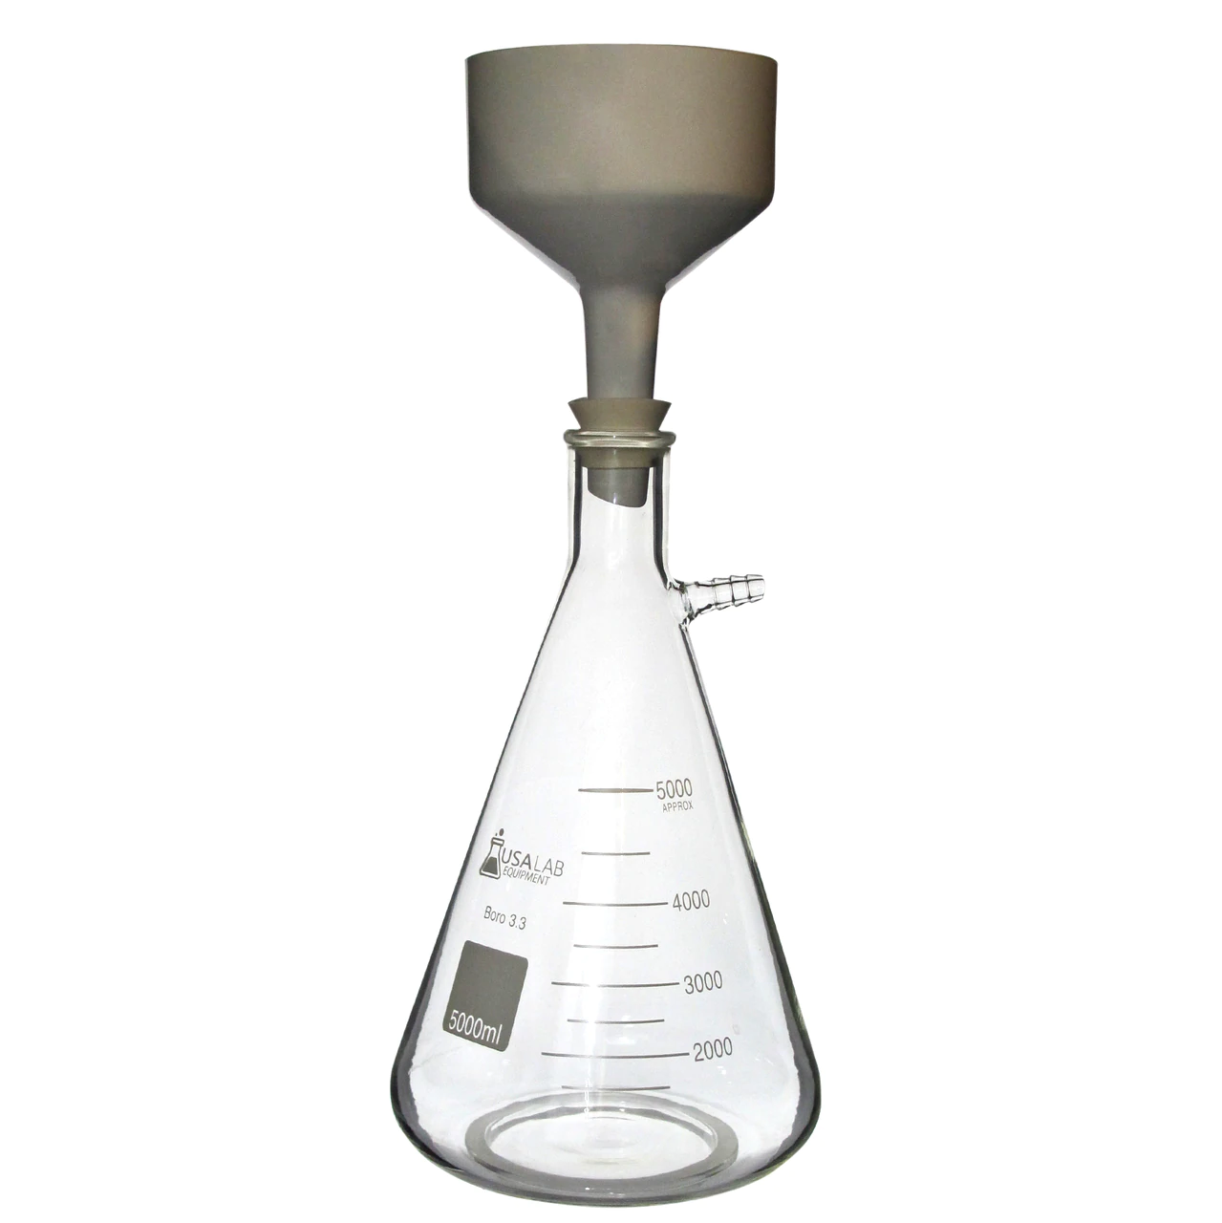
Analysis of Ag in Ag/Cu Alloy
The group was given an 8mm sterling silver alloy bead
The bead was dissolved in 6M nitric acid and left overnight
The students determined the amount of NaCl needed to precipitate the Ag⁺ in solution
The next day the group made a NaCl solution with the predetermined mass of NaCl needed and added it while stirring the Ag⁺ / Cu²⁺ nitrate solutions
Precipitation of AgCl took place during the addition of NaCl solution with a 15min heating
The precipitate was then poured into a filter funnel with a small filter paper, attached to a filter flask. All contents of the break was put into the funnel
A HNO₃ wash was poured over the precipitate followed by 10ml of Isopropyl Alcohol to aid in removing any excess water
The precipitate was sandwiched between the small filter paper and a large filter paper and left to dry over night
The next day, the sample was measured for mass and observations taken.

Slide 4
Initial Mass Measurements
Each student will be put into a group and you will use the data provided below for the lab
Each student will fill out their own data table. All other fields of the data table are to be calculated and added to your table
 | Group 1 (KH) | Group 2 (SL) | Group 3 (VR) | Group 4 (DS)
Mass of Alloy | 0.5134 g | 0.5181 g | 0.5183 g | 0.5125 g
Mass of Filter paper | 0.7859 g | 1.0631 g | 1.1416 g | 1.0140 g
Mass of Filter paper + AgCl | 1.3816 g | 1.6226 g | 1.6144 g | 1.7189 g

Slide 5
Your assignment…
Go through the lab sheet and this PPTX
Complete all calculations needed based on the group you put in
Show all work for each calculation
Insert pictures of your handwritten work
Your name in INK must be in every picture inserted into your document
Input your data into the data table provided
Answer the POST-LAB questions individually on your own sheet
May work with others within your group sample

Slide 6
Full Video of the experiment, different chemical
https://www.youtube.com/watch?v=dERZhN-01f8&feature=emb_logo

