Slide 1
Enthalpy of Reactions
Hess’s Law

Slide 2
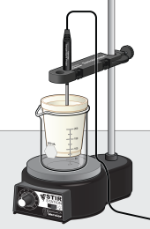
Through Calorimetry….
In this experiment, you will measure the
temperature change of two reactions, and use
Hess’s law to determine the enthalpy change, ΔH
of a third reaction. You will use a polystyrene foam
cup nested in a beaker as a calorimeter, as shown to
the right. For purposes of this experiment, you
may assume that the heat loss to the calorimeter
and the surrounding air is negligible

Slide 3
Procedure…ish
For each Reaction
NaOH + HCl
NaOH + NH₄Cl
HCl + NH₄OH
Each solution is 2.0 M and using 50ml of each per reaction
Initial temperature will be taken prior to adding the second solution, about 5-10 seconds
Final temperature is determined when temperature reaches the highest or lowest point then changes direction
Below are 3 separate experiments by 3 different lab groups
You are to use all 3 experiments to complete the data table and answering questions. You will be put into smaller groups to work with

Slide 4
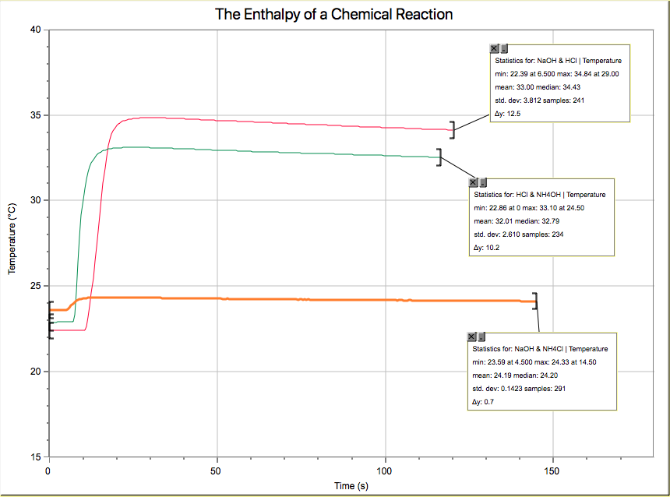
EXPERIMENT 1
Logger Pro

Slide 5
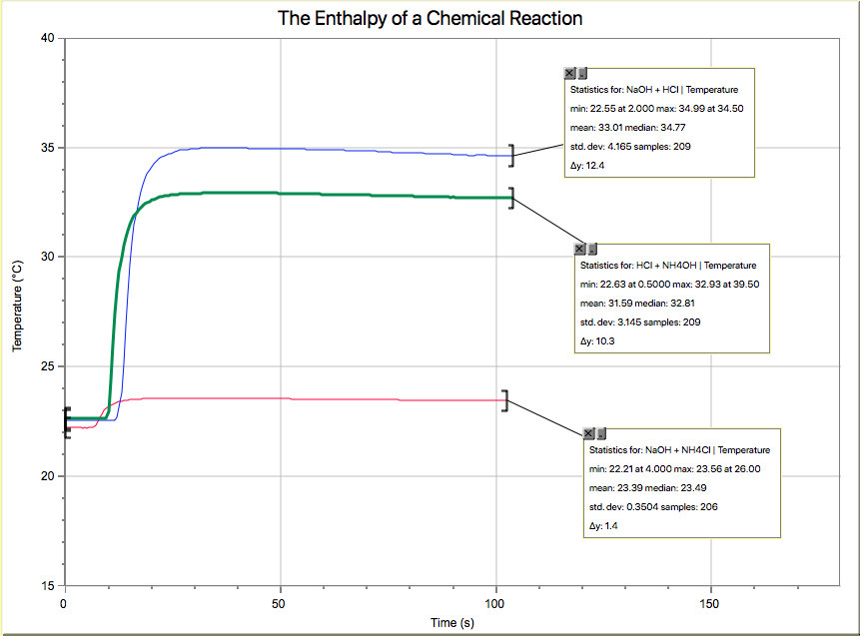
EXPERIMENT 2
Logger Pro

Slide 6
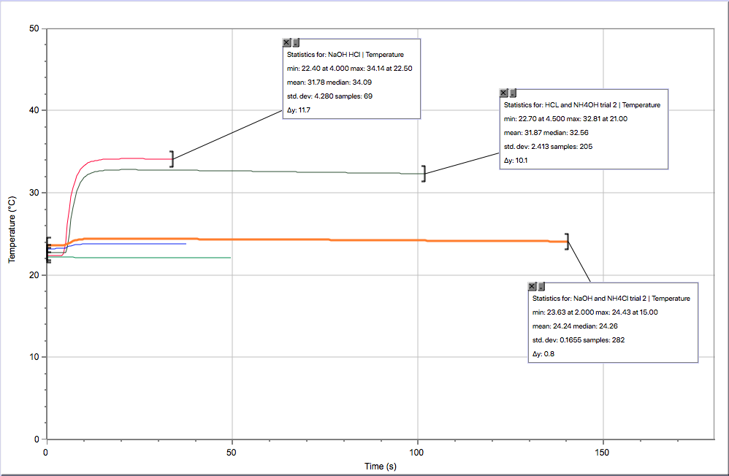
EXPERIMENT 3
Logger Pro

