Slide 1
Entropy of Reaction
ΔS°

Slide 2
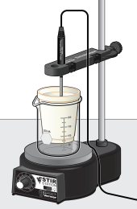
Through Calorimetry….
When studying thermodynamics, the equation for free
energy of a reaction, ΔG° = ΔH° - TΔS°, is often
encountered. In this experiment, you will use this
equation to estimate the minimum entropy change
required to bring about a reaction. The enthalpy
change, ΔH, and the initial temperature will be
determined for a reaction. From these values and the
equation for free energy, the minimum entropy
change to bring about a spontaneous reaction will be
estimated

Slide 3
Procedure…ish
For each Reaction (each group will have different set of data to use)
NaNO₃
NH₄Cl
NH₄NO₃
Each solution is 50.0 mL of of 1.00 M solution. You will need to calculate the mass needed to prepare this solution based on the sample you have – add an image of this calculation into the data table
Initial temperature will be taken prior to adding the second solution, about 5-10 seconds
Final temperature is determined when temperature reaches the highest or lowest point then changes direction
Everyone is given the same Calorimeter Constant Graph
The data you are using depends on the group # you are given
Assume the temperature of the reaction in happening at room temp or 25 C°

Slide 4
Some thinking…
The experiment is based on the fact of the minimum entropy to cause a reaction to occur…
Need to think about the dividing line of when a reaction can occur or not, is spontaneous or non-spontaneous…
Based on this, you can solve for ΔS° at 298 K
There is an assumption that must be made in order to solve this problem… that requires thinking. Do not ask me, I will not tell you this assumption. A big hint was given in #2 above

Slide 5
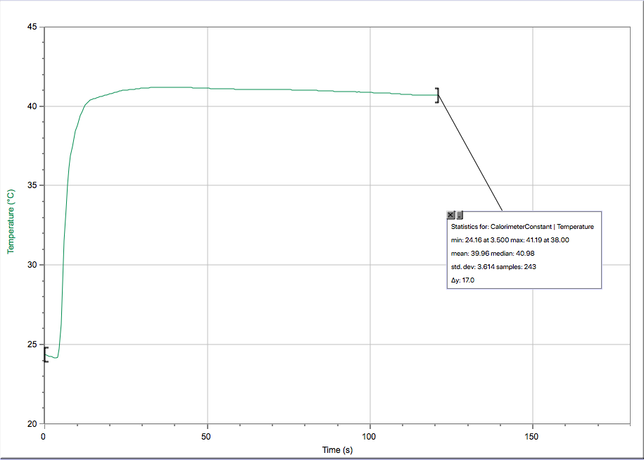
Calorimeter Constant Graph
Everyone will use this graph for their Calorimeter calculations
Click HERE for the logger pro file

Slide 6
Group number corresponds to what data you will use below (T₁ & T₂ are trials)
Group # | Data to Use | Mass of Solid T₁ (g) | Mass of Solid T₂ (g)
1 | LINK (NaNO₃ KH) | 4.2043 | 4.1497
2 | LINK (NH₄Cl KH) | 2.6739 | 2.6638
3 | LINK (NH₄NO₃ KH) | 4.0043 | 3.9903
4 | LINK (NH₄NO₃ YL) | 4.0843 | 4.0068
5 | LINK (NaNO₃ YL) | 4.2734 | 4.2576
6 | LINK (NH₄NO₃ DS) | 4.0074 (use T₂) | 4.0046 (use T₃)
7 | LINK (NH₄Cl YL) | 2.6708 | 2.6503

