Slide 1
Rate of Reaction
A Spectroscopic Kinetic Relationship

Slide 2
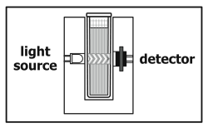
Objectives…
Conduct the reaction of KI and FeCl₃ using various concentrations of reactants.
Determine the order of the reaction in KI and FeCl₃.
Determine the rate law
expression for the reaction.

Slide 3
Purpose…
In this experiment you will conduct the reaction between solutions of potassium iodide and iron (III) chloride. The reaction equation is shown below, in ionic form.
2 I– (aq) + 2 Fe³⁺ (aq) → I₂ (aq) + 2 Fe²⁺ (aq)
As this reaction proceeds, it undergoes a color change that can be precisely measured by a Colorimeter or Spectrometer. By carefully varying the concentrations of the reactants, you will determine the effect each reactant has on the rate of the reaction, and consequently the order of the reaction. From this information, you will write a rate law expression for the reaction

Slide 4
Procedure-ish
Determine wavelength Max based on stock solution
The light source for the reaction is either 430 nm or 470 nm. The nearly monochromatic blue light is absorbed by the solution
…will conduct 5 trials of the reaction between KI and FeCl₃, using the volumes of liquids described
Need to keep note of time when mix all chemicals to putting into cuvette
Cuvette must be cleaned w/ water and side wiped every time
Need to analyze a portion of the graph within about the first minute

Slide 5
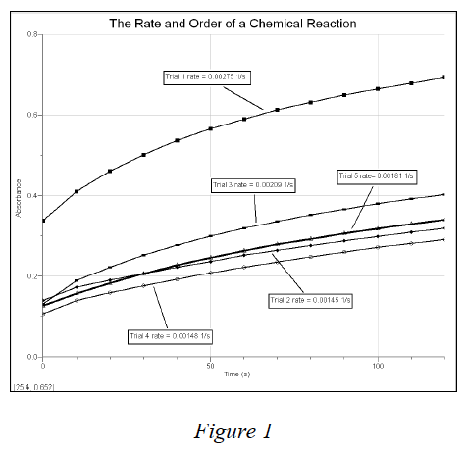
Sample Graph

Slide 6
Student Data – Data Table
Breakout Room | Data File
1 and 2 | File DS
3 and 4 | File KH
5 and 6 | File VR
7 and 8 | File YL

