Slide 1
“What’s in That Bottle?”
Bonding in Solids
Group Virtual Lab

Slide 2
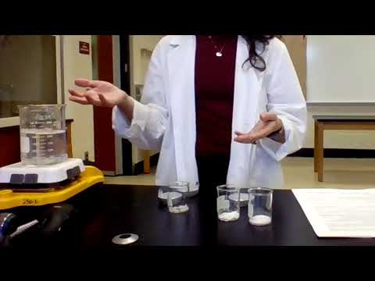
Watch YouTube Video:
Qualitative Analysis and Chemical Bonding
This is really the lab procedure and the tests that were done.
https://www.youtube.com/watch?v=eTEnq670oSg

Slide 3
“What’s in That Bottle?” Group Lab Data
There are 8 sets of group lab data for the experiment on this Google sheet.
Use the tab in the Google sheet that corresponds to your group number.
Your assignment...
Read the lab protocol and watch the lab video (in this PPTX).
Go through the lab sheet and this PPTX.
Answer the pre-lab questions and questions.
Input your data into the data table provided.
Complete all analysis needed based on the group’s data you were assigned.
Answer the post-lab questions and conclusion together as a lab group on a shared Google doc.
One person submits the shared Google doc as your group’s submission for the assignment in Google Classroom. The other group members submit that person’s name as a private comment for the assignment and click “Mark as Done.”

Slide 4
