Slide 1
Molar Volume of a Gas
Virtual Lab

Slide 2
NOTE: Using Eudiometer Tube, not a grad. Cyl. like procedure states. Therefore, DO NOT need to include Step 16 - SKIP IT!
Eudiometer Tube
Eudiometer Tube
Hydrogen Gas and Water Vapor
Beaker
Distilled Water and HCl
Magnesium Ribbon
Water
Rubber Stopper with Copper Wire Housing
Figure: Lab Setup, Inverted Eudiometer

Slide 3
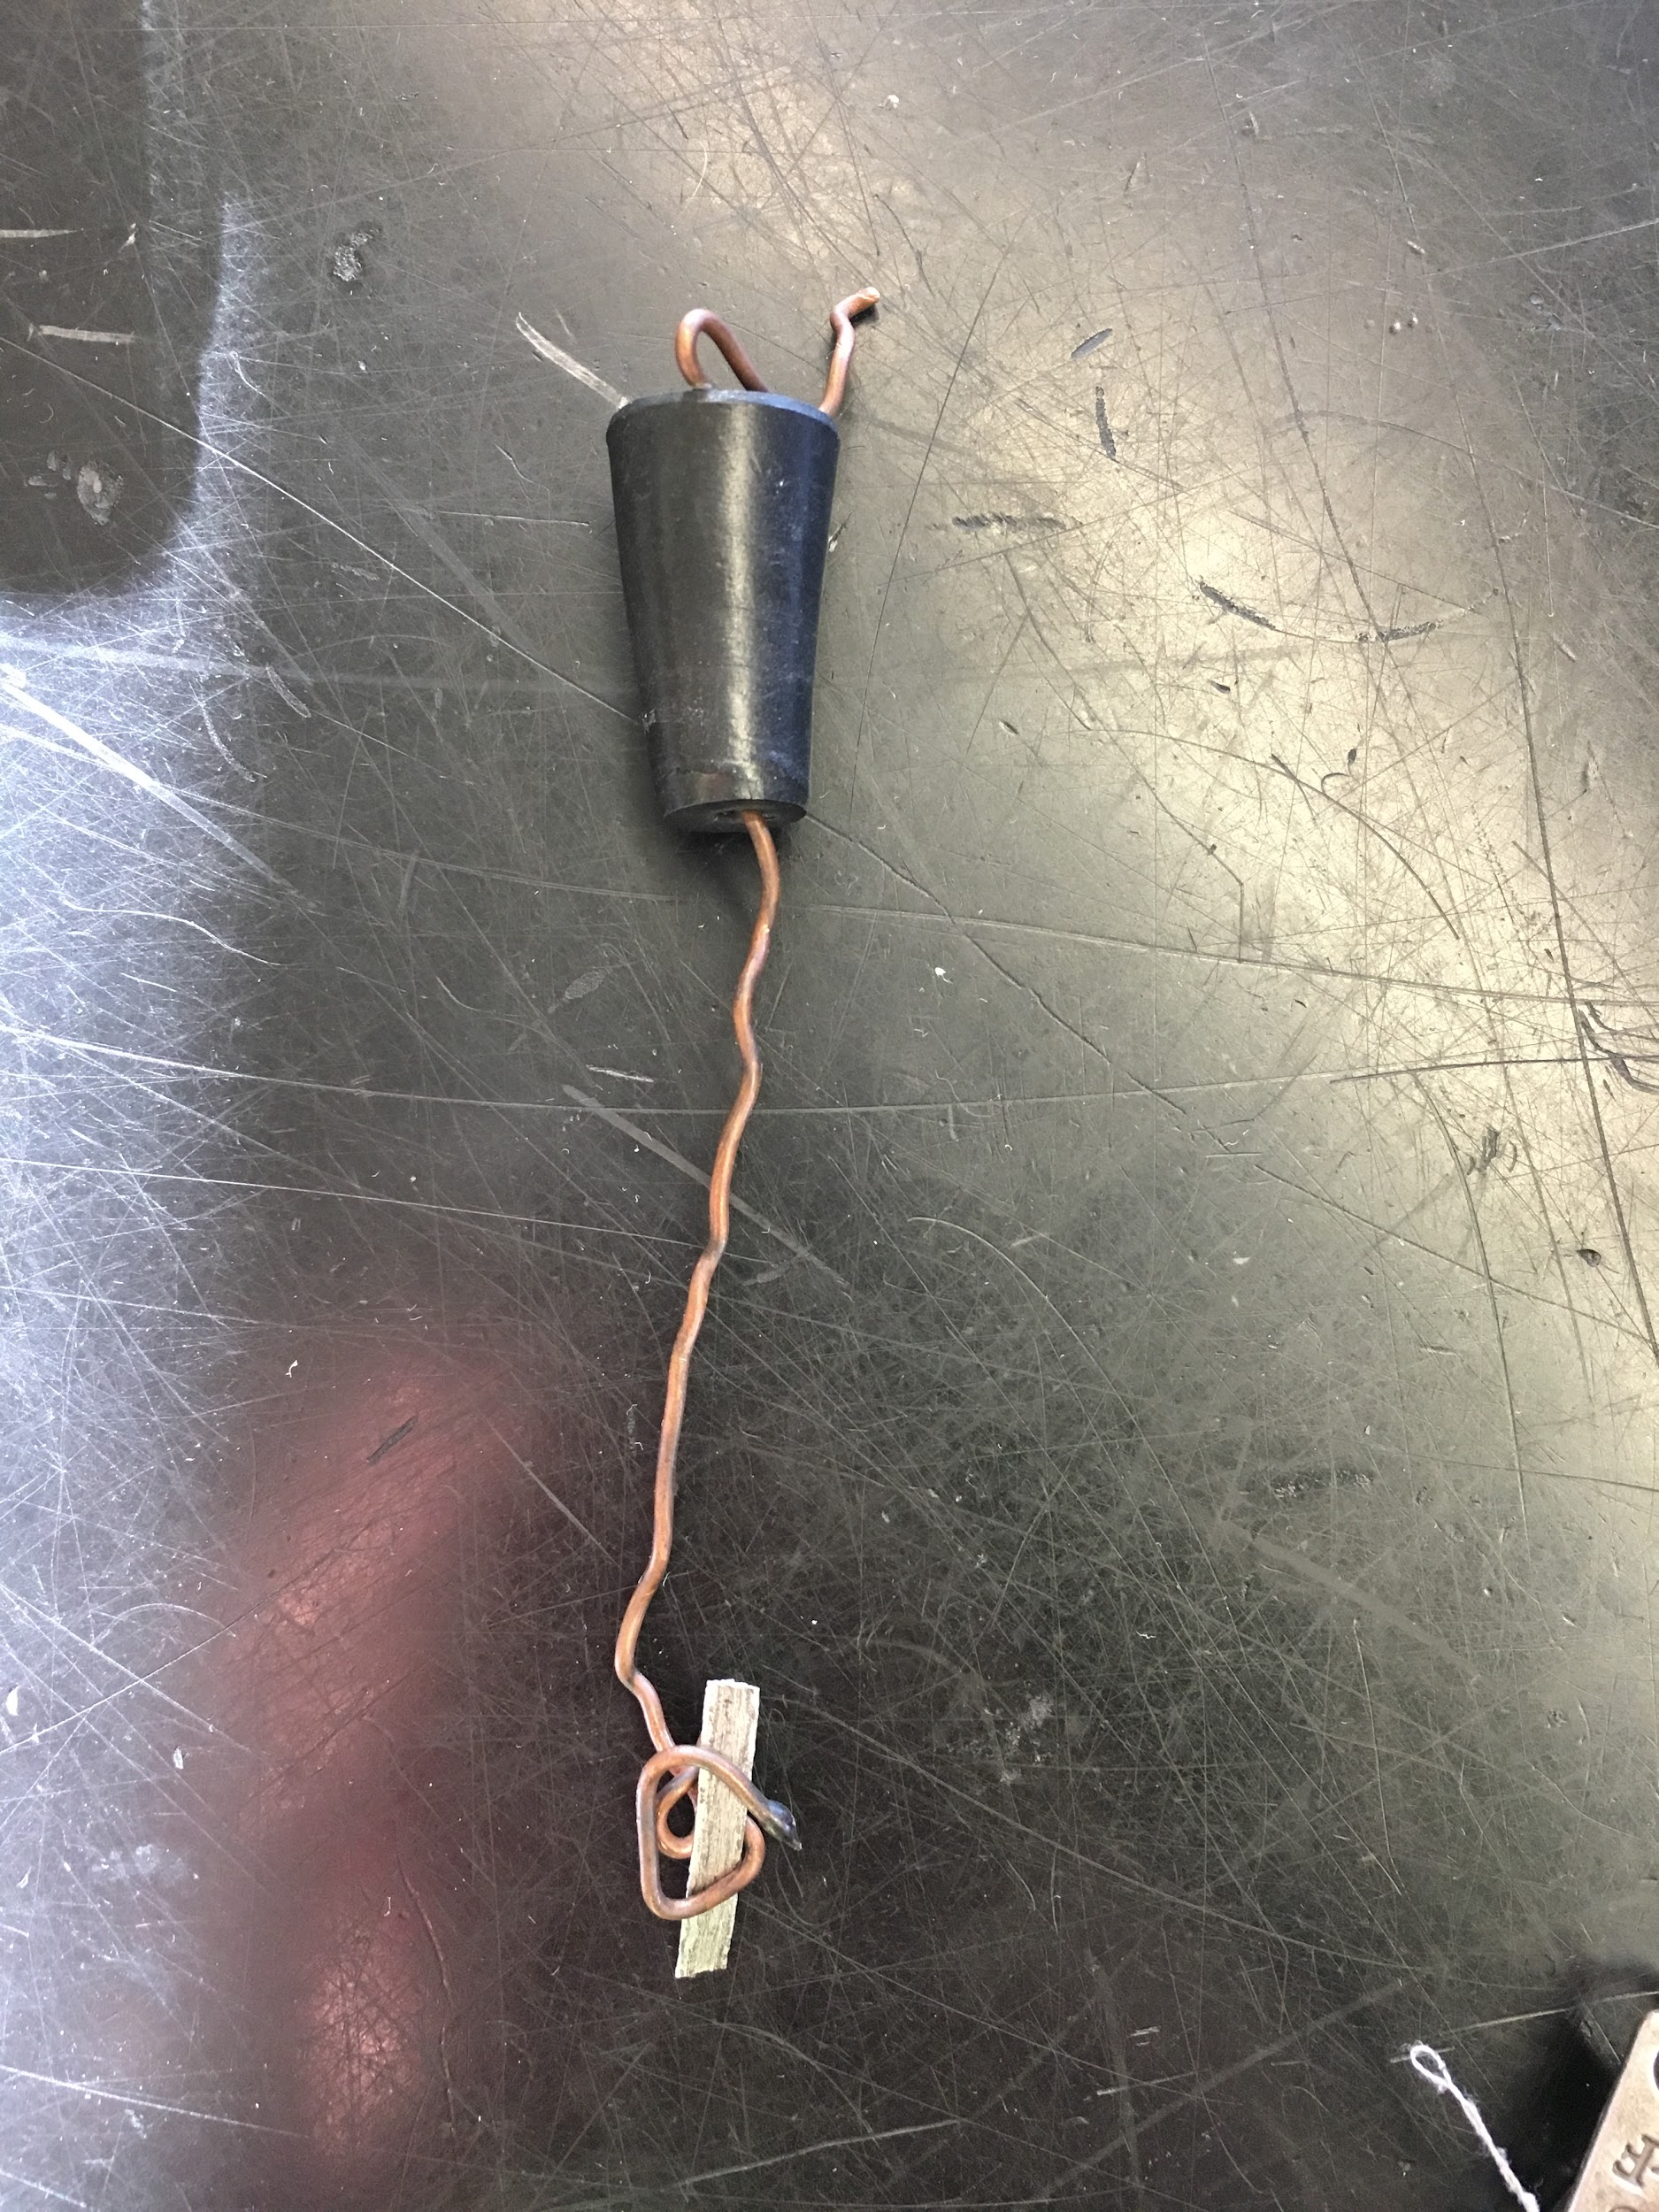
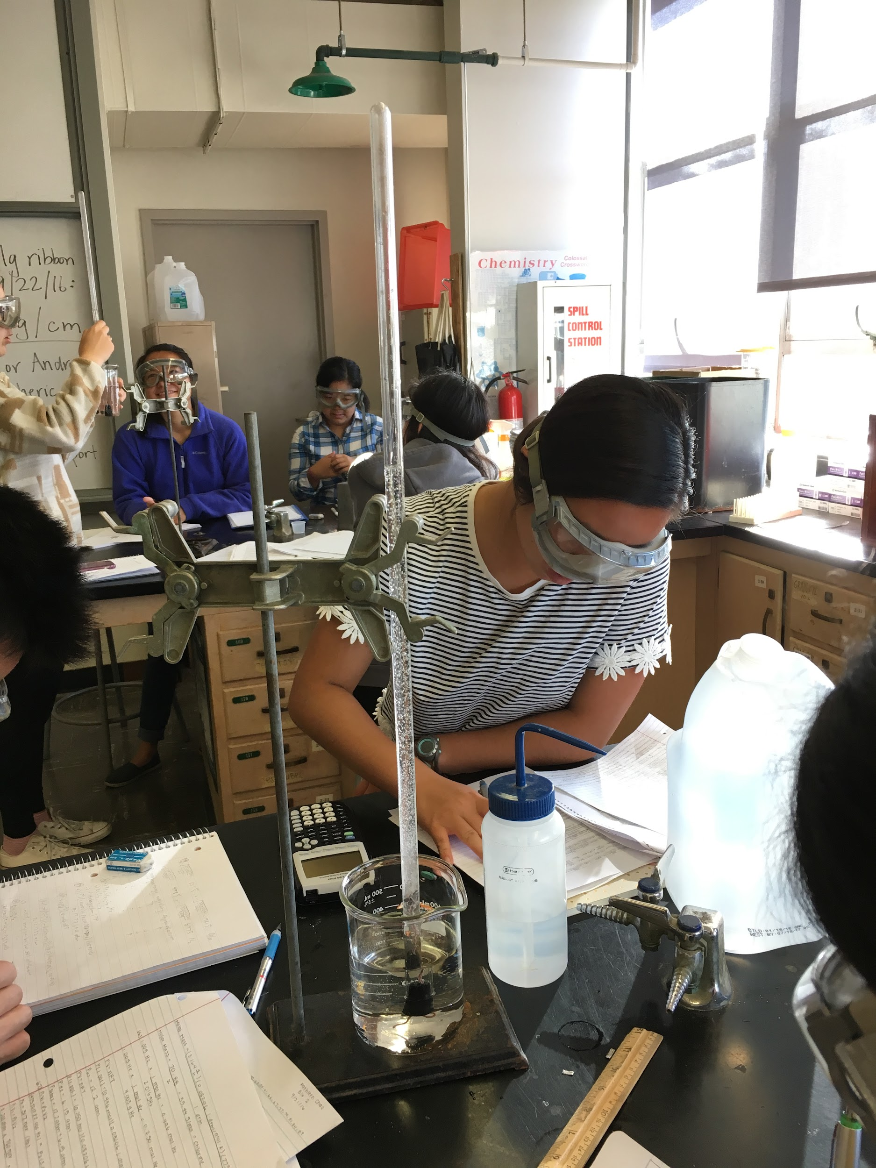
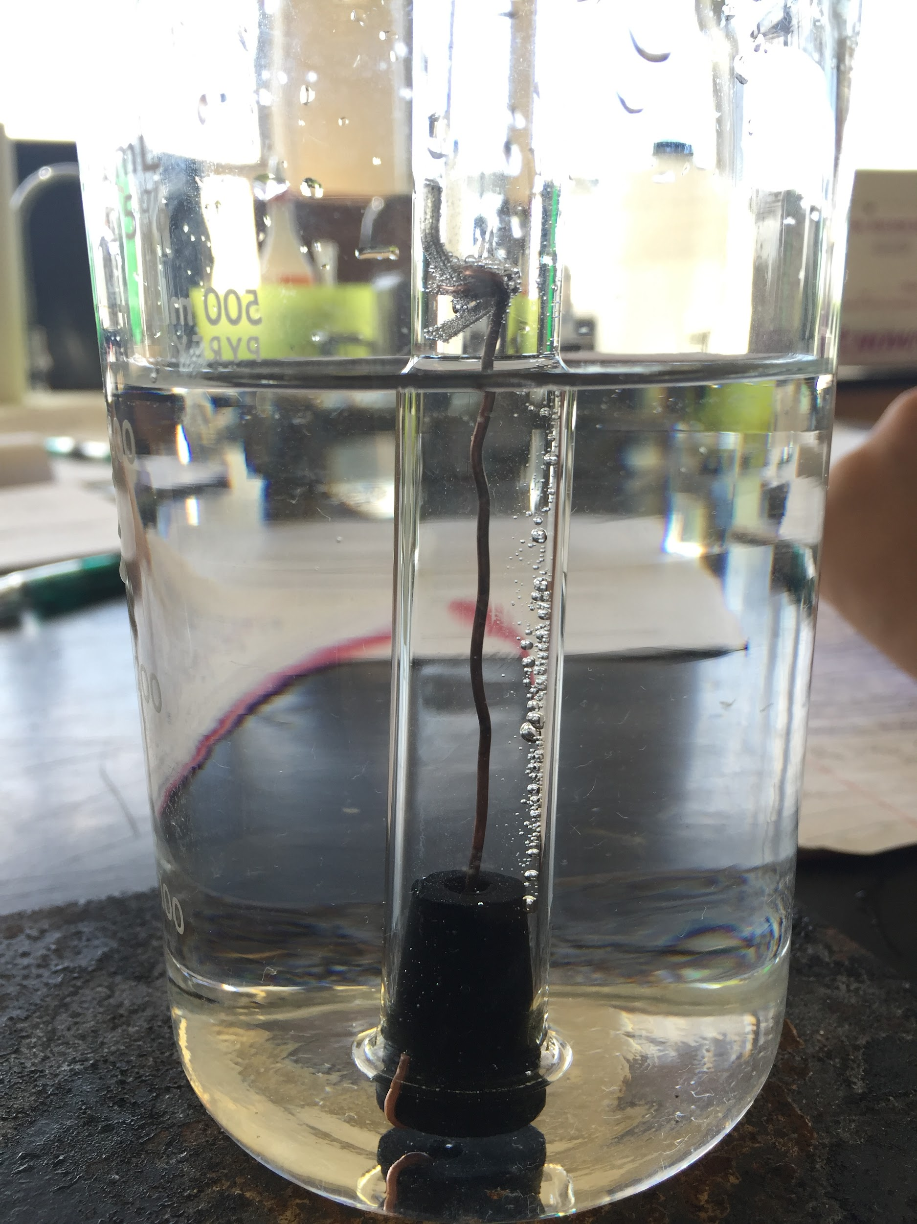
THE EXPERIMENT IN PICTURES
(1) The magnesium is secured in the copper wire attached to the rubber stopper.
(2) The stopper is placed snugly on the open end of the eudiometer. The eudiometer is inverted.
(3) A closer look at the setup from picture 2. The HCl is now in the top of the eudiometer.

Slide 4
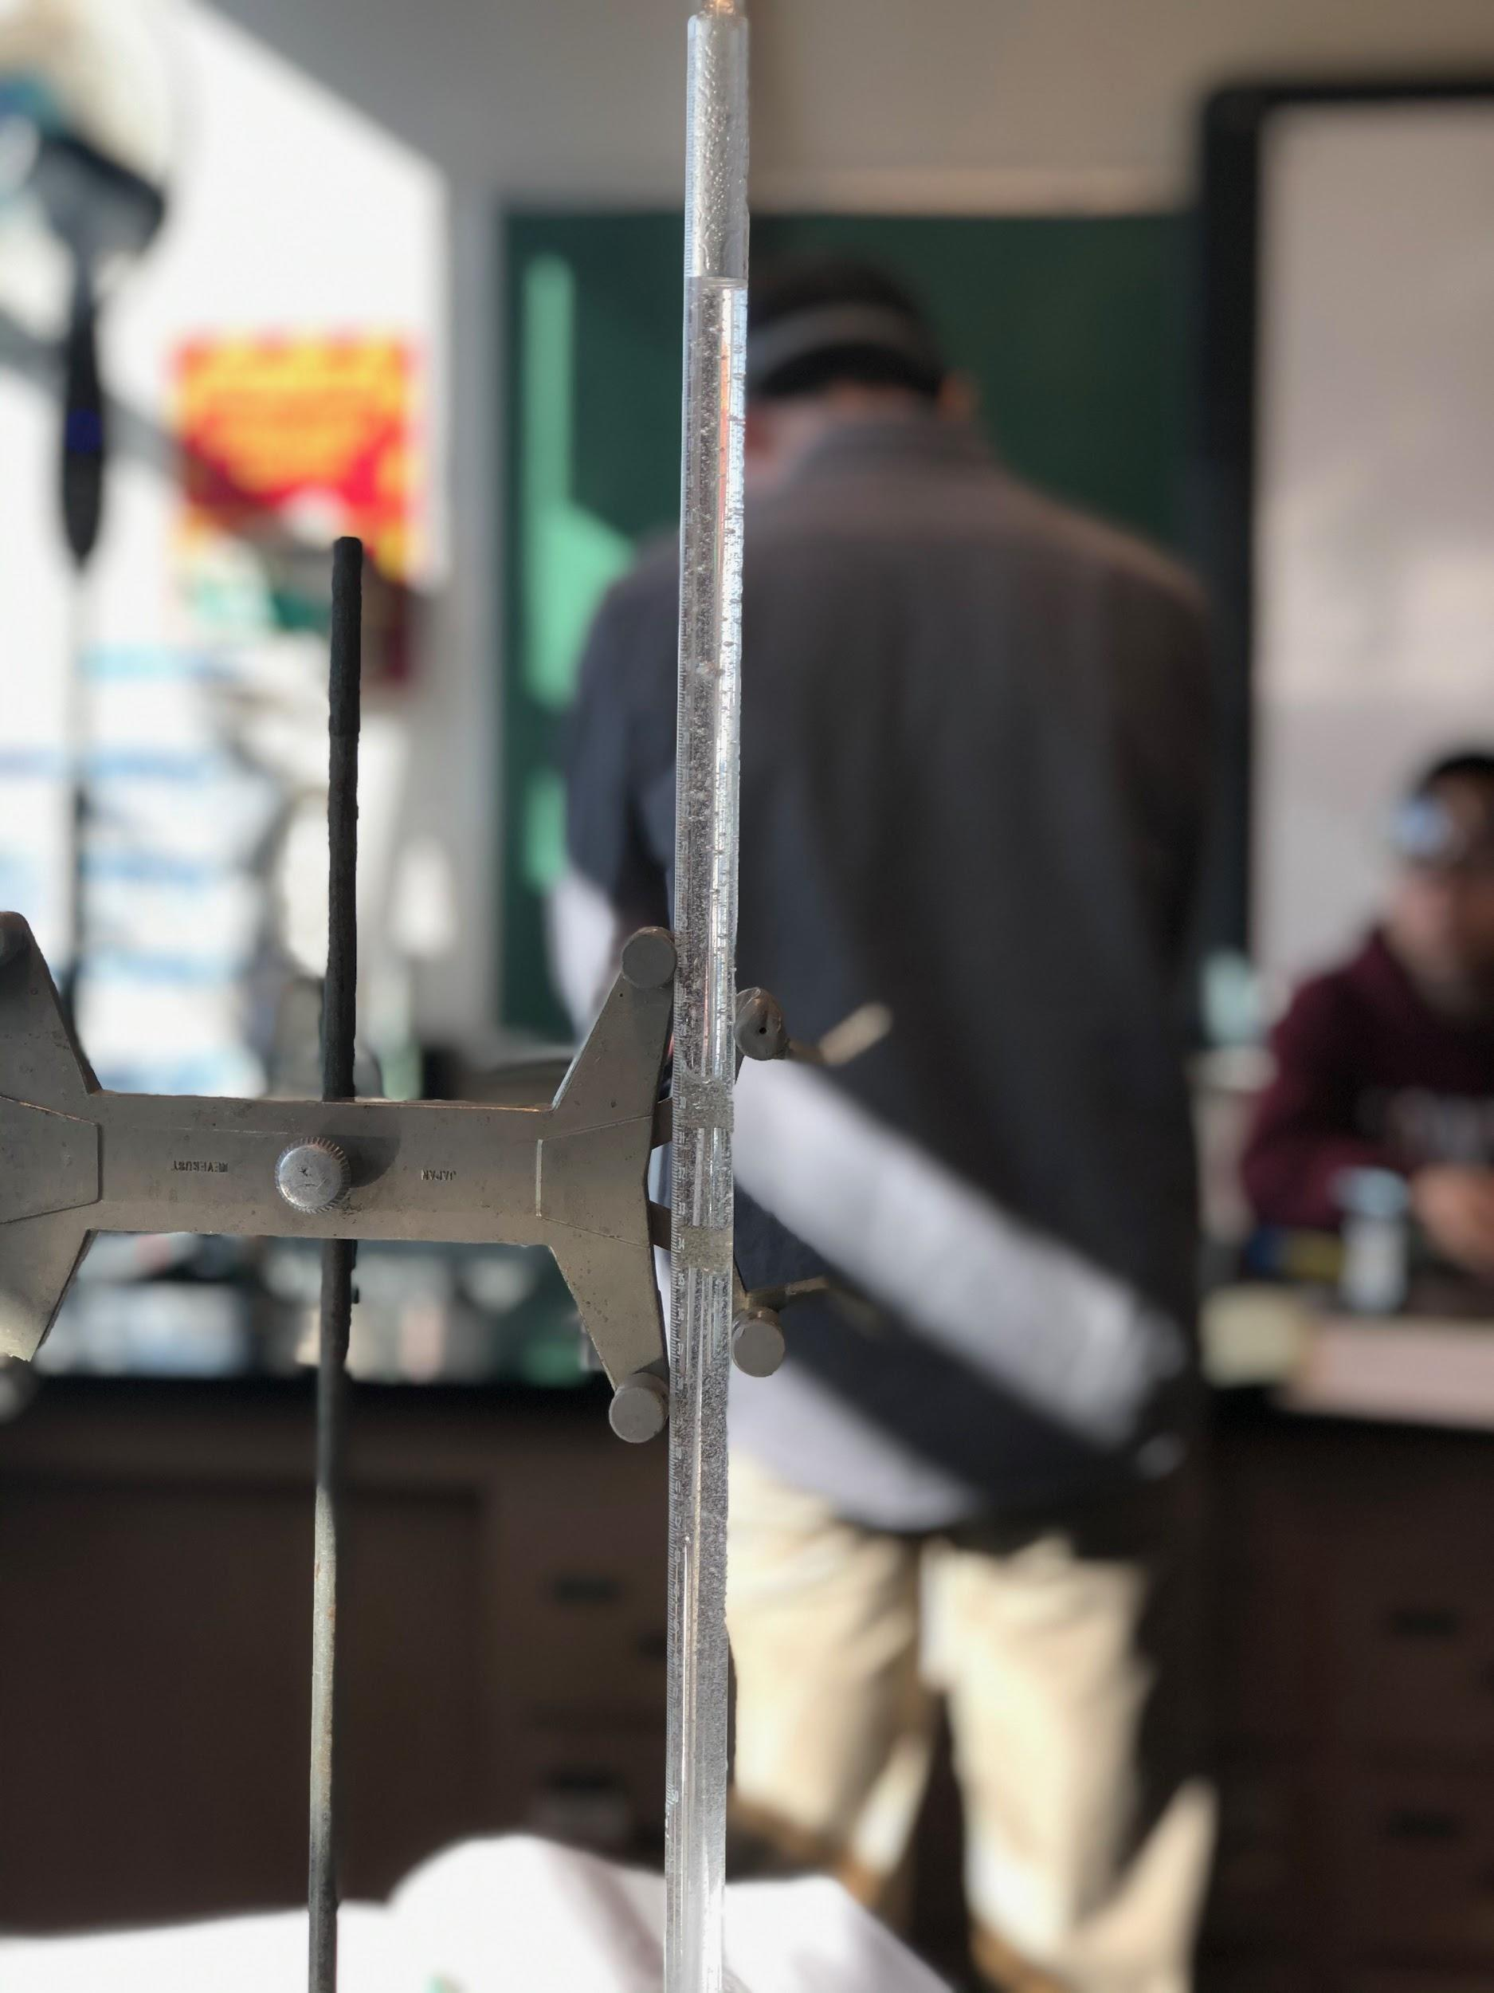
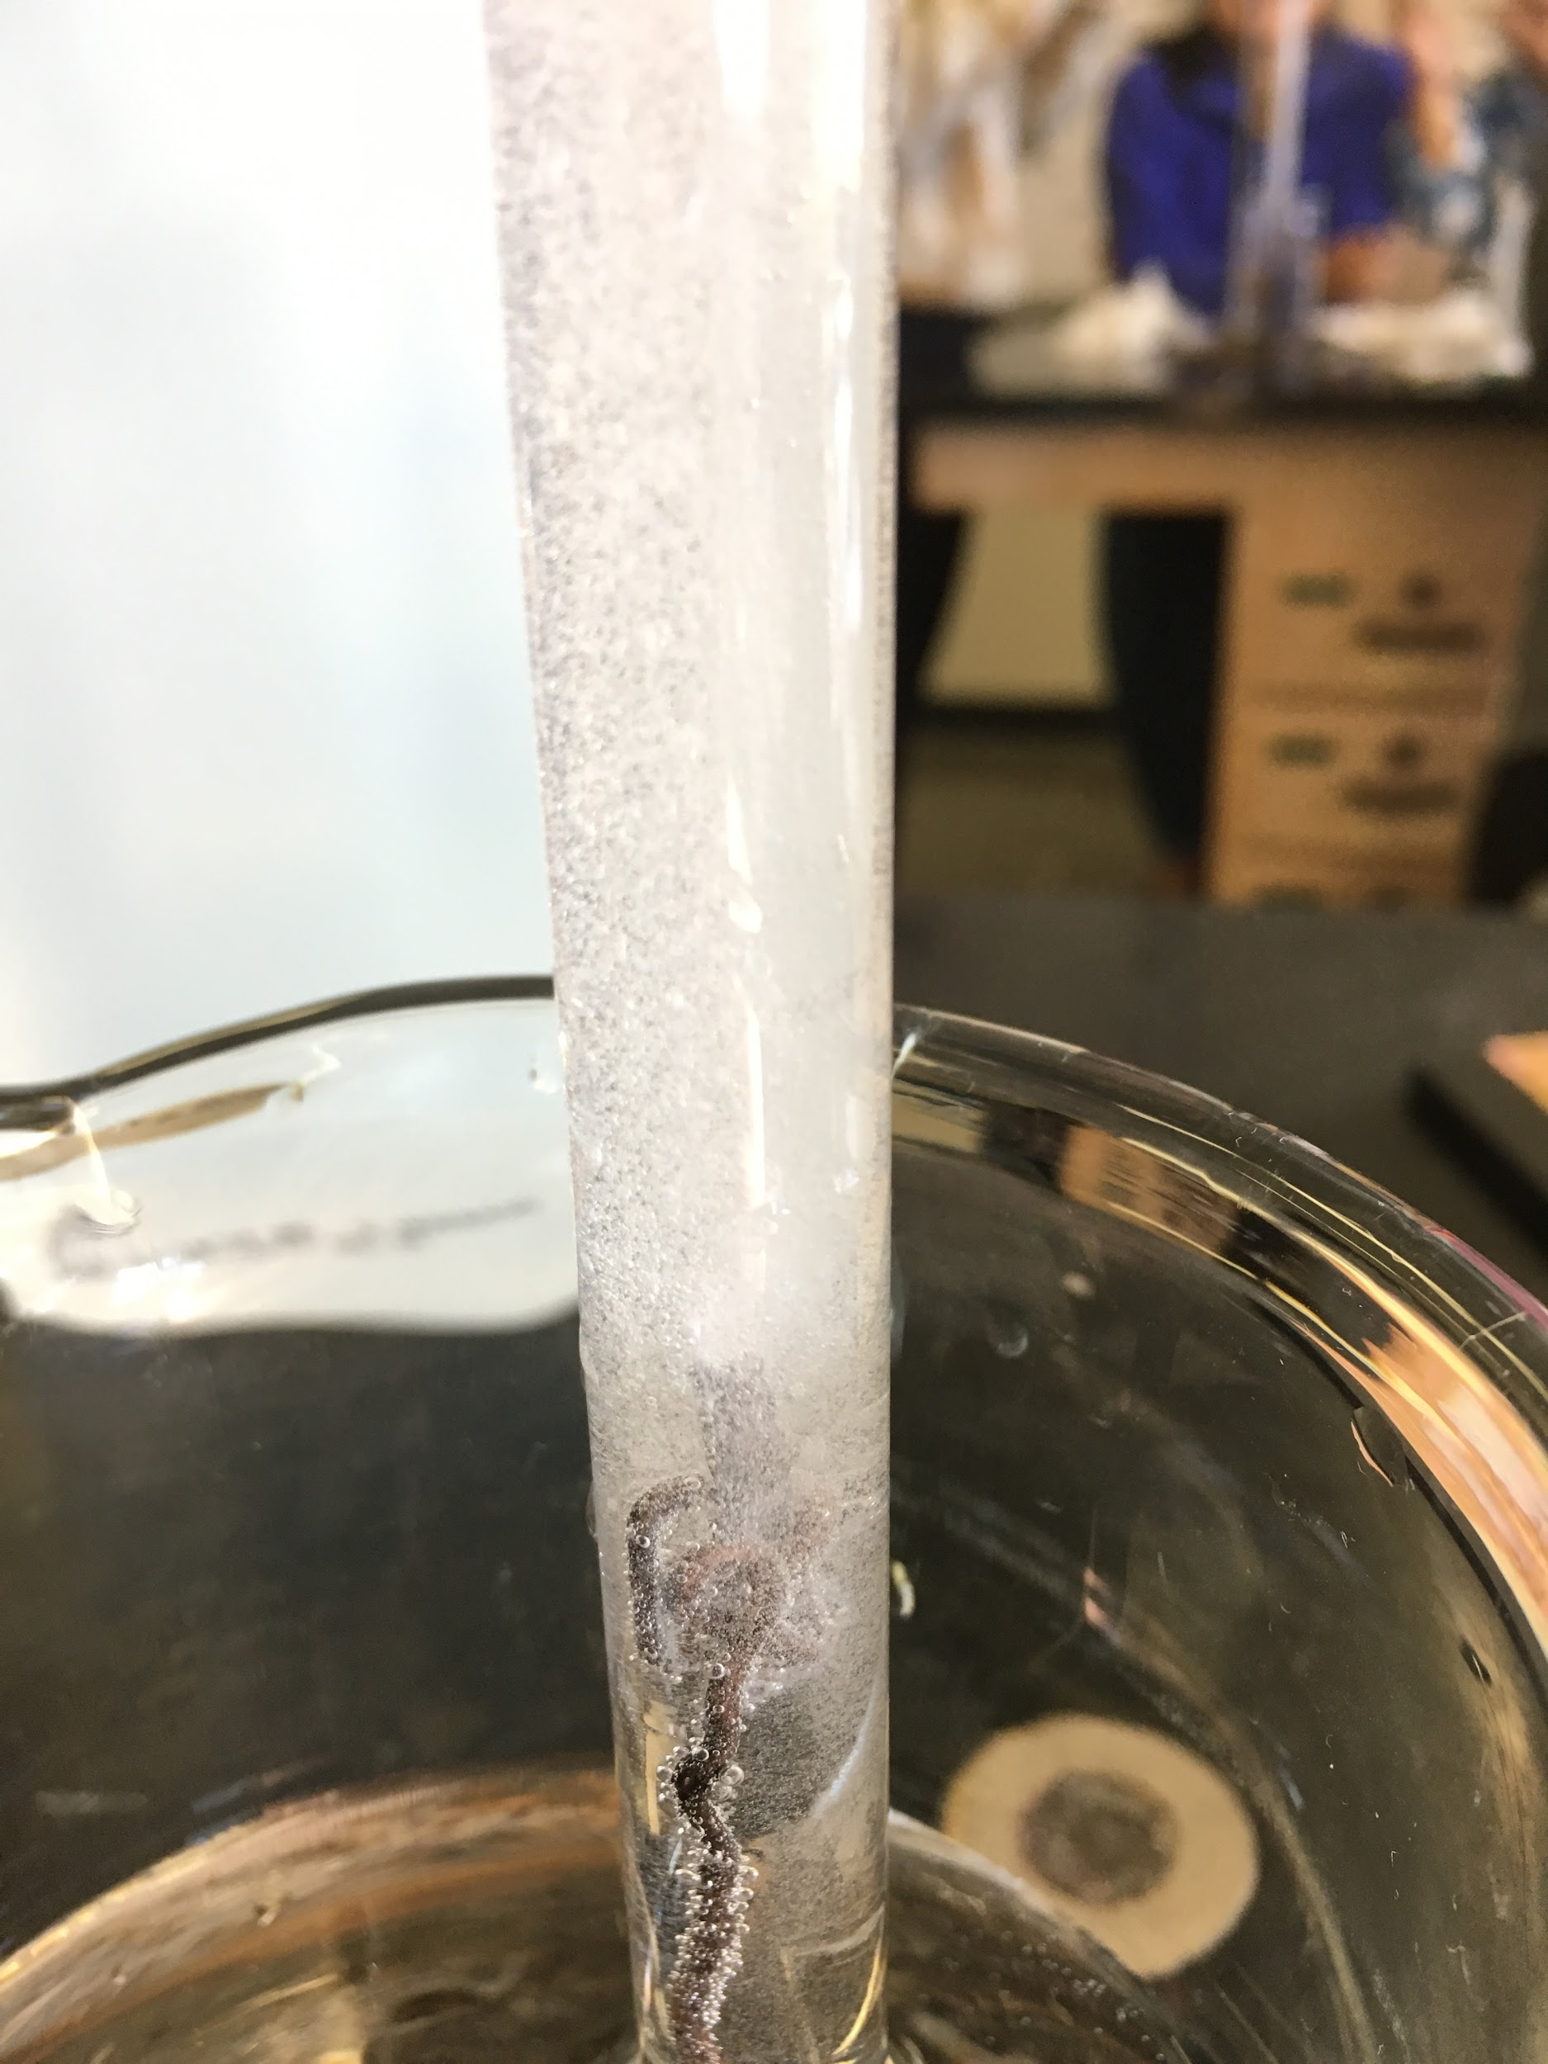
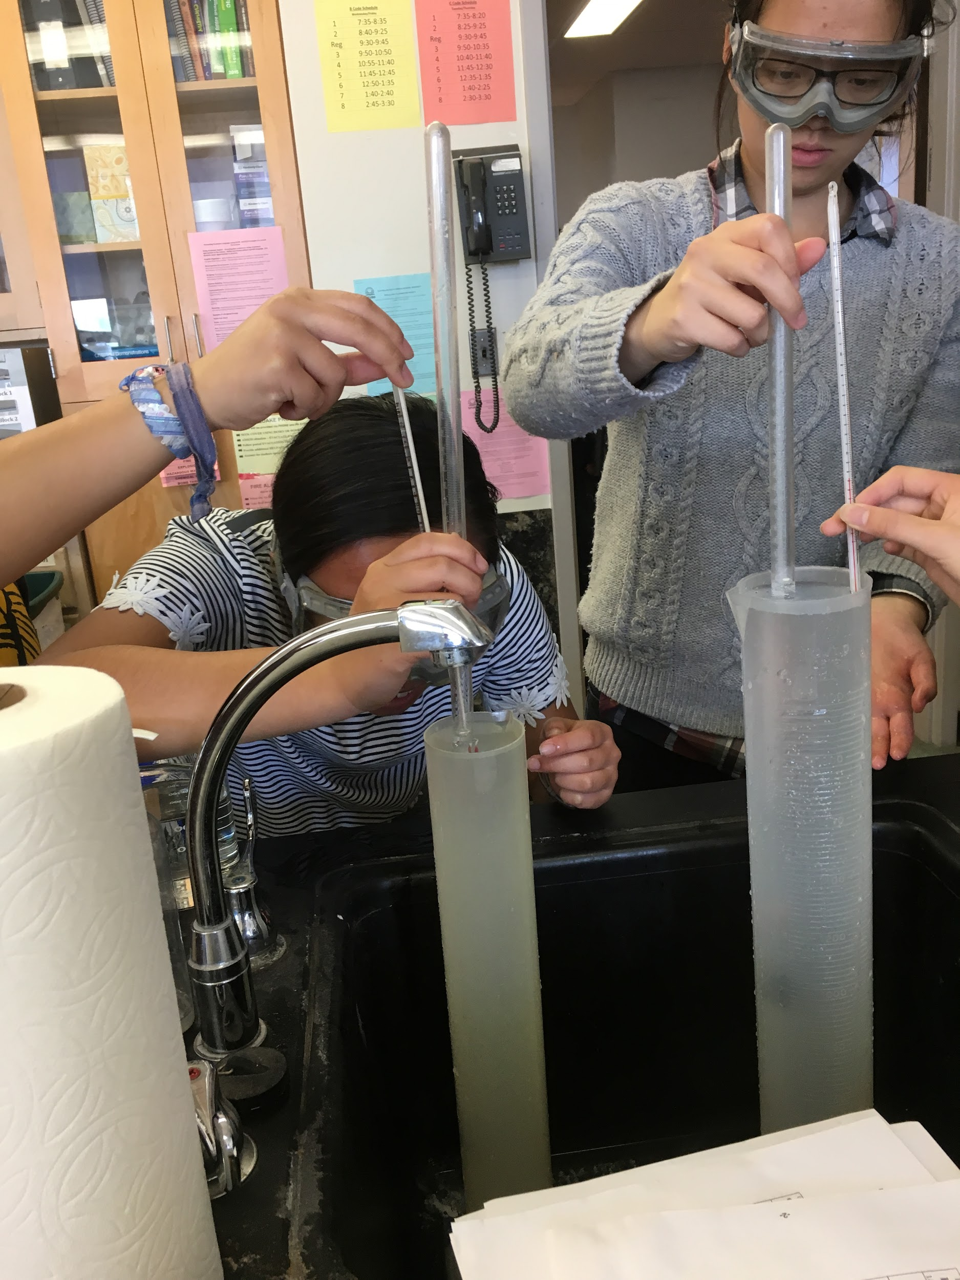
THE EXPERIMENT IN PICTURES
(4) HCl moves from the top to the bottom of the eudiometer.
(5) Hydrogen gas bubbles are produced. The reaction stops when all of the Mg is used up and no more bubbles form.
(6) The water level in the eudiometer is equalized with the water level in the graduated cylinder and the volume recorded.

Slide 5
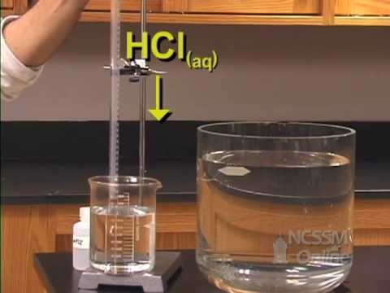
Watch YouTube Video:
Determination of the
Molar Volume of a Gas at STP
Determination of the molar Volume of a Gas at STP

Slide 6
Molar Volume of a Gas Lab Data
There are 9 sets of lab data for the experiment on the following slides.
Each student will be put into a group and you will use the data provided for the lab.
Each student will fill out their own data table.
Your assignment...
Read the lab protocol and watch the lab video (in this PPTX).
Go through the lab sheet and this PPTX.
Answer the pre-lab questions/calculations with work shown (Already done in PreLab)
Complete all calculations needed based on the group’s data you were assigned.
Show all work for each calculation
Insert pictures of your handwritten work.
Your name in INK must be in every picture inserted into your document.
Input your data into the data table provided.
Answer the post-lab questions individually on your own sheet.
You may discuss with others in your group sample, but each person produces their own work.

Slide 7
Data Set #1:
Conversion Factor for Mg ribbon: 0.007485 g/cm
 | Trial 1 | Trial 2
Length of Mg Ribbon | 2.70 cm | 2.77 cm
Volume of H₂ Gas | 21.90 mL | 22.30 mL
Barometric Pressure | 752.4 mm Hg | 752.4 mm Hg
Temperature of Water Bath | 26.1 ̊C | 26.1 ̊C

Slide 8
Data Set #2:
Conversion Factor for Mg ribbon: 0.01442 g/cm
 | Trial 1 | Trial 2
Length of Mg Ribbon | 2.47 cm | 2.45 cm
Volume of H₂ Gas | 39.80 mL | 36.24 mL
Barometric Pressure | 759.1 mm Hg | 752.4 mm Hg
Temperature of Water Bath | 26.5 ̊C | 26.5 ̊C

Slide 9
Data Set #3:
Conversion Factor for Mg ribbon: 0.01772 g/cm
 | Trial 1 | Trial 2
Length of Mg Ribbon | 1.99 cm | 2.24 cm
Volume of H₂ Gas | 35.56 mL | 37.13 mL
Barometric Pressure | 762.5 mm Hg | 762.5 mm Hg
Temperature of Water Bath | 21.9 ̊C | 21.9 ̊C

Slide 10
Data Set #4:
Conversion Factor for Mg ribbon: 0.007484 g/cm
 | Trial 1 | Trial 2
Length of Mg Ribbon | 2.79 cm | 2.71 cm
Volume of H₂ Gas | 21.55 mL | 21.47 mL
Barometric Pressure | 753.5 mm Hg | 753.5 mm Hg
Temperature of Water Bath | 23.9 ̊C | 23.9 ̊C

Slide 11
Data Set #5:
Conversion Factor for Mg ribbon: 0.01744 g/cm
 | Trial 1 | Trial 2
Length of Mg Ribbon | 2.12 cm | 2.07 cm
Volume of H₂ Gas | 36.52 mL | 36.40 mL
Barometric Pressure | 758.715 mm Hg | 758.715 mm Hg
Temperature of Water Bath | 23.5 ̊C | 23.5 ̊C

Slide 12
Data Set #6:
Conversion Factor for Mg ribbon: 0.007485 g/cm
 | Trial 1 | Trial 2
Length of Mg Ribbon | 2.48 cm | 2.89 cm
Volume of H₂ Gas | 20.52 mL | 23.40 mL
Barometric Pressure | 753.8 mm Hg | 753.8 mm Hg
Temperature of Water Bath | 29.1 ̊C | 29.1 ̊C

Slide 13
Data Set #7:
Conversion Factor for Mg ribbon: 0.01772 g/cm
 | Trial 1 | Trial 2
Length of Mg Ribbon | 2.49 cm | 2.10 cm
Volume of H₂ Gas | 37.22 mL | 35.61 mL
Barometric Pressure | 758.95 mm Hg | 758.95 mm Hg
Temperature of Water Bath | 23.9 ̊C | 22.5 ̊C

Slide 14
Data Set #8:
Conversion Factor for Mg ribbon: 0.01772 g/cm
 | Trial 1 | Trial 2
Length of Mg Ribbon | 1.92 cm | 2.11 cm
Volume of H₂ Gas | 34.10 mL | 36.02 mL
Barometric Pressure | 759.1 mm Hg | 759.1 mm Hg
Temperature of Water Bath | 25.2 ̊C | 23.2 ̊C

Slide 15
Data Set #9:
Conversion Factor for Mg ribbon: 0.01771 g/cm
 | Trial 1 | Trial 2
Length of Mg Ribbon | 2.11 cm | 2.00 cm
Volume of H₂ Gas | 38.11 mL | 36.18 mL
Barometric Pressure | 756.79 mm Hg | 756.79 mm Hg
Temperature of Water Bath | 27.8 ̊C | 28.5 ̊C

