Slide 1
Evaporation of Liquids
A virtual IMF study

Slide 2
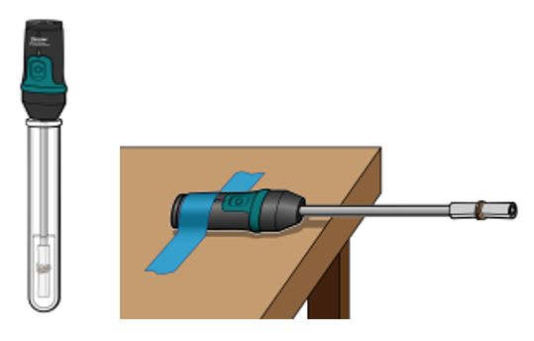
What is going on?
In this experiment, Temperature Probes are placed in various liquids. Evaporation occurs when the probe is removed from the liquid’s container. This evaporation is an endothermic process that results in a temperature decrease. The magnitude of a temperature decrease is, like viscosity and boiling temperature, related to the strength of intermolecular forces of attraction. In this experiment, you will study temperature changes caused by the evaporation of several liquids and relate the temperature changes to the strength of intermolecular forces of attraction. You will use the results to predict, and then measure, the temperature changes for several other liquids.

Slide 3
Some Specifics
After opening the data file, you will need to remove all graphs except ethanol and 1-propanol
Gather data for ethanol and 1-propanol…THEN…
According to STEP 10, you need to PREDICT delta T for Butanol AND explain why BEFORE gathering the data for Butanol
  Do the same for n–pentane
Now gather data for these two
Again PREDICT delta T and explain for methanol and n-hexane
THEN gather data…

Slide 4
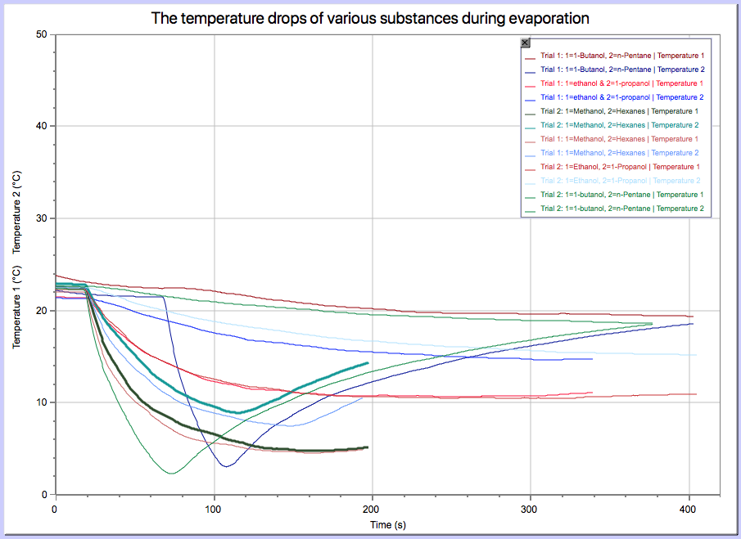
Data Set Group 1
File

Slide 5
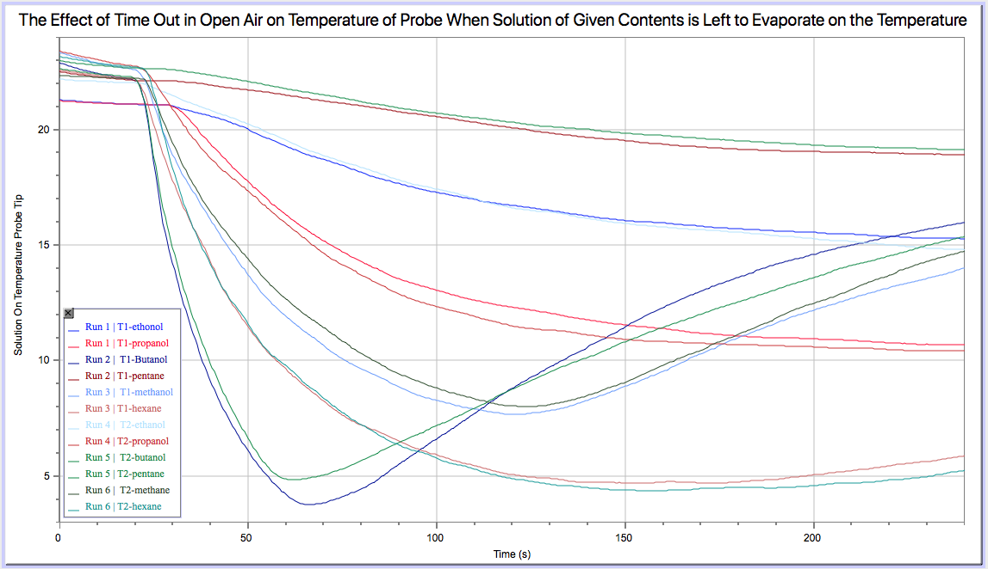
Data Set Group 2
File

Slide 6
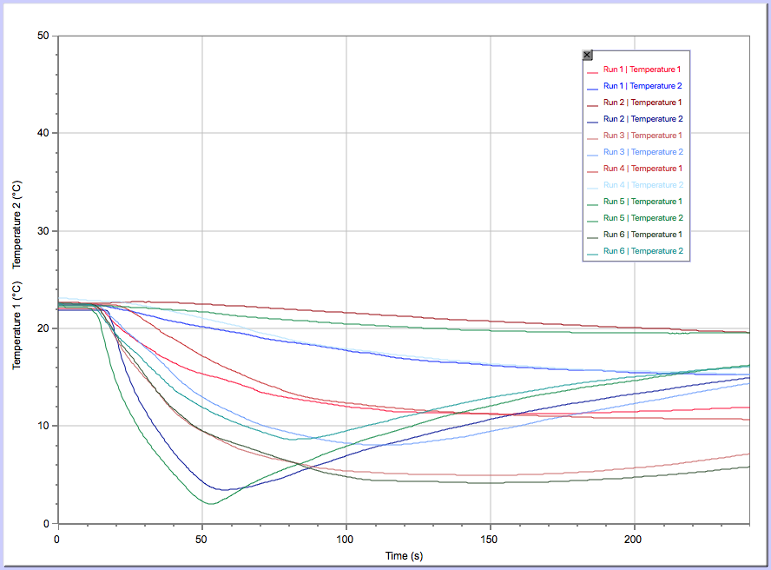
Data Set Group 3
File
Run 1/4 | Temp 1 | Ethanol
Run 1/4 | Temp 2 | Propanol
Run 2/5 | Temp 1 | Butanol
Run 2/5 | Temp 2 | Pentane
Run 3/6 | Temp 1 | Methanol
Run 3/6 | Temp 2 | Hexane

Slide 7
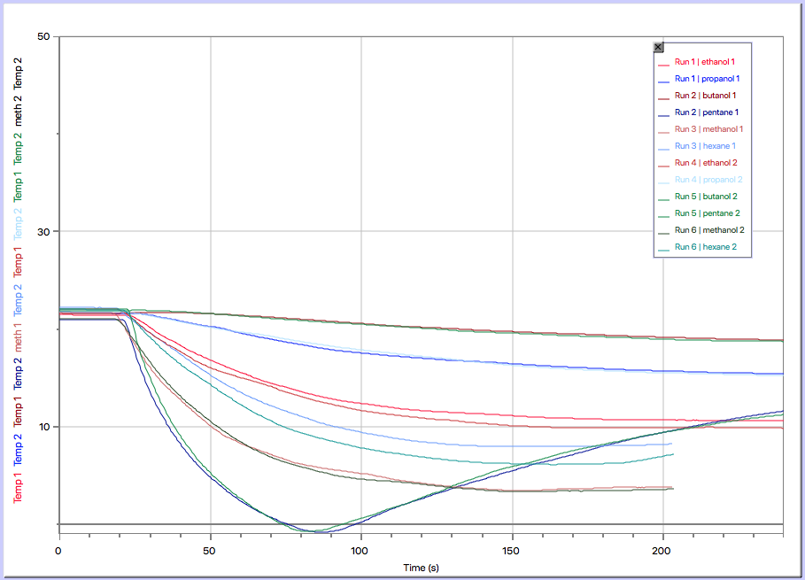
Data Set Group 4
File

