Slide 1
Titration of a Weak Acid
Group Virtual Lab

Slide 2
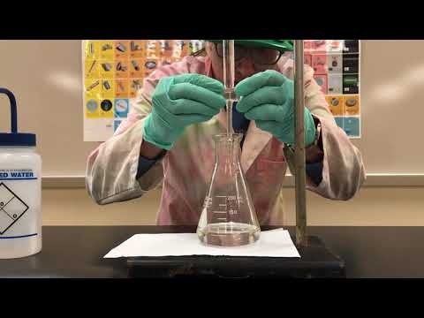
Watch YouTube Video: Acid-Base Titration Lab
This video is very close the our virtual lab procedure.
https://www.youtube.com/watch?v=9pS7Q4MQCYI

Slide 3
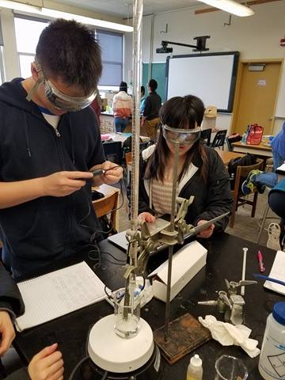
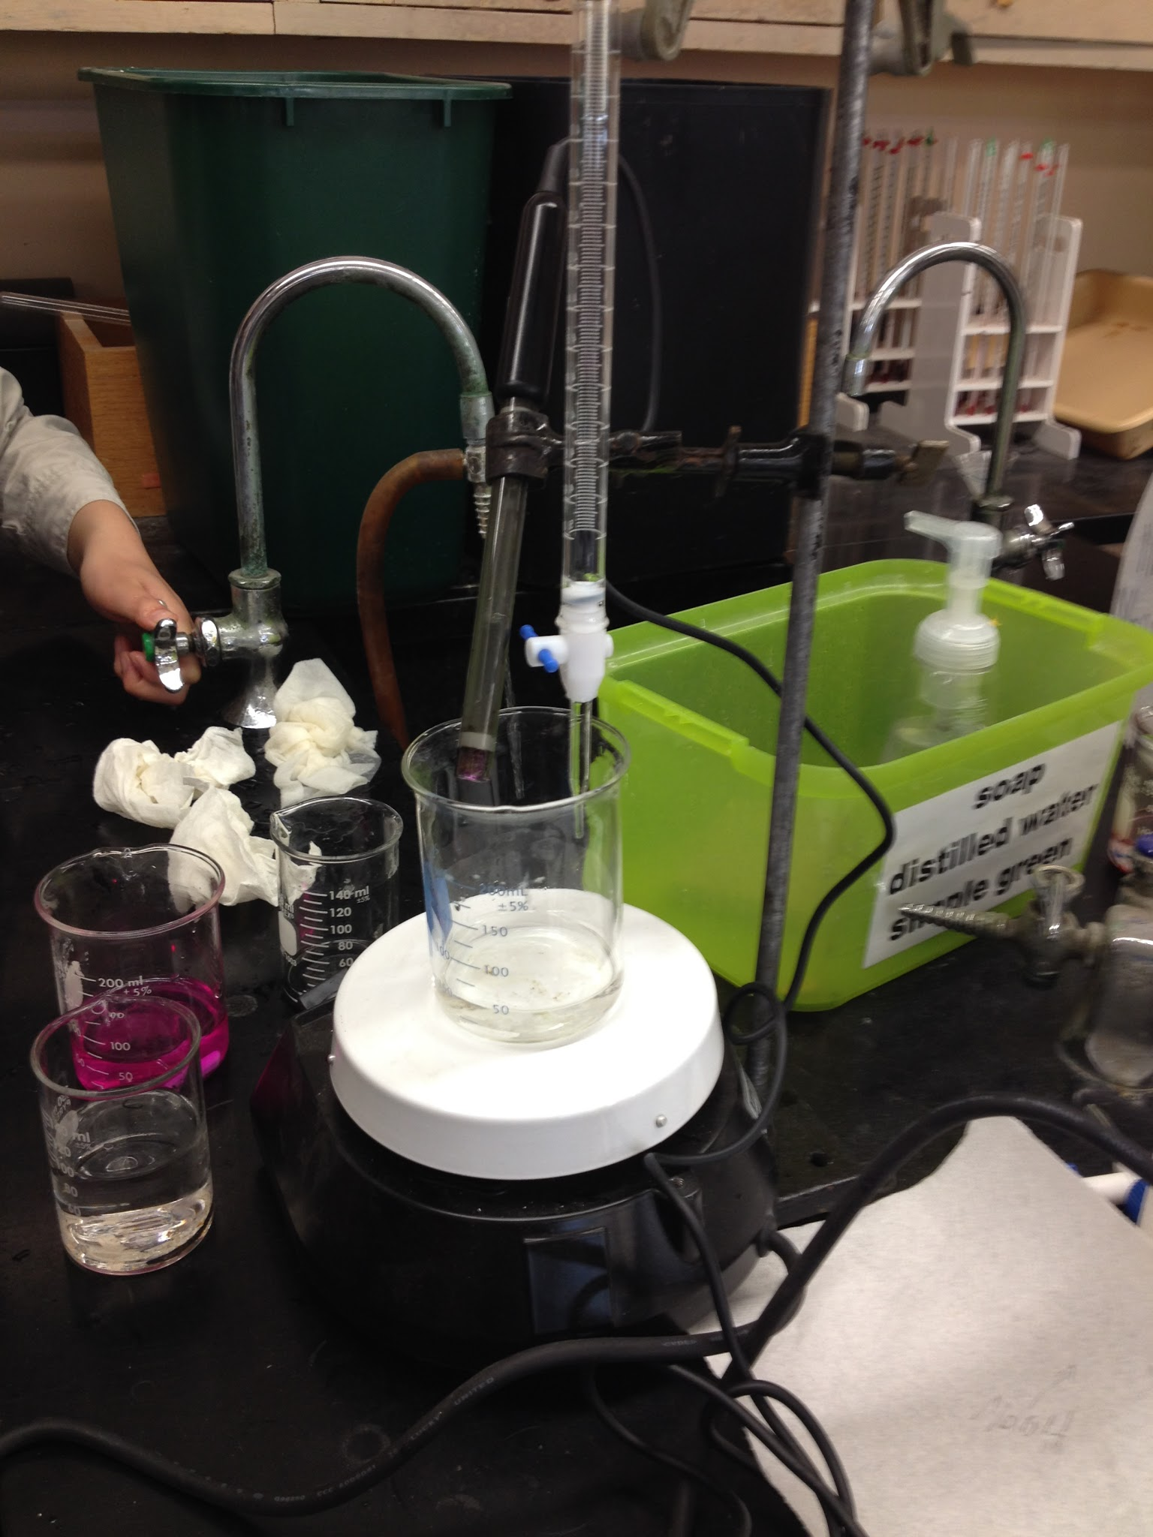
Filled the buret with 0.5M NaOH solution. Record your initial volume of NaOH(aq) in the buret.
The setup: A pH probe (connected to a computer) is placed into a beaker containing the initial solution containing 10.00 mL of 5% vinegar, a few drops of phenolphthalein, and some distilled water. A magnetic stir bar in the beaker stirs the solution as the beaker sits on the magnetic stir plate.

Slide 4
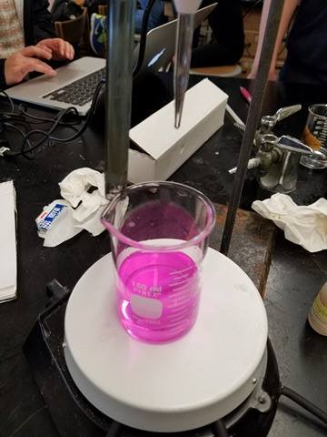
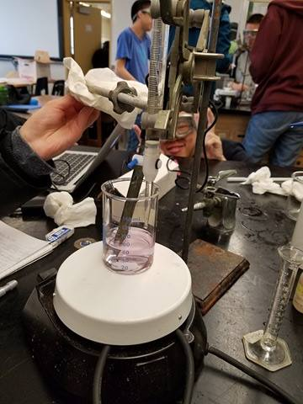
Trial #1: Titrated the vinegar by adding NaOH from the buret into the beaker containing the vinegar. A magnetic stir bar mixed the solution. Titrated to a faint pink (this picture is past that).
Trial #2: Repeated the titration with most data points collected near the equivalence point for greater precision in determining the equivalence point using the second sample of vinegar until the solution was faint pink.

Slide 5
https://d12oja0ew7x0i8.cloudfront.net/image-handler/ts/20200214121341/ri/560/src/images/Article_Images/ImageForArticle_19010_15816571924102752.png
Flask #1 represents when the acid solution with phenolphthalein indicator has reached the endpoint in the titration after enough base has been added. This is evidenced by the faint pink color observed in the solution.
Each subsequent flask (#2 through #5) shows what happens when 1 additional drop of base is added. Flasks #2 through #5 have overtitrated (or gone past the endpoint).

Slide 6
Titration of a Weak Acid Group Lab Data
There are 8 sets of group lab data for the experiment on this Google sheet.
Use the tab in the Google sheet that corresponds to your group number.
Your assignment...
Read the lab protocol and watch the lab video (in this PPTX).
Go through the lab sheet and this PPTX.
Answer the pre-lab questions and questions.
Input your data into the data table provided.
Complete all analysis needed based on the group’s data you were assigned.
Answer the post-lab questions and conclusion together as a lab group on a shared Google doc.
One person submits the shared Google doc as your group’s submission for the assignment in Google Classroom. The other group members submit that person’s name as a private comment for the assignment and click “Mark as Done.”

Slide 7
